Slide 1
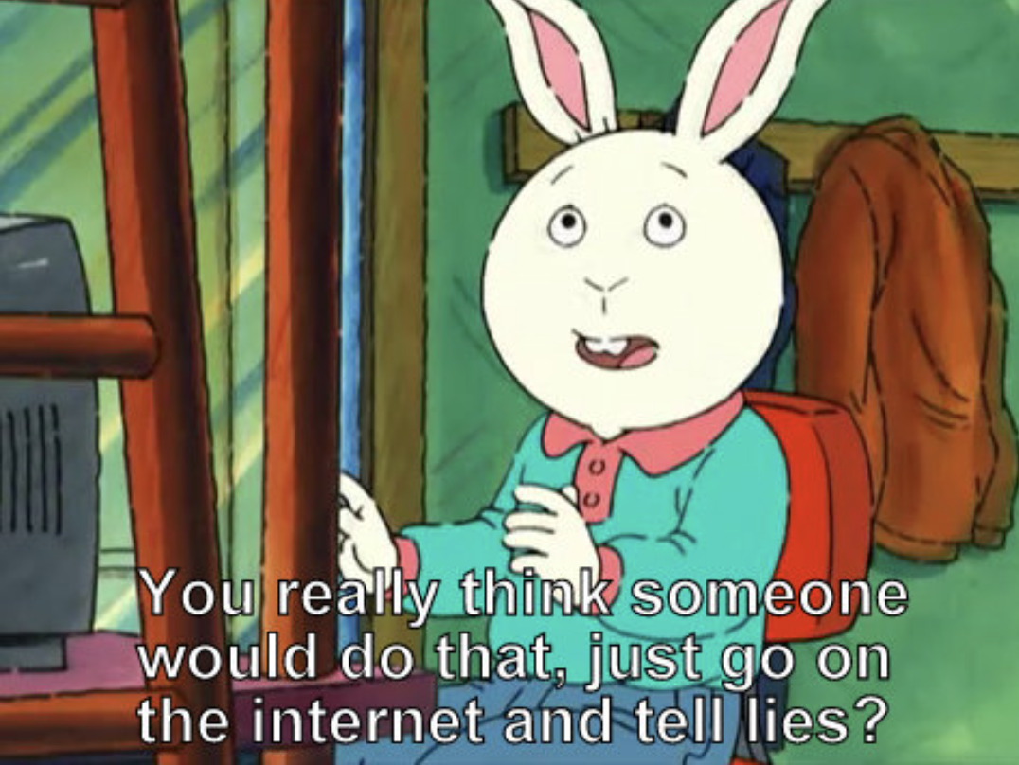

Slide 2
Olivia Hobbs
GEN Z’S PERCEPTIONS OF TRUTH ON SOCIAL MEDIA
November 4
ALAO 2022

Slide 3
HI, I'M OLIVIA AND I'M ON SOCIAL MEDIA WAY TOO MUCH
Gen Z
"Chronically Online"
Librarian
Notes:
Hi, my name is Olivia Hobbs and I'm on social media way too much.
My interest in this topic stems from the fact that I am Gen Z myself, just barely made the cut, and I do consider myself chronically online . However, I'm also a research librarian at Case Western who is deeply interested in how young people are learning on the internet and how misinformation is spreading.

Slide 4
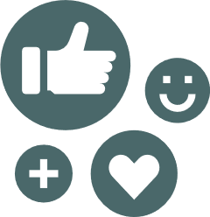
TODAY, I'LL ASK...
What kind of misinformation are people coming into contact with?
Why do they believe this misinformation?
Why should we, as librarians, be concerned?
Notes:
Today I want to ask what kind of misinformation are people coming into contact with?
Why do they believe this misinformation?
And finally why should we, as librarians, be concerned?

Slide 5
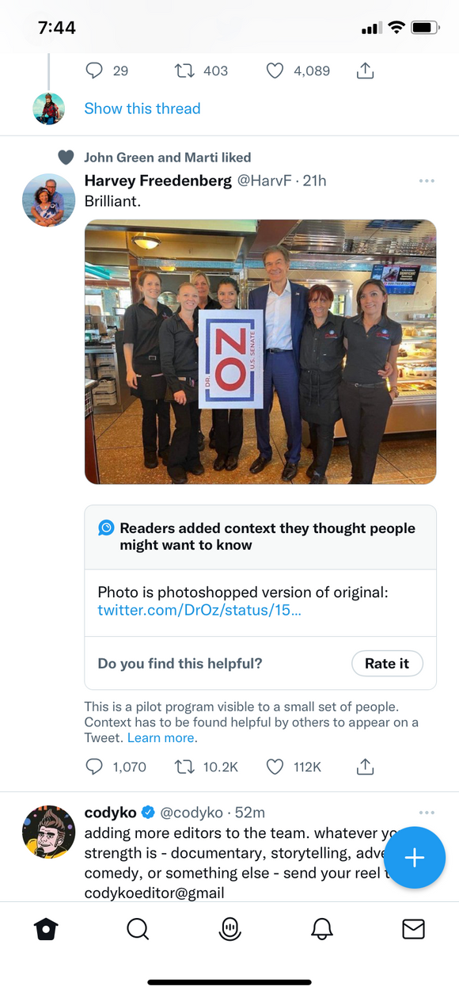
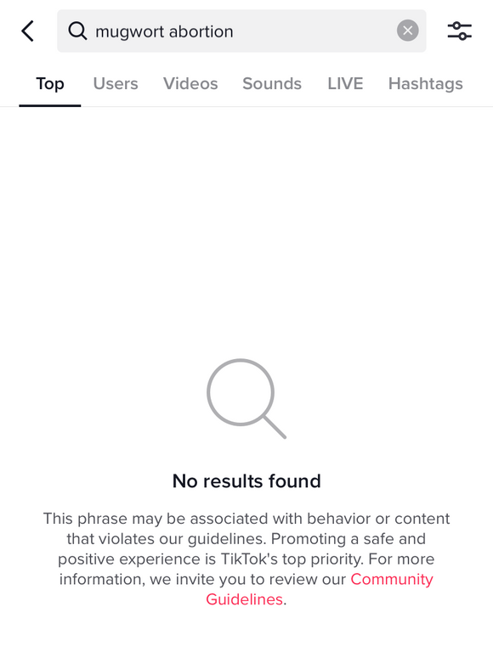
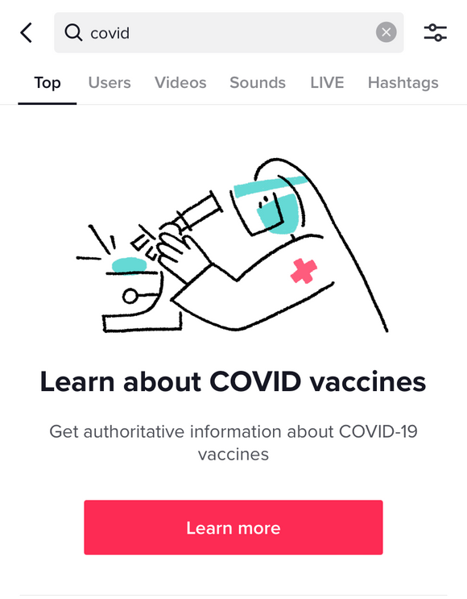
SOCIAL MEDIA PLATFORMS ARE
AWARE OF MISINFORMATION
Birdwatch
Note
Notes:
We all know that social media is rife with misinformation. The platforms themselves are aware of it as well and have taken some steps to combat it's spread. Twitter has added a feature called Birdwatch that allows users to add fact-checking notes to tweets that contain misleading or false information. For example, the image from this Tweet has been photoshopped so that the sign is being held vertically, saying NO, but the attached note has a link to the original image where she holds the sign horizontally so it correctly says OZ. TikTok hides sensitive content that is associated with misinformation or they make users scroll past a link to authoritative information before showing results. However, this system is far from foolproof.

Slide 6
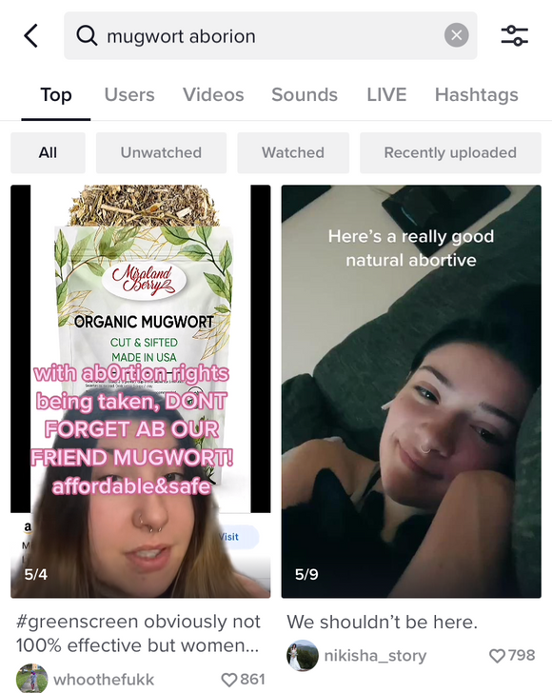
FLAWS IN THE SYSTEMS
Notes:
Users have figured out that simple typos like "aborion vs abortion" can reveal content that TikTok would otherwise hide, with these typos even showing up as autocomplete suggestions in the search bar. Birdwatch notes are user-sourced and are mostly connected to semi-viral tweets meaning a lot of people have already seen the misinformation before it gets corrected.

Slide 7
BUT THEY WON'T FACT-CHECK
EVERYTHING
Policies only cover certain types of misinformation
"Less important" topics are ignored
Originate from organic, personal sources
Usually to gain views/followers or as a joke
Escalate into memes and go viral
Hard to trace back to origin and fact-check
Notes:
The policies for misinformation on Facebook, Twitter, and TikTok only focus on topics like world events, health information, and politics, allowing misinformation about celebrities and other popular topics spread freely. These rumors tend to originate from non-media accounts so it can be difficult to fact-check the source. Based on how interesting the rumor is, it can spread organically to other audiences and create conversation, memes, and jokes that go even more viral with even less context, making it difficult to track. When the story is revealed to be a rumor, the explanation reaches far less people than the original misinformation.

Slide 8
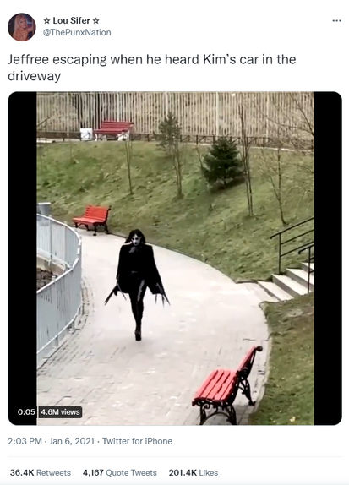
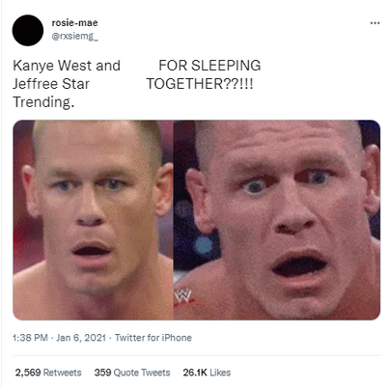
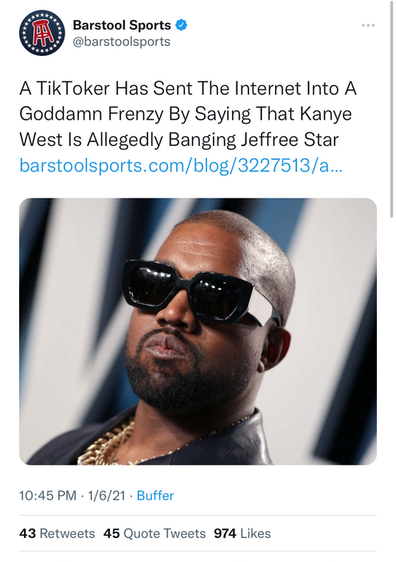
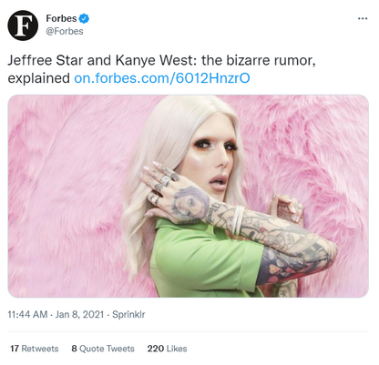
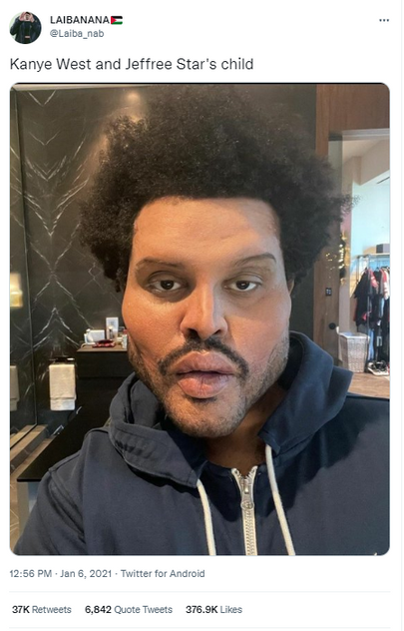
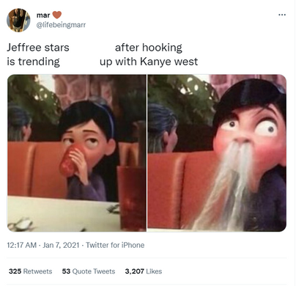
Memes
Mainstream
Media
2021 Google Trends
Celebrities Searched Together
1) Kim and Kanye
2) Bill and Melinda Gates
3) Kim Kardashian and Pete Davidson
4) Kanye and Jeffree Star
5) Taylor Swift and Jake Gyllenhaal
Notes:
Take, for example, the rumor about an affair between rapper Kanye West and make-up mogul Jeffree Star. This rumor was started on TikTok with absolutely no basis in reality but the story took on a life of its own through memes. Some of these memes got hundreds of thousands of likes and all came from none-verified accounts. The story became so popular that the pair even ranked #4 as the most searched celebrities together on Google for 2021. This search brings up articles from mainstream media that debunked the rumors but those received far less engagement than the memes encouraging the rumor. Researchers at MIT refer to this phenomenon as "rumor cascades" because they found that false news spreads much farther and faster than true news on social media. You can never reach everybody who saw or believed the original rumor.

Slide 9
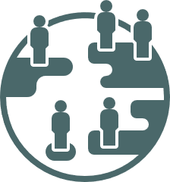
TIKTOK AS A SEARCH ENGINE
An internal Google survey found that 40% of young people (18-24) use TikTok as a search engine
(Haung, 2022
Raghavan, 2022)
Young users associate Google with bias (advertisements as results, fake news articles, etc.)
TikTok's results are people sharing their experiences / thoughts
in a short, digestible video format
Notes:
A recent statistic from an internal Google survey showed that 40% of young people, ages 18-24 now use TikTok as their preferred search engine. They know that Google's results are compromised and that advertisements or "fake news" are mixed in. They turn to TikTok with the expectation that they'll be seeing a real person's experience or opinion which they find more trustworthy. They also find the short videos more digestible and interesting than long, written articles. It's a faster, more passive way to receive information though it means sacrificing accuracy and critical thinking.

Slide 10
EDUCATION VS. ENTERTAINMENT
Creation of #DidYouKnow and #LearnOnTikTok
$50 million Creative Learning Fund
Grant funding for "educators, professional experts, and nonprofits" (Thoensen, 2020)
"...supports creators with the production of learning content, provides resources for learners, and introduces emerging teachers to the TikTok platform. " (Thoensen, 2020)
No distinction between platform-supported content and user-created content
Notes:
It doesn't help that TikTok has recently started positioning itself as a platform for both education and entertainment.
In 2020 TikTok started several initiatives related to learning on their platform, including two hashtags, and grant funding for "educators, professional experts, and non-profits". The only identification for these partnerships is the use of the #TikTokPartner on videos. But, anybody can post content under these hashtags so there is no distinction between educational content vetted and supported by the platform and "educational" content posted by random users with no fact-checking.

Slide 11
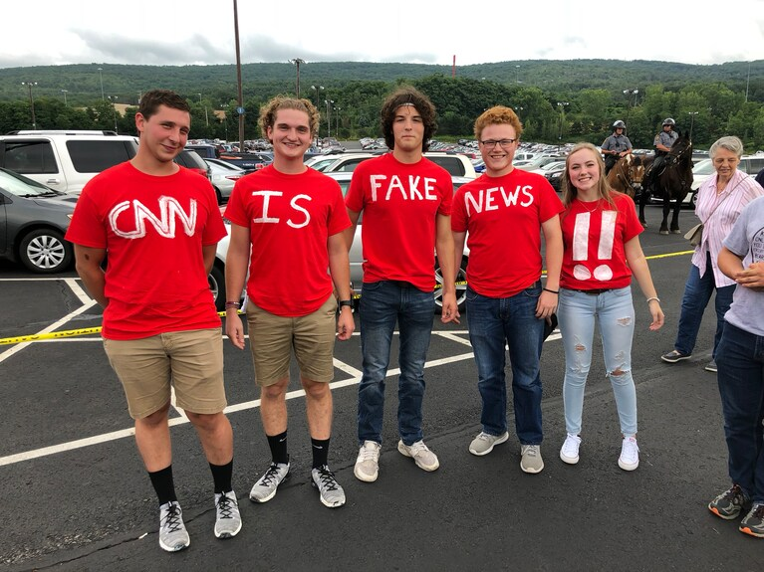
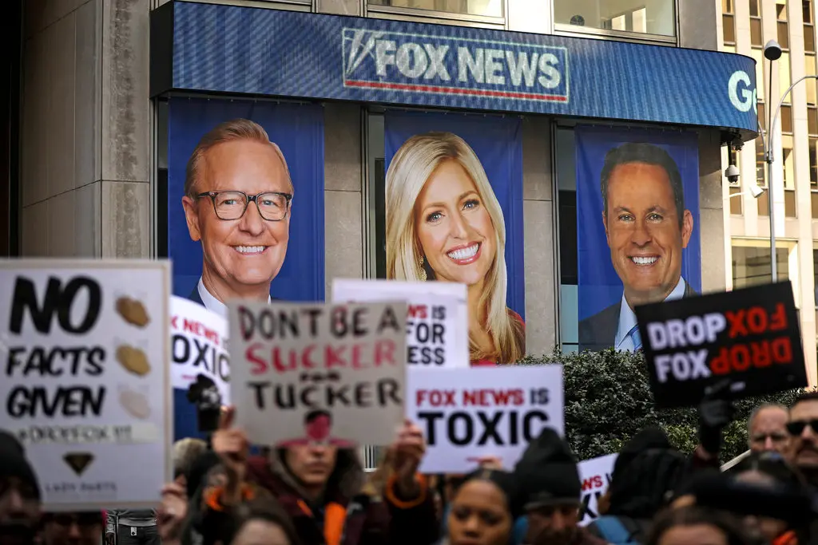
Trump supporters at a Trump rally in Wilkes-Barre, Pa., in August 2018. (Philip Bump/The Washington Post)
DISTRUST OF AUTHORITY
Focus on the biases of media and experts, rendering them untrustworthy
Students as private investigators vs. critical thinkers (Murchie & Neyer, 2018)
So what does it look like to learn on TikTok?
A protest at Fox News headquarters in Manhattan last year.Credit...Drew Angerer/Getty Images
Notes:
I think part of the reason we see this escalation in misinformation from these organic and personal sources is Gen Z's distrust of authority. Now this happens with every generation reaching adulthood but Gen Z has come of age during a particularly turbulent time of the 2016 and 2020 Presidential elections and COVID-19 pandemic. These events were plagued with misinformation that was heavily reported on. Media organizations and experts were attacked for being untrustworthy and biased.
Educators Murchie and Neyer noticed that their high school students were becoming what they called private investigators rather than critical thinkers. They skimmed results, never going past the first page, and expected the Internet to deliver a singular, correct answer rather than evaluating multiple results to form their own conclusion.

Slide 12
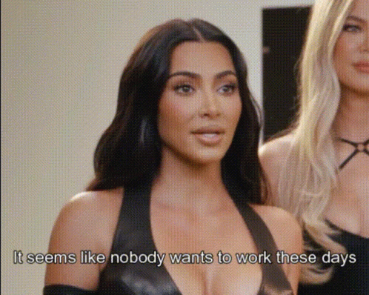
research
Notes:
TikTok only exacerbates this issue because it is not designed as a search engine. There is no way for users to practice the search skills of filtering, advanced search methods, or evaluation because the app does not support those. The algorithm is designed to prioritize results with the most engagement versus relevance, similar to Google Scholar returning the most cited results. TikTok is also designed to keep users in the app, so when viewers are presented with information they check the comments which can be moderated or check the creator's own profile. Even when TikTok directs users to authoritative information like the link when you search for covid, it doesn't take you outside of the app.

Slide 13
EXPECTATION OF
INFORMATION
01
02
03
04
05
In the wake of Queen Elizabeth's death, a viewer asks why Ireland has a problem with the British monarchy.
This user makes a video reply to that comment, finding it funny that someone would ask this.
People flock to his video, asking him to teach them. He refuses, saying he is an entertainer, not an educator.
Viewers continue to plead with him, saying it's easier to watch a video than read Wikipedia. Some think he is Irish himself.
He reiterates that he is not an expert on this topic and not a good source. A user replies that they don't want a good source, they just want to know.
Notes:
Gen Z seems to be anxious to take on the responsibility of research and they instead expect information to be presented to them. I came across this discussion of colonized nations' relationship to the British monarchy after the death of Queen Elizabeth. One viewer innocently asked why Ireland didn’t like the royals which spawned 500 replies, including a video reply by another user saying that this comment “stopped him in his tracks”. People then flocked to his profile, asking him to educate them on this history. They told him they never learned about this topic in school, they didn't know how to even start searching, and they didn't want to read biased sources. The creator, who emphasized that he was an entertainer, not an educator, told the viewers to seek this information elsewhere because he was not a good source but they still pleaded with him to create educational content. It's easy to see how misinformation could spread in such an environment, he could have easily made something up or even just misspoke, it's clear that nobody was planning to fact-check him or do further research.

Slide 14
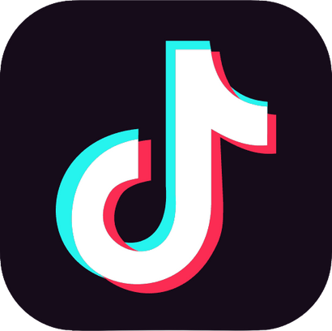
WHY SHOULD WE CARE?
These attitudes may carry over into academic research
Empower students to be active learners
Build critical information literacy skills in everyday life
Notes:
I think it's important to be aware of this attitude because it may follow students into the classroom. You may already struggle to redirect students from Google Scholar, now you have to redirect them from TikTok, which has even more distance from academic sources. The passivity of students is another issue, they need to be empowered to take an active role in the research process. Critical information literacy can show students how to think of information as a whole and read laterally, instead of following a checklist for evaluation. Introducing examples like this, that they may encounter in everyday life, can make the topic more approachable and relatable, hopefully allowing it to stick.

Slide 15
REFERENCES
Bump, P. (2018, October 26). Analysis | How CNN became Trumpworld’s most-hated network. Washington Post. https://www.washingtonpost.com/politics/2018/10/26/how-cnn-became-trumpworlds-most-hated-network/
Google. (n.d.). Year in Search 2021. Google Trends. Retrieved October 13, 2022, from https://trends.google.com/trends/yis/2021/US/
Huang, K. (2022, September 16). For Gen Z, TikTok Is the New Search Engine. The New York Times. https://www.nytimes.com/2022/09/16/technology/gen-z-tiktok-search-engine.html
Raghavan, P. (2022, July 12). Brainstorm Tech 2022: Organizing The World’s Information [Video]. https://fortune.com/videos/watch/Brainstorm-Tech-2022-Organizing-The-Worlds-Information/934585a6-7fb6-41a5-8ef3-e497f8ca2986
Sharon A. Murchie, & Janet A. Meyer. (2018). What is the Story? Reading the Web as Narrative. In Critical Media Literacy and Fake News in Post-Truth America (Vol. 2). Brill. https://search.ebscohost.com/login.aspx?direct=true&AuthType=ip,shib&db=nlebk&AN=1923907&site=eds-live&custid=s8481523
Swisher, K. (2020, March 31). Opinion | Fox’s Fake News Contagion - The New York Times. https://www.nytimes.com/2020/03/31/opinion/coronavirus-fox-news.html
Thoensen, B. (2020, May 28). Investing to help our community #LearnOnTikTok. Newsroom | TikTok. https://newsroom.tiktok.com/en-us/investing-to-help-our-community-learn-on-tiktok
Thomas, Z. (n.d.). TikTok Is the New Google for Some Young People. Retrieved October 10, 2022, from https://www.wsj.com/podcasts/google-news-update/tiktok-is-the-new-google-for-some-young-people/a12122b8-123c-4ff2-a0f2-597425de0943
Vermeulen, K. (2021). Mistrusting Authorities in an Unstable World. In K. Vermeulen (Ed.), Generation Disaster: Coming of Age Post-9/11. Oxford University Press. https://doi.org/10.1093/oso/9780190061630.003.0006

