Slide 1
Centering Disability Justice in Library Instruction
Jaclyn Spraetz (spraetj@MiamiOH.edu) | November 4, 2022

Slide 2
Faculty Learning Community: Fall 2021-Spring 2022 Disability Studies Grows at Miami
The purpose of this community is to build cross-discipline alliances and collaboration that support the expansion and growth of the field of Disability Studies at Miami University.
Goals -investigate and incorporate ways in which bodymind differences can enhance teaching and learning -increase faculty collaboration across disciplines and divisions -create and enhance the coherence of learning across disciplines -foster faculty alliances for the Disability Studies minor that is interdisciplinary in nature.
Notes:
Information about FLC participants: participants come from sports leadership and management, educational psychology, family science and social work, global initiatives, college of education, health, and society, libraries (me),

Slide 3
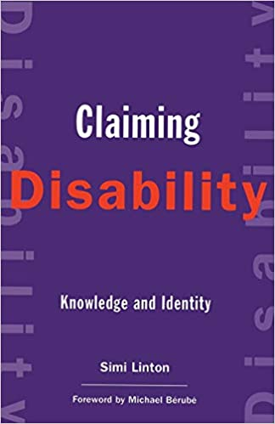
Claiming Disability
Linton, S. (1998). Claiming Disability: Knowledge and Identity. New York University Press.
Looks at disability studies and its relationship within the larger academic context.
Social model of disability; disability is an identity.
Notes:
“A comprehensive assessment of the field of Disability Studies that presents beyond the medical to dig into the meaning.”
Social model of disability
Disability as an identity
“Disability has become, then, like a guest invited to a party but never introduced.” p. 88
Disability studies is a branch of the disability rights movement: “Disabled people, across the broadest spectrum of disability, have solidified as a group. Although this group identity has certainly not been comfortably embraced by all disabled people, a strong disability alliance has led to civil rights victories and the foundation of a clearly identified disabled community.
“The material that binds us is the art of finding one another, of identifying and naming disability in a world reluctant to discuss it, and of unearthing historically and culturally significant material that relates to our experience.” pg. 5

Slide 4
Medical Model vs Social Model of Disability
Medical Model
Social Model
Responsibility on the individual
Deficit model (rather than a neutral way of being, disability viewed as a deficit)
Places the responsibility on the individual to ‘fit in’ with their environment
Caregivers and practitioners may be seen as the experts
Responsibility on society
Looks at how society disables individuals through environmental or attitudinal barriers (examples: broken elevators, stairs but no ramps, hurdles to getting accommodations)
The person with the disability is the expert
Notes:
Medical model can be isolating for disabled people: Take for example, a wheelchair user trying to access a building’s entrance that has stairs but no ramp. According to the medical model, this person’s difficulty with entering the building is due to their mobility impairment, rather than because the building’s entrance does not have a ramp. In essence, the medical model places the burden of disability on the individual, focusing on what is 'wrong' with the person, rather than what is ‘wrong’ with the situation, context, or environment. A consequence of the medical model of disability is that people with disabilities often report feeling socially excluded, undervalued, and treated as if they are completely incapacitated or objects of pity [3]. But for many, the main disadvantage of living with a disability is less about their own body and more about society’s response to them. This response often comes in the form of an unwelcoming reception, in terms of social attitudes and institutional norms, as well as built physical environments that promote exclusion. https://www.thesocialcreatures.org/thecreaturetimes/the-social-model-of-disability
Pg. 11: “One clear benefit has been the medical treatments that have increased the well-being and vitality of many disabled people, indeed have saved peoples lives. Yet, along with these benefits are enormous negative consequences… Briefly, the medicalization of disability casts human variation as deviance from the norm, as pathological condition, as deficit, and, significantly, as an individual burden and personal tragedy. Society, in agreeing to assign medical meaning to disability, colludes to keep the issue within the purview of the medical establishment, to keep it a personal matter and ‘treat’ the condition and the person with the condition rather than ‘treating’ the social processes and policies that constrict disabled people’s lives.
Disability studies’ and disability rights movement’s position is critical of the domination of the medical definition and views it as a major stumbling block to the reinterpretation of disability as a political category and to the social changes that could follow such a shift.”
Care Work p. 69: “the deficiency model by which most people view disability only sees disabled people as a lack, a defect, damaged good, in need of cure… Able-bodied people are shameless about really not getting it that disabled people could know things that the abled don’t. That we have out own cultures and histories and skills. That there might be something that they could learn from us.”

Slide 5
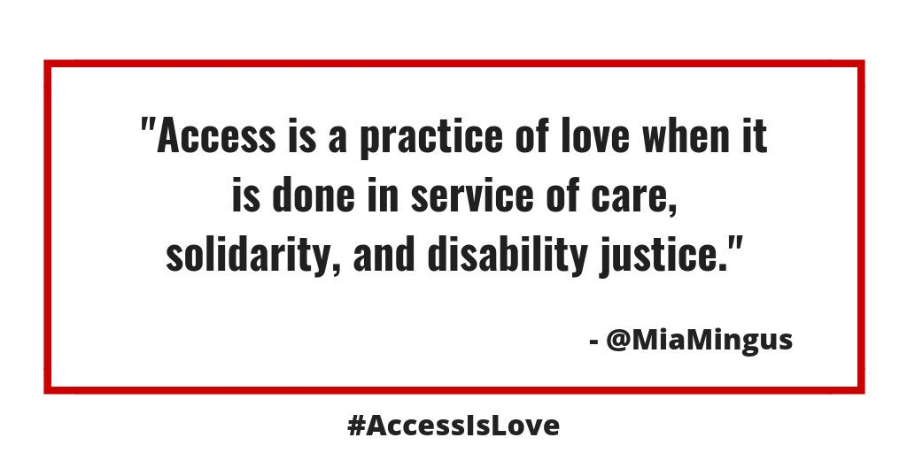
Takeaways from the Faculty Learning Community
Access = Love
Fostering access and interdependency in the classroom
Accessible Syllabus
New opportunities for participation in the classroom
Connecting Disability Justice and Critical Information Literacy

Slide 6
Intersectionality
Leadership of Those Most Impacted
Anti-Capitalist Politic
Commitment to Cross-Movement Organizing
Recognizing Wholeness
Sustainability
Commitment to Cross-Disability Solidarity
Interdependence
Collective Access
Collective Liberation
10 Principles of Disability Justice - Sins Invalid
Notes:
https://dsq-sds.org/article/view/5970/4697
“Activist oriented”
Challenges what we value about people
Have a better understanding of intersectionality
Centering disabled people for a world with real access

Slide 7
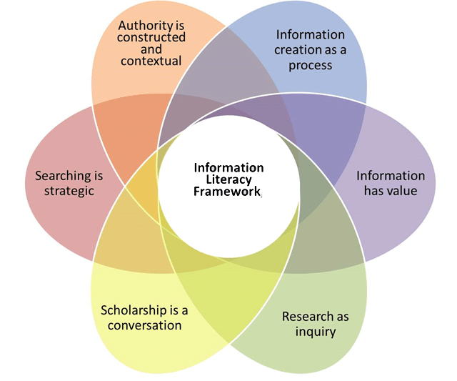
Disability Justice & Critical Information Literacy
Authority is Constructed & Contextual
Define different types of authority, such as subject expertise, societal position, or special experience.
Recognize that authoritative content may be packaged formally or informally and may include sources of all media types.

Slide 8
Disability Justice & Critical Information Literacy
Information Has Value
Understand how and why some individuals or groups of individuals may be underrepresented or systematically marginalized within the systems that produce and disseminate information.
Experts understand that value may be wielded by powerful interests that marginalize certain voices.
Notes:
yet that the document is still articulated in the rhetoric of neoliberalism and reinforces the notion that the way information is produced and commodified is a natural condition that need not be challenged.

Slide 9
Disability Justice & Critical Information Literacy
(Drabinski & Tewell, 2019; Tewell, 2016)
“Critical information literacy (CIL) is a theory and practice that considers the sociopolitical dimensions of information and production of knowledge, and critiques the ways in which systems of power shape the creation, distribution, and reception of information.”
Teaches students how to deal with complicated issues
Challenges the traditional ways information is produced, disseminated, consumed, valued
Importance of student agency
Notes:
Teaching students how to deal with complicated issues
“Considers the social, political, economic, and corporate systems that have power and influence over information production, dissemination, access, and consumption.”
“Critical information literacy considers in what ways librarians may encourage students to engage with and act upon the power structures underpinning information’s production and dissemination.”

Slide 10
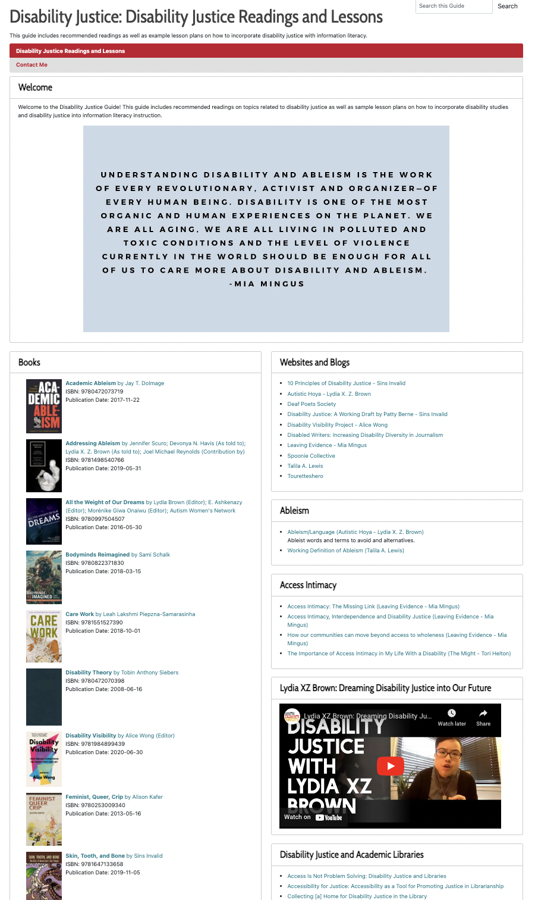
Disability Justice Guide
Developed in the FLC
Disability Justice Resources for Librarians
Activists to follow
Lesson Plans incorporating the ACRL Framework and Disability Justice
https://libguides.lib.miamioh.edu/disabilityjustice

Slide 11
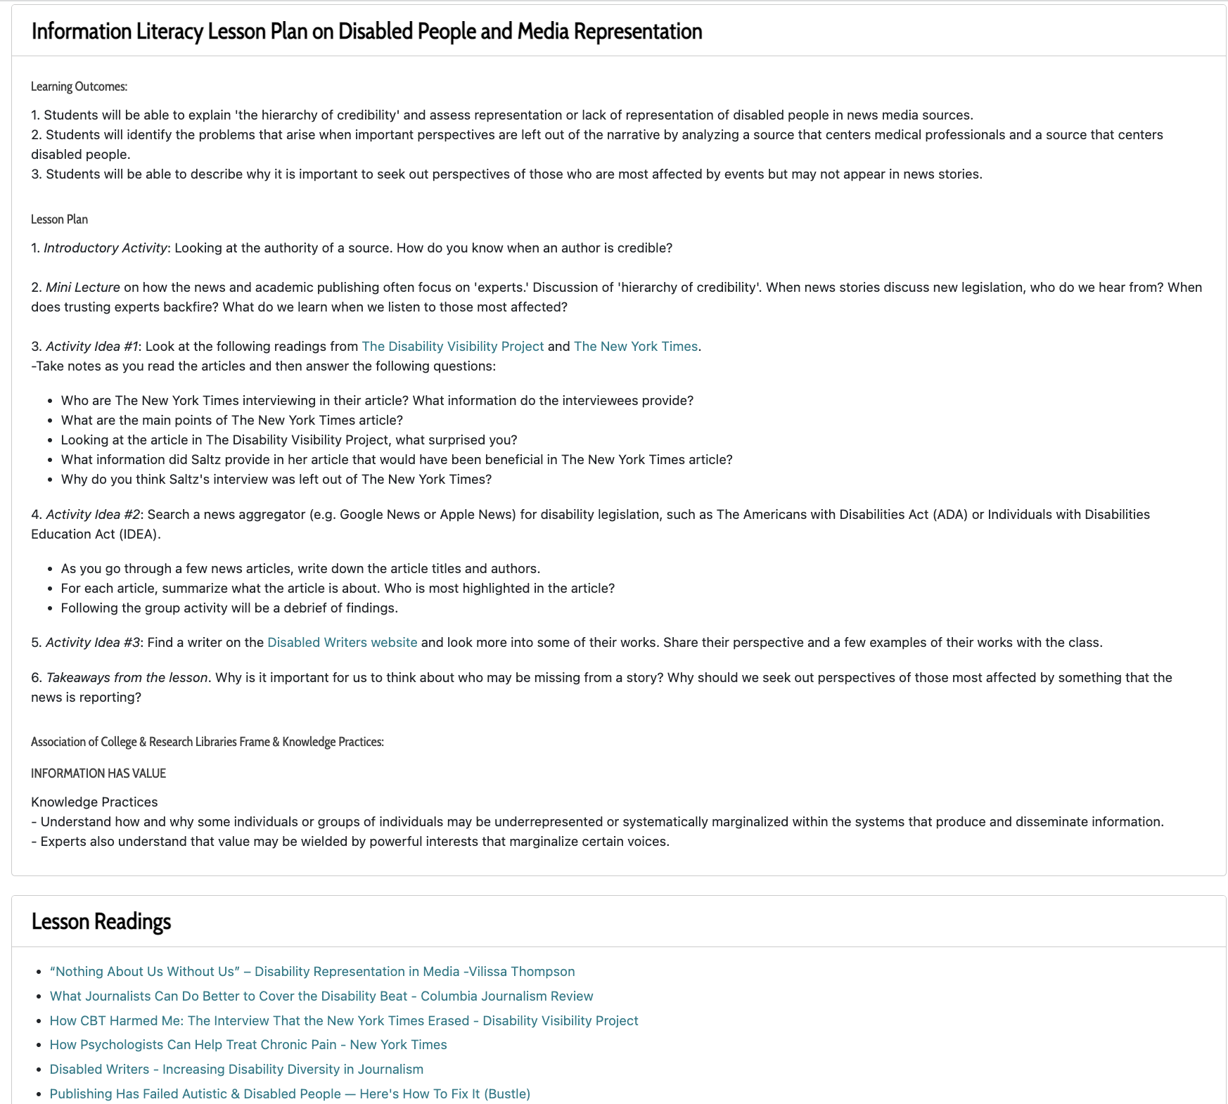

Slide 12
Lesson Plan on News Media & Representation
Learning Outcomes:
Students will be able to explain 'the hierarchy of credibility' (or the power structures in traditional information production) and assess representation or lack of representation of disabled people in news media sources.
Students will identify the problems that arise when important perspectives are left out of the narrative by analyzing a source that centers medical professionals and a source that centers disabled people.
Students will be able to describe why it is important to seek out perspectives of those who are most affected by events but may not be central to news stories.

Slide 13
Lesson Plan News Media & Representation
Activity Idea #1
Look at the following readings from The Disability Visibility Project and The New York Times.
-Take notes as you read the articles and then answer the following questions:
Who are The New York Times interviewing in their article? What information do the interviewees provide?
What information is provided in The Disability Visibility Project? What surprised you?
What information did Saltz provide in her article that would have been beneficial in The New York Times article?
Why do you think Saltz's interview was left out of The New York Times?

Slide 14
Lesson Plan News Media & Representation
Activity Idea #2
Search a news aggregator (e.g. Google News or Apple News) for disability legislation, such as The Americans with Disabilities Act (ADA) or Individuals with Disabilities Education Act (IDEA).
As you go through a few news articles, write down the article titles and authors.
For each article, summarize what the article is about. Who is most highlighted in the article?
Following the group activity will be a debrief of findings.

Slide 15
Lesson Plan News Media & Representation
Activity Idea #3
Find a writer on the Disabled Writers website and look more into some of their works.
Consider:
What topics do they write about? What is their perspective on these topics?
How does their perspective provide nuance to the topic?
Share their perspective and a few examples of their works with the class.

Slide 16
Lesson Plan News Media & Representation
Takeaways:
Challenges the power structures in traditional information production with specific examples.
Asks students:
Why is it important for us to think about who may be missing from a story?
Why should we seek out perspectives of those most affected by something that the news is reporting?

Slide 17
Jaclyn Spraetz
Email: spraetj@MiamiOH.edu

Slide 18
References
Association of College & Research Libraries. (2015). Framework for information literacy for higher education. https://www.ala.org/acrl/standards/ilframework
Drabinski, E., & Tewell, E. (2019). Critical information literacy. The International Encyclopedia of Media Literacy. https://doi.org/10.1002/9781118978238.ieml0042
Linton, S. (1998). Claiming disability: Knowledge and identity. New York University Press.
Mingus, M. [@miamingus]. (2019, February 4). Access is more than something to check off a list. Access is an opportunity to gift the best of ourselves to each other. access for the sake of access is not necessarily revolutionary, but access for the sake of connection, justice, solidarity, love has the power to transform [Tweet]. Twitter. https://twitter.com/miamingus/status/1092483547045056515
Robinson, O. E. (2017). Moving toward disability justice. Disability Studies Quarterly, 37(3). https://dsq-sds.org/article/view/5970/4697
Sins Invalid. 10 principles of disability justice. https://www.sinsinvalid.org/blog/10-principles-of-disability-justice
Tewell, E. (2015). A decade of critical information literacy: A review of the literature. Communications in Information Literacy, 9(1), 24-43. 10.15760/comminfolit.2015.9.1.174

