Slide 1
Managing Change, Maintaining Continuity
Reinventing and Retaining Core Technical Services Approaches Following Long-term Retirements
by
Cara Calabrese, Acquisitions & Access Librarian
Alea Henle, Head of Access & Borrow

Slide 2
Session Map
Background
Challenges
Communication
Changes
Discussion Activity

Slide 3
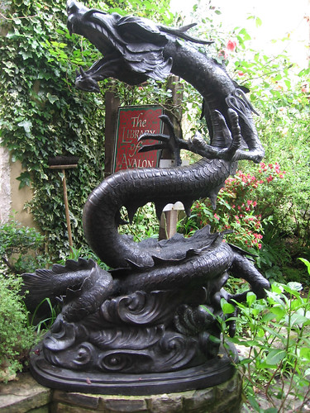
Notes:
3-5 min top BACKGROUND (for those of you who knew Karen, this is a very appropriate image!)

Slide 4
Keeping up with orders
Previous staffing changes
Lack of back ups
Notes:
2-3 min Challenges for her departure -- Alea

Slide 5
Challenges
Newly continuing contract line
Collecting distributed tasks
Credit card issues
Amazon discrepancies
Funds expended
Additional Vacancies
Notes:
5 mins?

Slide 6
Notes:
5 mins Communication

Slide 7
Notes:
15 min Changes
Quick changes>Old workflow/procedure being redone>New workflow created
Kanopy
https://docs.google.com/document/d/1wvP1tkmgGmTudvAklM4RxdQNxPKWVaujxaZZdOGm7k0/edit
Gobi
https://docs.google.com/document/d/1sRTj17tu4RABFQzjFXXyCrewsjEU8ZmGQoJIaguMmgs/edit#heading=h.f4670f73niyn

Slide 8
Document (before, after, review)
Expect unexpected road blocks
Start & End by Degrees
Takeaways
Notes:
7-10 min Activity
Discussion
Identify and address problems with respect to creation and maintenance of supporting documentation.
Documentation focused (training included?)
Group attendees
Pose a few questions:
How do You view documentation? Department? Library?
How often do you review documentation?
Audience of current documentation at work?
for ways to make it better/easier/faster?
Do you have people not typically involved in said process review for clarity? either upon creation or periodically?
If you need to create documentation for a new workflow/procedure, how do you currently do that?
Is there any research or info gathering before creation?
Do you have external reviewers?
Do you solicit feedback? Do you encourage those using the documentation to edit as mistakes or new/better ways are found? (or do you make new documentation?)
Where do you keep it? (Master or copies)
Physical, online (wiki, confluence, Google Drive, computer drives), multiple spots
Do you index your procedures?
Do you sunset old or not in use documentation?
delete/archive?
Alea and I will lead or moderate or float
At ten minutes in groups naturally wind down we open the floor for regular questions about content or it discussions are strong we just note that they are welcome to ask any questions they have
Can pull in either speaker at this point to answer question at either group

Slide 9
References
openclipart. (2016). Old map scroll. [Digital Image]. Retrieved from https://publicdomainvectors.org/en/free-clipart/Old-map-scroll/52632.html
pshab. (2008). Dragon library. [Digital Image]. Retrieved from https://www.flickr.com/photos/83133617@N00/2569093520
Nick Youngson. (2008). Highway sign challenge image. [Digital Image]. Retrieved from https://www.picpedia.org/highway-signs/c/challenge.html
Nick Youngson. challenge [Digital Image]. Retrieved from http://www.thebluediamondgallery.com/wooden-tile/c/challenge.html
geralt. (2017). communication. [Digital Image]. Retrieved from https://cdn.pixabay.com/photo/2017/01/19/09/31/communication-1991849__340.png
Nick Youngson. Changes Ahead. [Digital Image]. Retrieved from http://www.thebluediamondgallery.com/tablet/c/changes-ahead.html

