Slide 2
Incoming Freshmen: A Retention Initiative
Melissa Bauer, Online Learning Librarian
Ted Guedel, Reference and Instruction Librarian
Rob Kairis, Library Director
ALAO 2019 Conference
Friday, October 18, 2019 Nationwide Hotel and Conference Center, Columbus, OH

Slide 3
Why we Did it…
Campus administration challenged individual units to develop specific retention initiatives
Library staff discussed:
Retention = freshmen enrollment from fall to spring
Library deeply invested in FYE: Destination Kent State
About 500-600 students enroll each fall (@90% of all freshmen)
Sections get a session on orientation to the library
As well as a session (in their classroom) for Plagiarism
Since we already engage in a class setting, wanted this to be an individual (one-on-one) experience
Need to incorporate incentives
Outcome based—specific measurement of results

Slide 4
Why we Did it…
First year (2017) findings (briefly)
57 students participated (9%)
53 of those participating enrolled in the spring of 2018
The program yielded a 93% retention rate
Overall retention rate for all incoming freshmen was 80%
For 2018
Based on the very small participation rate, we needed to:
Expand marketing efforts
Base marketing efforts on the results
Buy-in from coordinators and instructors of the FYE course
Made it a “tour” instead of a “consultation”

Slide 5
Why It’s Important…Nationally
“Student retention is one of the most critical issues in higher education. Student persistence plays a major role in institutions’ financial planning as tuition is a major driver of an institution budget.”
“The reason students persist is highly complex and difficult to predict with many institutions creating individual and successful programs.”
Because of this…retention and completion rates have become a focus across academic and non-academic departments.
Burke, A. (2019). Student Retention Models in Higher Education: A Literature Review. College and University, (2), 12.

Slide 6
Why It’s Important…
Retention numbers vary by how the academic literature and government reports measure student persistence; however, you will see the numbers are not too dissimilar.
“Retention rate is the percentage of a school's first-time, first-year undergraduate students who continue at that school the next year. For example, a student who studies full-time in the fall semester and keeps on studying in the program in the next fall semester is counted in this rate.”
US Department of Education

Slide 7
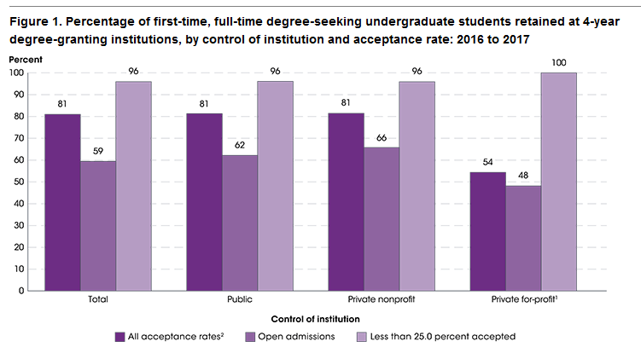
Why It’s Important…Nationally
First-time, full-time students at 4-year degree granting institutions.
Close to a 40% attrition rate.
National Center for Education Statistics. (2019). Undergraduate retention and graduation rates. Retrieved from https://nces.ed.gov/programs/coe/indicator_ctr.asp

Slide 8
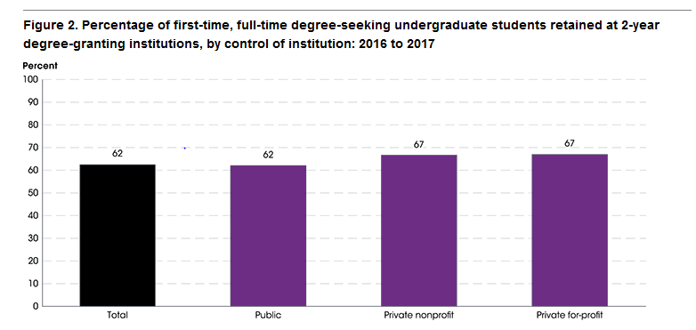
Why It’s Important…Nationally
First-time, full-time students at 2-year degree granting institutions.
Close to a 40% attrition rate.
National Center for Education Statistics. (2019). Undergraduate retention and graduation rates. Retrieved from https://nces.ed.gov/programs/coe/indicator_ctr.asp

Slide 9
Why It’s Important
Association of American Colleges & Universities
High Impact Practices for Student Retention and Engagement
Undergraduate Research
Diversity/Global Learning
ePortfolios
Service Learning, Community-Based Learning
Internships
Capstone Courses and Projects
First-year Seminars & Experiences
Common Intellectual Experiences
Learning Communities
Writing-Intensive Courses
Collaborative Assignments and Projects
Association of American Colleges & Universities. (2008) High-impact practices. Retrieved from https://www.aacu.org/resources/high-impact-practices

Slide 10
Why It’s Important…Libraries
Relates to broad research on libraries and retention…
Oliveira (2017) conducted a review of the literature on the library’s role in student retention. He ultimately found that student engagement plays a central role in retention.
Main factors related to student retention in library context
Library instruction/Information literacy initiatives
Spaces that foster academic and social interaction
Library material and resource use
Oliveira, S. (2017). The academic library’s role in student retention: A review of the literature. Library Review, 66(4–5), 310–329. doi:10.1108/LR-12-2016-0102

Slide 11
Why It’s Important…Libraries
ACRL Report “Academic Library Impact on Student Learning and Success: Findings from Assessment in Action Team Projects,” in 2017 had similar findings…
Information literacy helps them perform better in courses and achieve institutional core competencies.
Library use, including resources and materials positive impact on retention, GPA, course grades.
Collaborative programs, including writing center, etc. had positive impact on student grades, confidence, and retention.
Library research appointments enhanced academic success such as confidence, GPA and improved course assignment grades.
American College & Research Libraries. (2017). New ACRL report highlights library contributions to student learning and success. Retrieved from http://www.ala.org/news/member-news/2017/05/new-acrl-report-highlights-library- contributions-student-learning-and-success

Slide 12
Why It’s Important…Kent State University
Stark Campus Library retention initiative highlights many of the library literature’s findings…
Student Engagement : Establish personal connection to students. Build relationship and sense of community. Make them feel welcome and a sense of belonging.
Materials & Resources: Increase awareness of library resources, services, and physical space.
Collaborative programs: Include several program spaces in the library, such as writing center, veteran commons, LGBTQ safe space.

Slide 13
Why It’s Important…Kent State University
How is retention measured at Kent State University?
The difference between Kent campus and regional campus retention efforts.
Kent campus looks at fall to fall retention efforts
Stark campus looks at fall to spring semester enrollment
Retention within the KSU system, not campus level
Stark student enrolled on Kent campus for Spring semester counts as a retained student.
Why is there a difference in retention measurement?

Slide 14
Why It’s Important… Kent State University
Kent Campus & Regional Campuses Student Retention Profile
First-year retention rates for KSU
81% Kent Campus
59% Regional Campuses (Includes all regionals)
74% Average for all KSU new freshman (Kent campus and regionals)
Compton, C., Pringle, E., Seregi, K., & Wilson, K. (2019) The story: Our students leave, & we can do something about it [PowerPoint sidles]. Kent State University.

Slide 15
Why It’s Important… Kent State University
Institution specific research - recently Kent State University conducted an institution-wide survey to discover why students were leaving the university.
Top five reasons for Kent campus students to leave…
49 % Lack a sense of belonging
25% Financial reasons
25% Homesick
23% Lack a support group
23% Campus climate was not welcoming
Compton, C., Pringle, E., Seregi, K., & Wilson, K. (2019) The story: Our students leave, & we can do something about it [PowerPoint sidles]. Kent State University.

Slide 16
Why It’s Important… Kent State University
Institution specific research - recently Kent State University conducted an institution-wide survey to discover why students were leaving the university.
Top five reasons for regional campus students to leave…
26 % Financial reasons
20% Personal reasons
19% Lack a sense of belonging
18% Did not like major
17% Campus climate was not welcoming
Compton, C., Pringle, E., Seregi, K., & Wilson, K. (2019) The story: Our students leave, & we can do something about it [PowerPoint sidles]. Kent State University.

Slide 17
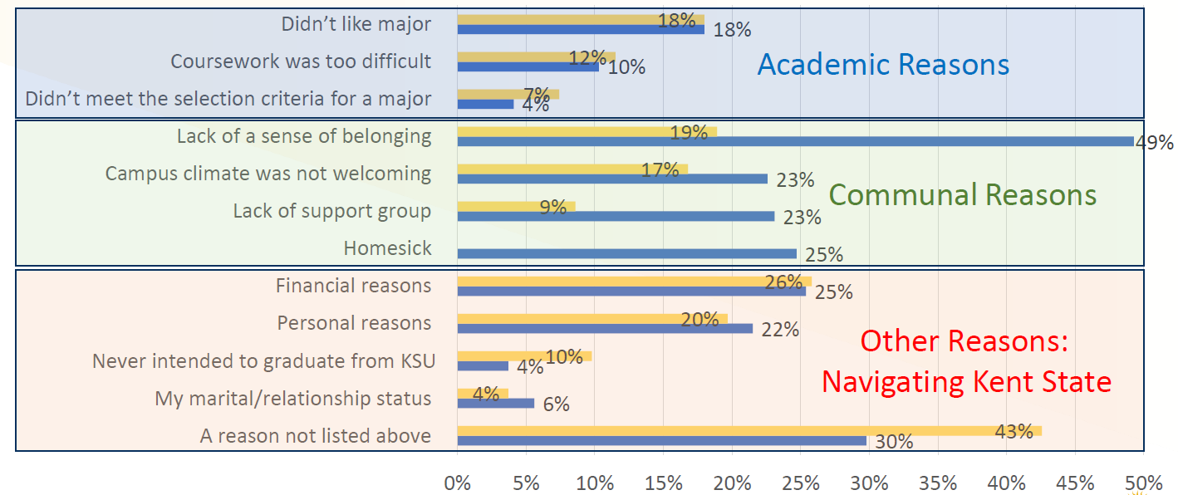
Why It’s Important…
Emphasis on Engagement
Compton, C., Pringle, E., Seregi, K., & Wilson, K. (2019) The story: Our students leave, & we can do something about it [PowerPoint sidles]. Kent State University.

Slide 18
What it is…
The First Year Experience (FYE) Course
Mandatory Kent State University Program for incoming freshmen
Regional campuses have a lot of latitude in running the course
1 credit, 15-week course
Library plays significant role in the program

Slide 19
What it is…
Student Success Series
The Student Success Series is a group of activities designed to promote the campus as well as student involvement. It is a way for students to meet their peers and actively engage in the campus.
Students are required to complete three Campus Involvement Activities, at least two must be from the Success Series.
The third Campus Involvement Activity may be a campus play, concert, sporting event, etc. Any event that helps promote campus and student participation.
Success Series consists of 19 scheduled campus events throughout the semester. The events fall on different dates and times to accommodate the most students.
Success Series gives students the freedom to choose what it is interesting or important to them.

Slide 20
What it is…
Incentives/advantages
FYE Library Tours last the entire semester.
Students may pick the time & date that is most convenient for them.
Students receive $5 worth of free printing (100 prints)
Each student is entered in a drawing for free textbooks for the spring semester. The winner has their spring semester books paid for by the library. The student returns the books to the library at the end of the semester. The library then enters those books in the catalog.

Slide 21
What it is…
The FYE Library Tour
The entire library staff is trained to give the tours (librarians, support staff, and graduate students)
Student assistants at the circulation desk are trained on the order of who to get for tours.
Tours last from 10-15 minutes.
Each tour consists of 14 major points of interest.
Each tour is highly individualized by the person giving the tour. The major points must be covered, but the tour giver has a lot of freedom in presenting the material.
Each student is given a library brochure.
The last stop is always the Writing Center.
The Writing Center then has one of their students give a brief description of the center. They also have a brochure.

Slide 22
What it is…
The Completion Survey
In order to get credit for any Campus Involvement Activity the student must complete an online survey that discusses the event they attended.
The survey asks for basic student information. It also asks the student why they selected the event, why it is important to attend this event, how they expect to use what they learned, what could make the topic better, and what is one question you have about the topic.
The library then collects all surveys and assesses the data.
The survey helps us to continually improve our tours.

Slide 23
What it Does…
Fall 2018 results
 | Enrollment | Retention
All Freshmen | 597 | 75%
All FYE Students | 522 | 77%
Library Participants | 296 | 84%
Participation rate = 57%
249 of the 296 participating students enrolled for spring classes
Using a Chi Squared test (at .01, .05 and .10 levels) revealed there was a statistically significant difference in enrollment

Slide 24
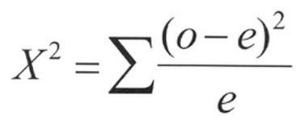
What it Does…
Chi Square formula

Slide 25
What it Does…

Slide 26
What it Does…

Slide 27
What it Does…
Participant Survey Results
49% rated it as “Excellent”
33% rated it as “Very Good” (82% = Excellent or Very Good)
Only 3 students rated it as “Fair” (no one rated it as “Poor”)
99% believed the length was “About Right”
2 students believed it was “Too Short”
No one answered that it was “Too Long”

Slide 28
What it Does…
Participant Survey Results
“How do you plan to use what you learned”
1/3 answered “Writing Center”
When asked how the tour could be improved
63% indicated that it needed no improvement
“To make this topic better I think they could make the time a little bit longer to be able to go into more detail about everything the library has to offer students.”

Slide 29
What it Does…
Participant Survey Results
Positive comments
“I think this topic was perfect”
“Why don’t you make it a mandatory event so everyone knows where and what to do here?”
Not so positive comments
“Why do we have to do this? I think it’s actually really pointless.” (It should be clear that this is optional)
“There wasn’t really a whole lot that went on here. It was like a 5 minute tour.”

Slide 30
What it Does…
Cost for the initiatives
 | Printing Credited | Printing Used | Potential Cost | Actual Cost | Textbooks
2017 | 5700 | 504 | $285.00 | $25.20 | $548.30
2018 | 33500 | 3967 | $1,675.00 | $198.35 | $501.28
Total direct costs for 2017 = $573.50
Total direct costs for 2018 = $699.63

Slide 31
What Do We Do Next…
Future considerations
Make it an FYE course requirement?
Pro: All FYE students get better orientation to the library
Con: Another have to for the course
(Now it has the advantage of being an optional but easy to obtain activity… do we want students to fail their FYE course because they didn’t take a library tour?)
Open it to ALL incoming freshmen (not just FYE students)
(For fall 2018, 75 students (13%) of incoming freshmen were not enrolled in the FYE course)

Slide 32
Questions…

Slide 33
Incoming Freshmen: A Retention Initiative
Melissa Bauer, Online Learning Librarian
Ted Guedel, Reference and Instruction Librarian
Rob Kairis, Library Director
ALAO 2019 Conference
Friday, October 18, 2019 Nationwide Hotel and Conference Center, Columbus, OH

