Slide 1
JESS CROSSFIELD MCINTOSH
Public Services Librarian
ALA0 2019
Great Minds Think Alike:
Expanding Outreach through Community Partnerships
bit.ly/alao2019partnerships
Notes:
Hello! I am Jess, public services librarian at Otterbein and today I am going to be talking about community partnerships and the positive impacts they’ve had on our library, our strategic plan, and our community.
I also wanted to mention Kirsten Peninger, our assistant to the library who has been integral to these partnerships and largely plans and runs these events,
Additionally, you will see the bitly link here. That will take you to the slides and references list. So don’t feel as though you have to take down all the notes

Slide 2
Objectives
& CONVERSATION
Define the process and outcome of developing a new partnership among different types of libraries
Provide best practices for running a collaborative project and marketing a library in the community
Generate ideas for future events and programming to benefit and appeal to a variety of audiences
Notes:
Conversation points will include discussion about the initial partnership development, why we decided to work together, expanding that partnership into new outreach/programming, and best practices/lessons learned.
this talk is limited to the more immediate and practical experiences at Otterbein/Westerville and encouraging others to explore relatively easily obtainable library partnerships and benefits

Slide 3
Walk away with ideas to grow your own partnerships
Notes:
We will also be holding reflective questions with time to share with a partner as my hope is that you leave today with tangible ideas to implement or explore so start thinking about possible partners/ideas now and we will reflect/share in a bit

Slide 4
Why?
2017 Strategic plan study emphasized the importance of the library as space and the desire for more engagement
We also know that engagement on campus helps with student retention. When students develop relationships in our department, we are aiding in their academic success
Source: ACRL Impact report
Notes:
So why? AS public services librarian, I’ve always wanted to grow collaboration opportunities with WPL. A big impetus for this was based on our 2015 strategic plan which prioritized programming and community engagement.
We also know from the ACRL impact report that engagement, particularly library engagement, helps with retention and student success.

Slide 5
Goal
Foster relationships within our community
Strategy
Form, grow, and sustain external partnerships
Tactic
Develop programming calendar to appeal to all audiences
Partner with Westerville Public Library

Slide 6
Create life-long library users
Notes:
Ok. So we know why are we are working towards partnerships in our community because we want to align with the focus of the university in being an integral to the community makeup

Slide 7
NATURAL PARTNERS
Westerville Public Library is a 5-star award winning public library less than a mile from our campus
BUILDING ON STRENGTHS
Otterbein University has grown their ties to the community over the years
This cemented the fact that the library wanted to be a part of that growth
Notes:
Deeper research that leads to background supporting partnership/outreach. Specifically to community?
To grow on this: Otterbein’s longterm town and gown relationship- wanted to build on that
So this dropped us into our first natural partnership with WPL
Point out abbreviations

Slide 8
Think-Pair-Share
Get a Partner in mind
CHOOSE A CURRENT PARTNERSHIP OR ONE YOU THINK YOU WANT TO START. WRITE DOWN SHARED GOALS OR POSSIBLE OBJECTIVES.
Notes:
CHOOSE A CURRENT PARTNERSHIP OR ONE YOU THINK YOU WANT TO START. WRITE DOWN SHARED GOALS OR POSSIBLE OBJECTIVES AND WHAT YOUR FIRST STEPS WOULD BE.
TALK TO A NEIGHBOR ABOUT WHY YOU ARE INTERESTED IN WORKING WITH THEM.

Slide 9
First Steps
Notes:
So we have “a story” now. How do we go from that to a program or event/project?

Slide 10
Keys to Success
flexibility
personal relationships
strategic planning
openness to work outside of academic units/library
knowing the resources needed and those that already exist
a desire and ability to move from conversation to action
Source: Meyer, E. E. (2014). Low-Hanging Fruit: Leveraging Short-Term Partnerships to Advance Academic Library Outreach Goals. Collaborative Librarianship, 6(3), 112–120.
Notes:
One article that I really recommend in looking at best practices for outreach is Meyer from Collraborative Librarianship. These keys to success (abbreviated here) really hone in on how to create successful and long lasting parnerships

Slide 11
Starting a Conversation
SETTING SHARED GOALS
Town and Gown relationship establisted but always room for growth
EXAMINE YOUR SHARED GOALS & BENEFITS
Outlined how this project would benefit both libraries
FIND THE RIGHT TIMING
And keep trying. It may not work right away but that doesn't mean a collaboration can't be down the road.
Notes:
Starting with a convo- you find the shared goals and examine those for mutual benefits to support each library/partner.
The right timing is also important bc it may work for one organization but not the other. It def took some years to get to a place where we could fully partner and its grown even more since we began

Slide 12
Identify a Need​
Meet Your Counterpart​
Check for Administrative Approval
​Determine Individual Roles​
​Marketing, Finance & Logistics

Slide 13
Book Nook
Our first major collaboration bringing together two community libraries​
A browsing fiction collection from Westerville Public Library (WPL) available at Otterbein​’s Courtright Memorial Library (CML)
WPL's first permanent off-site collection
Notes:
And this became the Book Nook!
​
We can promote the public library to our students, staff, and faculty while giving them the easy option of acquiring materials at Otterbein​
Allows for in-person promotion of WPL and an increase in collaboration for both libraries.​
​
So far, very successful. Almost 80 checkouts over 200 titles. ​
​
​

Slide 14
Benefits
A low cost way to provide popular fiction to our campus
Mutual promotion of programs and events
Raised awareness in the community about services and resources of both libraries​​
Greater Otterbein staff engagement
​Increase advocacy for both libraries
​Benefits members of the community and reaches new audiences​
And supported our “Story” of building library users

Slide 15
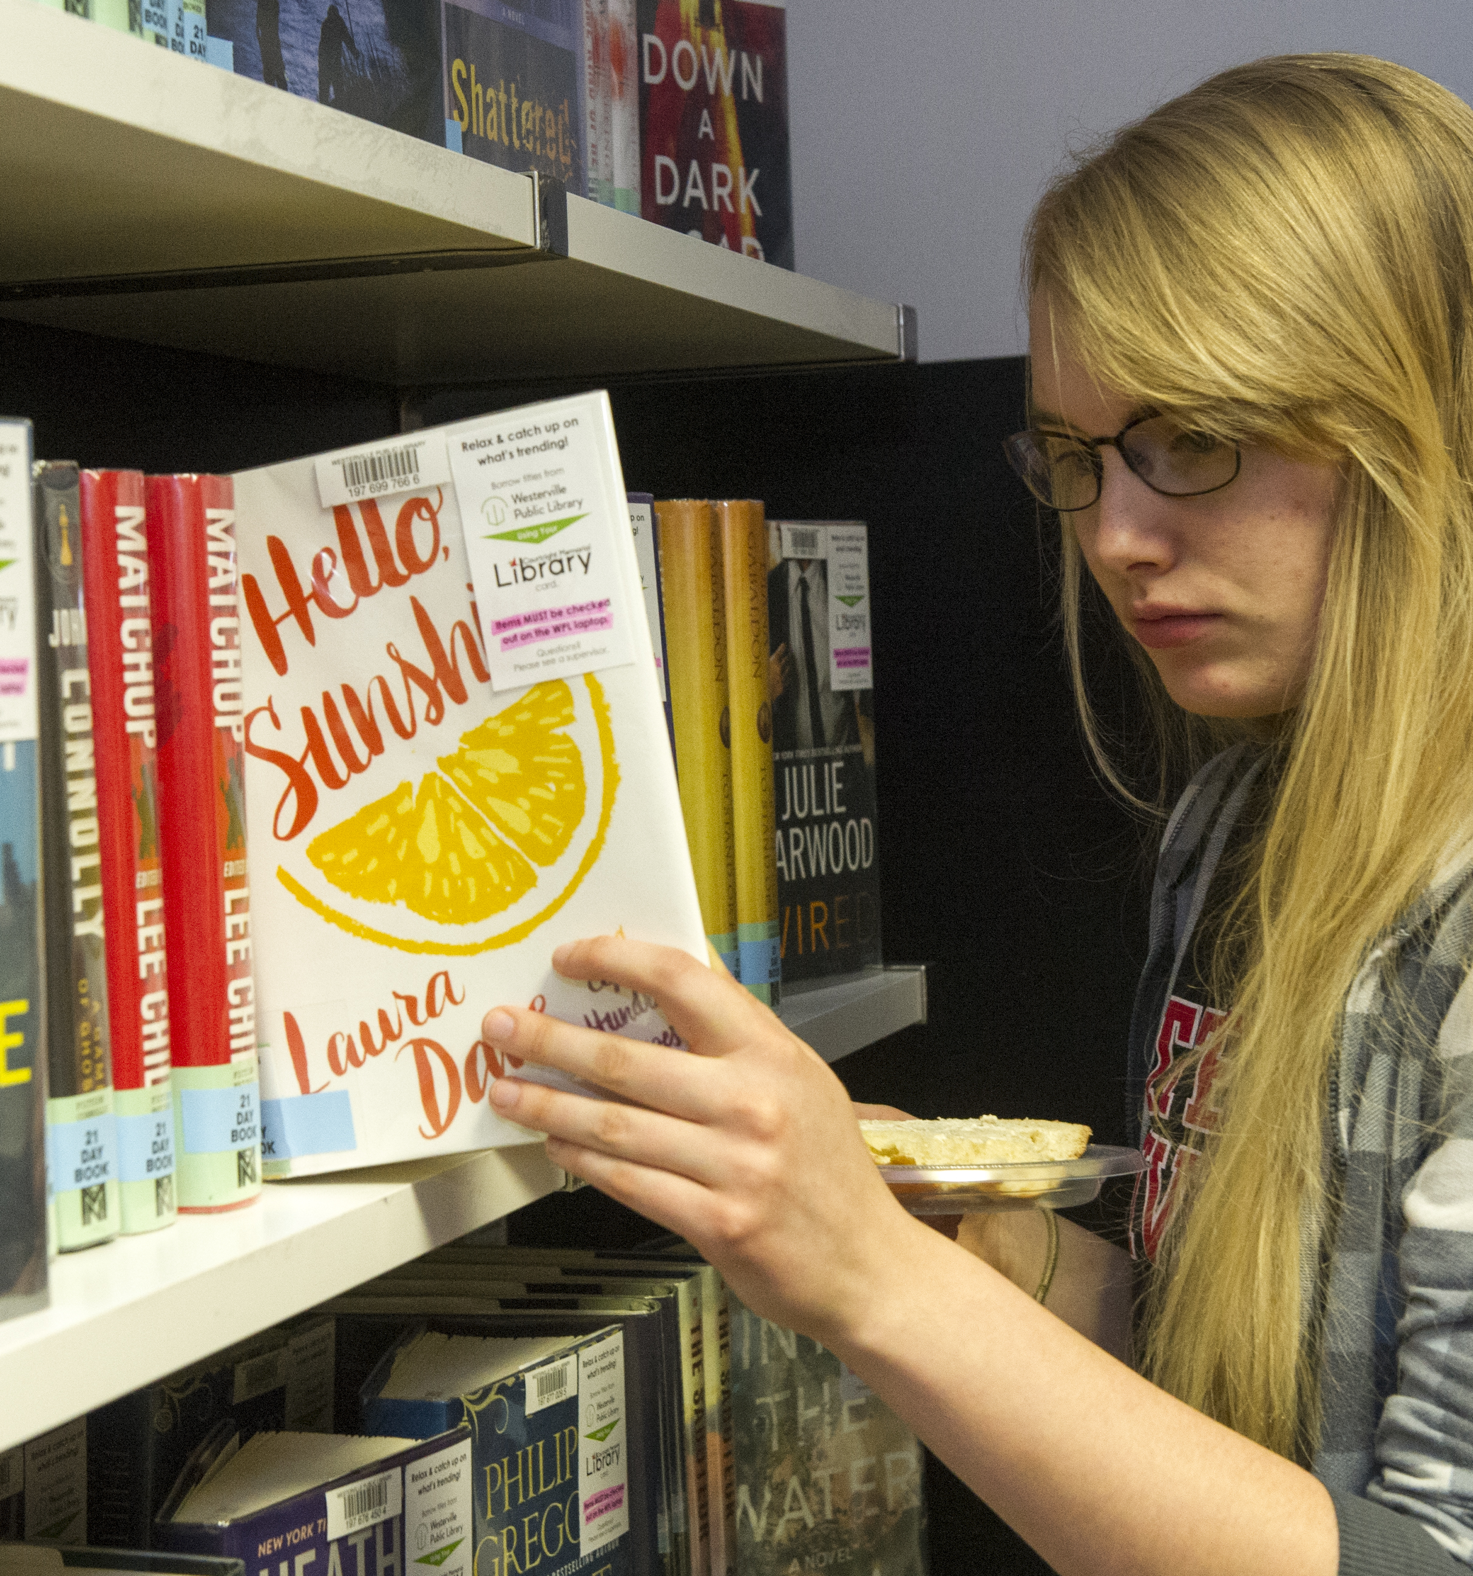
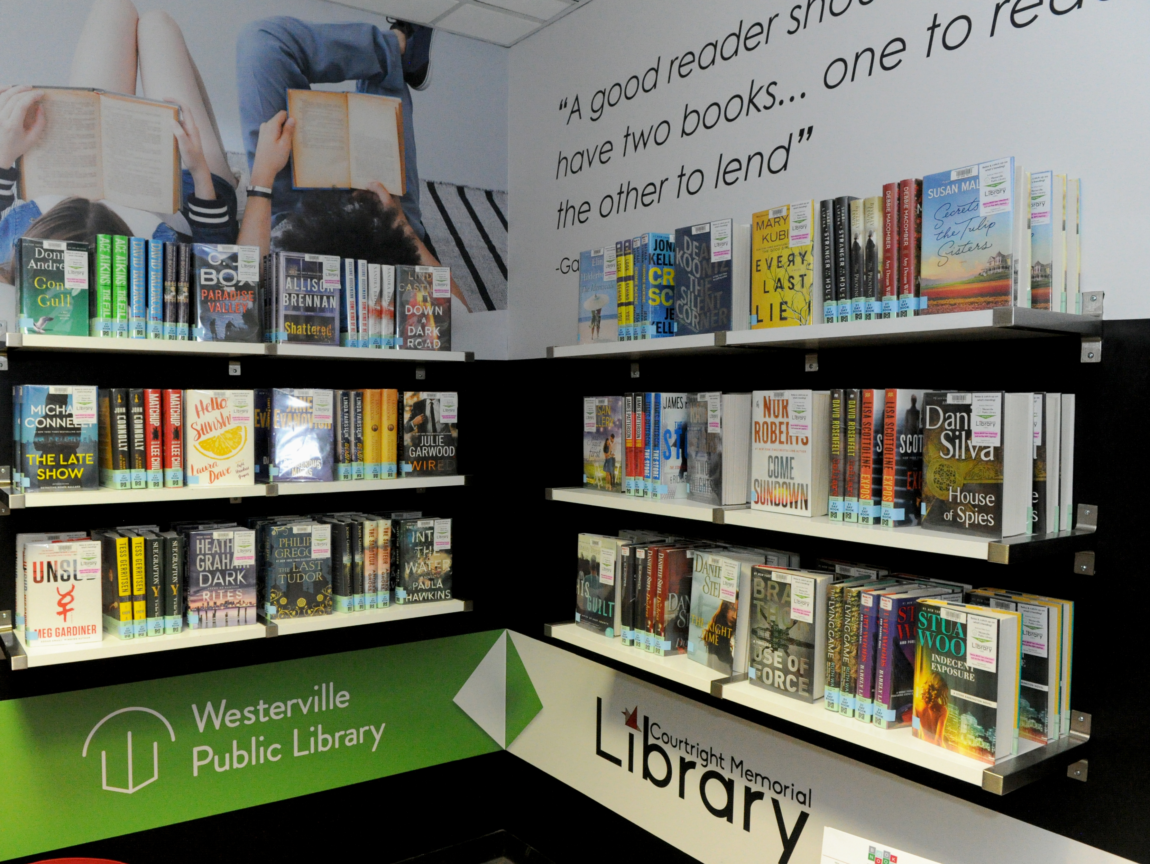
Notes:
# of titles
# of collections

Slide 16
Notes:
Examples of some social media marketing we did that is ongoing. Plan on doing some student book recommendations in the fall and a promotion for fall break.
Survey to be sent out to people who've used the Book Nook.
Been really nice because staff have been using the Book Nook a lot and we are always looking for ways to get staff engaged with the library.
Now Erin and Kirsten will take a step back and talk about additional event collaboration that our libraries developed.

Slide 17
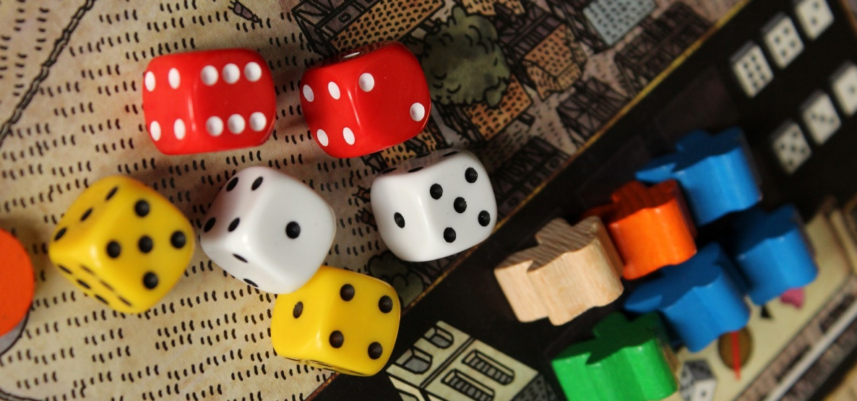
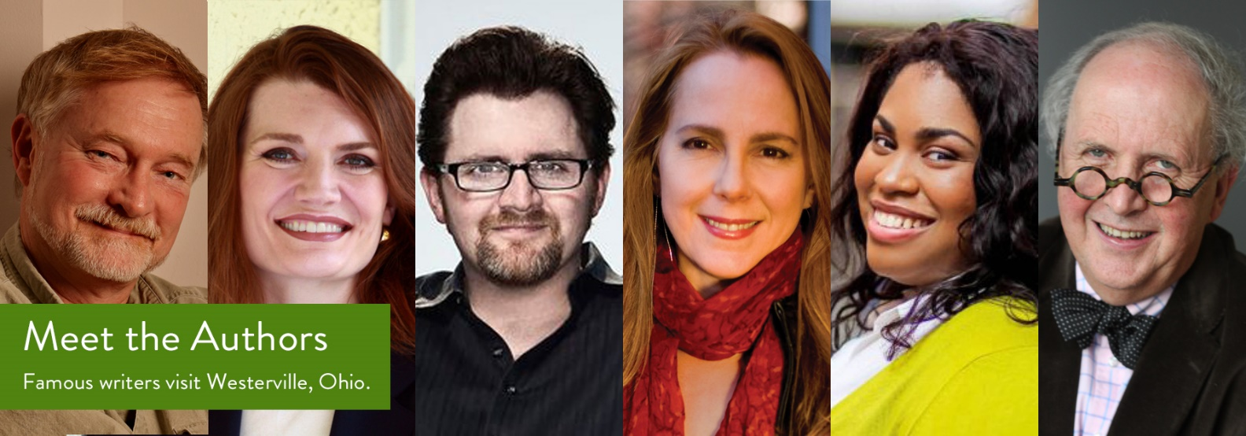
Collaborations that grew from the Book Nook
Photo from Westerville Public Library
Photo by Robert Coelho on Unsplash
Photo from WPL Facebook
AUTHOR EVENTS
GAME NIGHTS
PROGRAMS
Karen White Visit
The Hate U Give Book Discussion
Game nights at Otterbein geared towards teens from the community
CML programs to support WPL's events
Otterbein faculty speaking engagements
Notes:
Just as we hoped, additional programs and collaborations grew from the Book Nook. First being a large author event with Karen White that WPL hosted but the physical location was on Otterbein’s campus. Many of WPLs larger events are held offsite at highschools for ex. So we were able to give them a space for their author talk.
Also, in conjunction with author talks we’ve had book discussion groups to support WPLs efforts in bringing the community into their author events. Angie Thomas came last year and we held two book discussions during that time with our students and open to the community. It was also a book that we highlighted in the BookNook.
The discussion will be led by Vashitta Johnson, a Westerville Library Foundation member and activist. Four lucky attendees to our book discussion will be given a free ticket to the Meet the Author event.
Two game nights- geared towards teens and/or families coordinated with the teen librarian
They got to promote their new board game collection- she passed out information about the game night to local schools- Michala Sage
55 attend first game nights- half Otterbein and half WPL
20 attended second- fewer WPL
If interested, teens were given admission packets
Supporting the WPL programming by creating our own programming and promoting WPL
Bookmarks to be handed out at Harry potter events

Slide 18
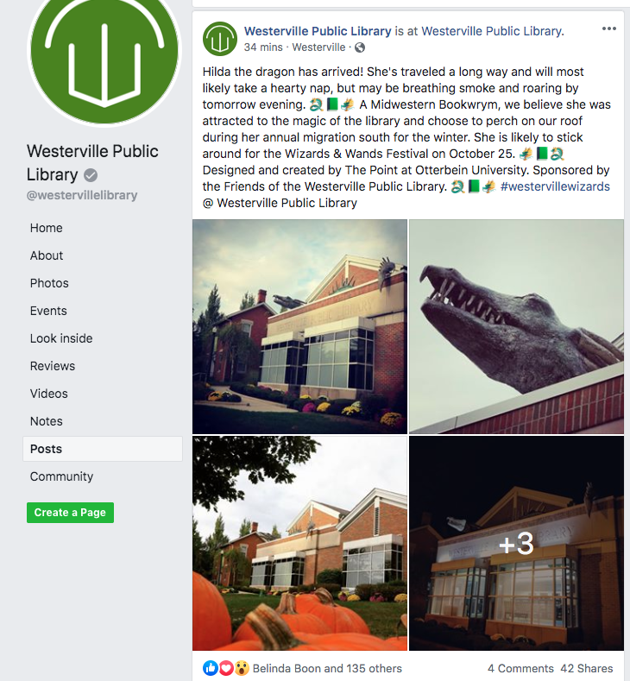
Wizards and Wands & Harry Potter events
Notes:
Our makerspace in the Point is involved via their production of this awesome dragon in celebration of the Wizards and Wands festival

Slide 19
Think-Pair-Share
Let’s Expand
HOW WOULD YOU TAKE AN EXISTING PARTNERSHIP OR COLLABORATION AND EXPAND OR GROW IT?

Slide 20
Our Expansion
Notes:
The WPL collaboration has been very beneficial and continues to grow and enhance our community. After the launch of the BookNook, a new opportunity with WCHS began to develop and has built our town and gown relationship even further.

Slide 21
Westerville Central High School
"Getting Ready for College” Panel
This grew into another town and gown relationship with one of our local high schools. This outreach opportunity also met our goal of continuing external partnerships.
A faculty/staff driven panel with juniors and seniors to discuss life in college.
Notes:
Again, initiated by a conversation between myself and Amy the librarian at WCHS,

Slide 22
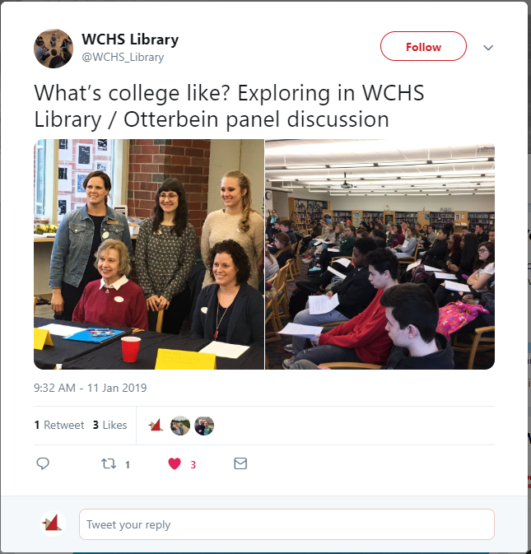
Notes:
In lieu of holding a sort of research session, we wanted to offer something abit more expansive. I invited multiple faculty and staff to participate and we saw over 145 high school students through the event. The students chose the questions

Slide 23
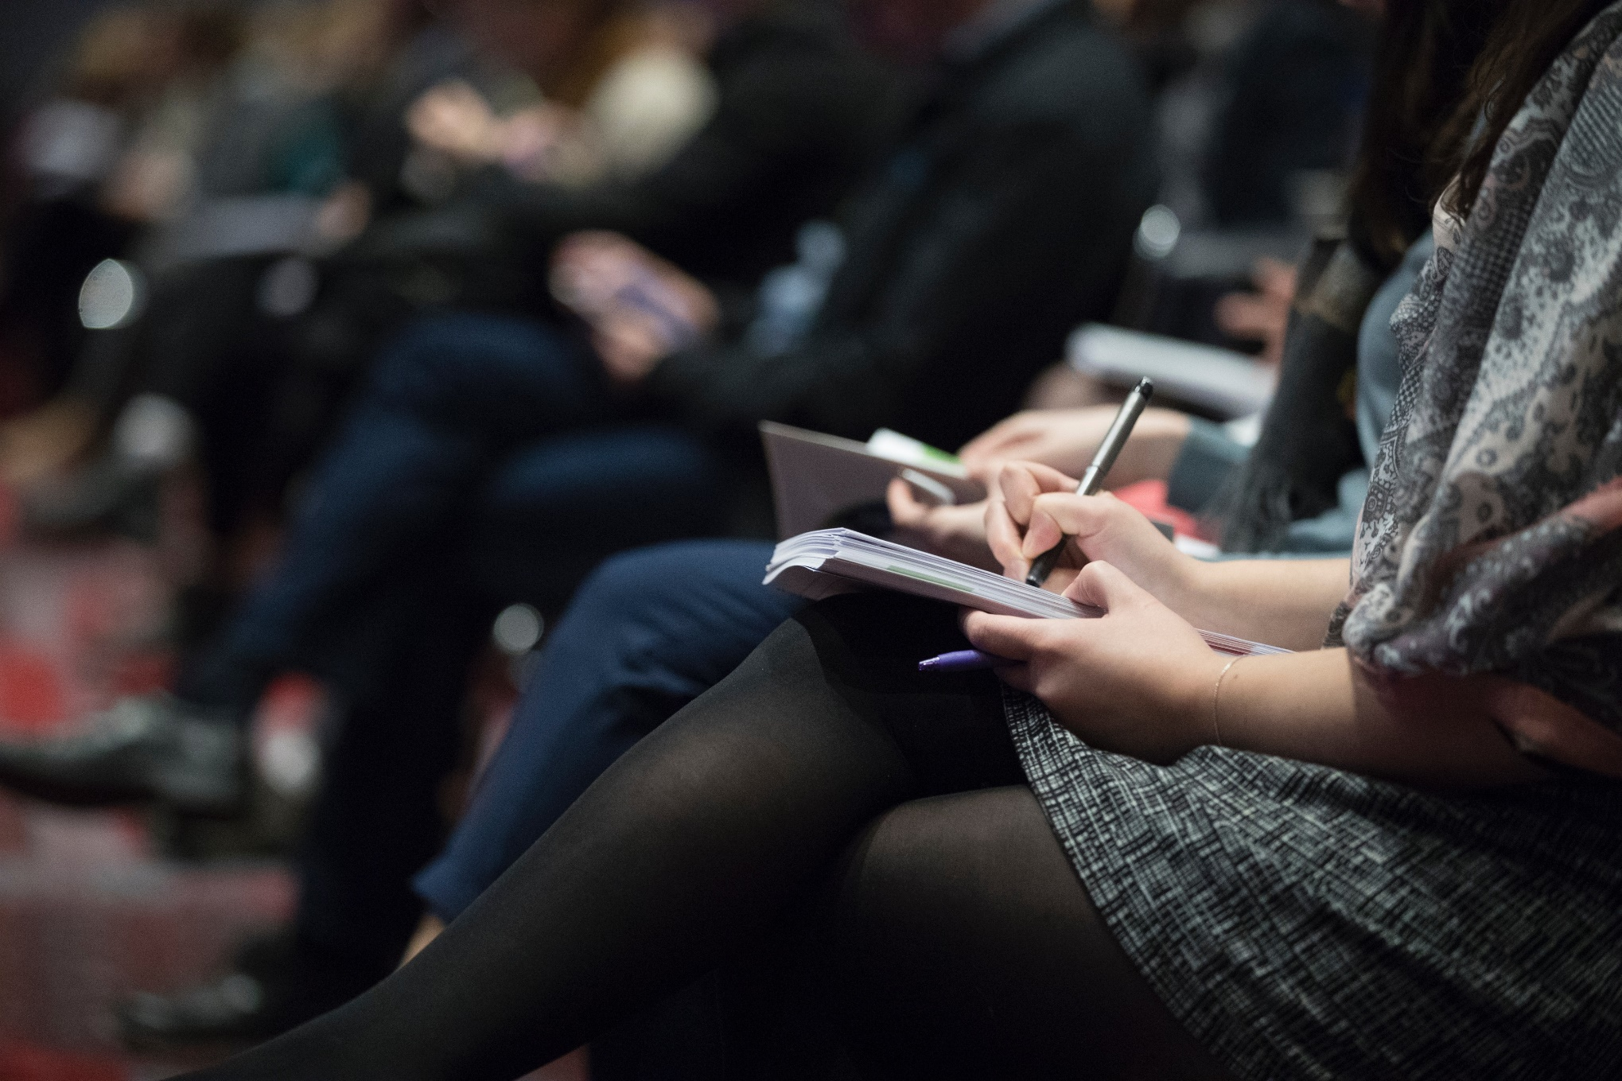
Lots of positive feedback and suggestions
second event to be held spring 2020
Focus specifically on juniors
Integrate more library-specific information
More diverse panel
Work with admissions department to provide swag or program budget
Event targeted as recruitment
Photo by The Climate Reality Project on Unsplash

Slide 24
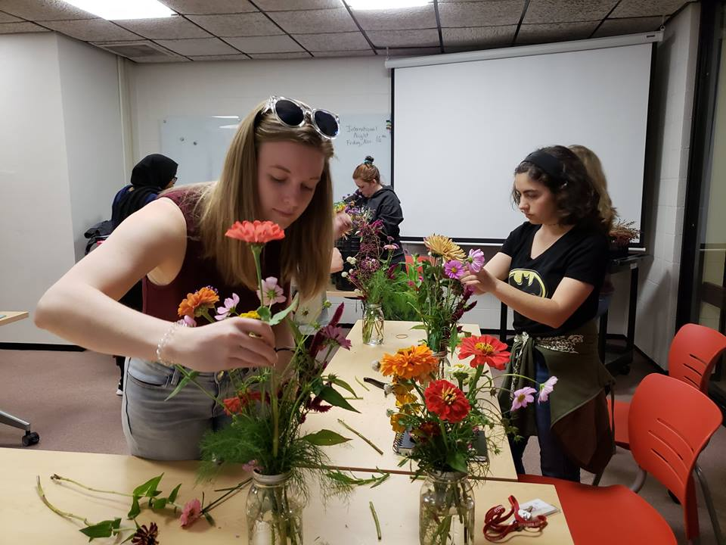
Additional
Community
Partners
LOCAL EXPERTS
Coffee and Sustainability
Flower Arranging
Columbus Metroparks
Westerville Parks and Recreation
League of Women Voters
Notes:
With Java central- hands on demonstrations with coffee- role of coffee in the sustainability cycle- november
Flower arranging Watson Acres- local farm- at half price
BLISS photography different types of gardening/container
Bike trails/photography

Slide 25
Telling the Story

Slide 26
What do these collaborations have in common?
Connect to our mission and strategic plan
Serve our library users and community members
Grow our involvement in our Town and Gown relationship
Connect back to our story

Slide 27
Shout it out
Getting the collaborations out to our community and share the benefits
Annual Reports/Newsletters
Social Media
Press Releases/News coverage
Share with your partners

Slide 28
Keep Message Consistent
Values, keywords, vision statements
Always coming back to our mission “…engaged collaboration, and a welcoming community.”
Notes:
https://www.slideshare.net/thewikiman/branding-the-academic-library-115590316- branding the academic library
https://www.entrepreneur.com/article/232069
https://crln.acrl.org/index.php/crlnews/article/view/16898/18549- branding matters; reimage your library services

Slide 29
Think-Pair-Share
How are you succeeding?
WHAT ARE SOME WAYS YOU ARE ALREADY TELLING YOUR LIBRARY’S STORY? IS THERE ANYTHING NEW YOU COULD TRY?

Slide 30
Positive Growth

Slide 31
Engagement
36
Since our major programming push in 2017, we’ve had a 71% increase number of events.
25
21

Slide 32
Engagement
And we’ve seen a 195% increase in attendance.

Slide 33
Growing our approaches for assessment
Assessing more consistently
Expanding on surveys to gather community feeling and engagement
Notes:
EVENT LIAISON

Slide 34
Next Chapter
Notes:
Ok. So we know why are we are working towards partnerships in our community because we want to align with the focus of the university in being an integral to the community makeup

Slide 35
Continuing developing programming & outreach
Craft brand strategy focusing on the perception of the library
Focus assessment efforts to measure the positive effect of engagements

Slide 36
Thank you!
Questions?
jcrossfieldmcintosh@otterbein.edu
@JessCMcIntosh
bit.ly/alao2019partnerships

