Slide 1
Do You Need Help?
The Implementation of Proactive Chat and its Effect on the Quantity and Quality of Reference Interactions

Slide 2
Helpful
Not Annoying
3 considerations
for proactive chat

Slide 3
#1
Proactive Chat Timing
We chose 45 seconds

Slide 4
Pop up after 14 seconds?
Usability study at 3 Penn State regional campuses asked...
Is proactive chat useful?
Yes, 83% more likely to use the service.
How long before a pop-up should appear?
Average response was 14 seconds.
Imler, B. B., Garcia, K. R., & Clements, N. (2016). Are reference pop-up widgets welcome or annoying? A usability study. Reference Services Review. https://doi.org/10.1108/RSR-11-2015-0049

Slide 5
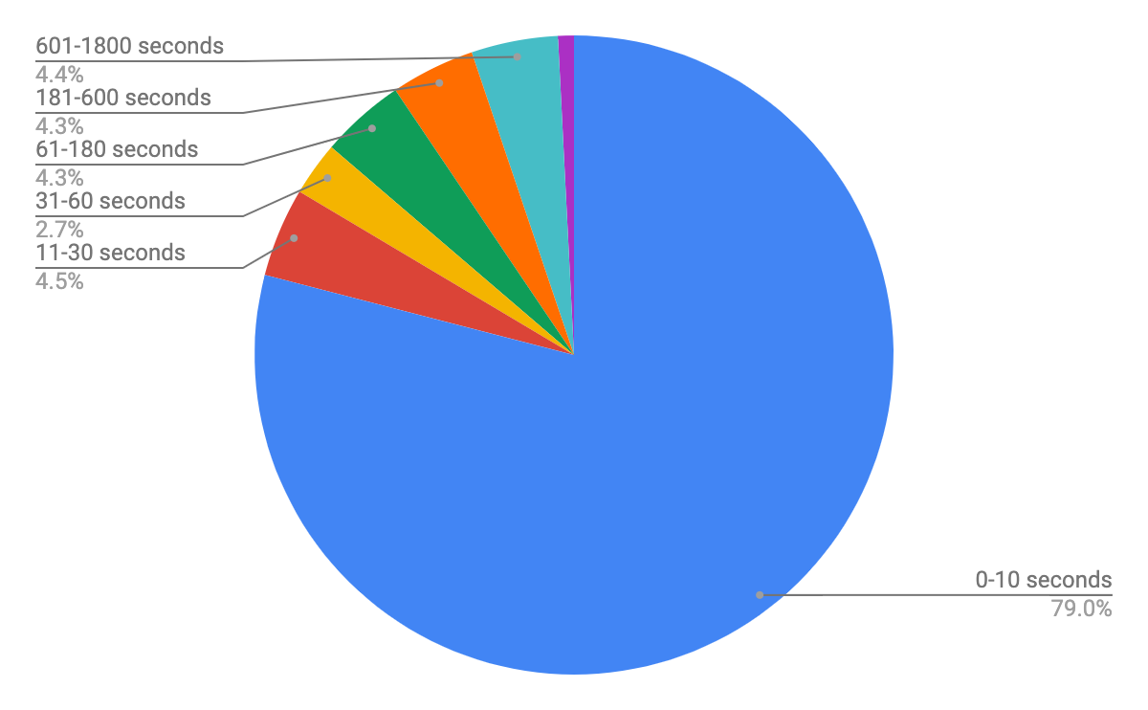
How long they are staying?
Google Analytics
~85% of library website sessions
do not see proactive chat

Slide 6
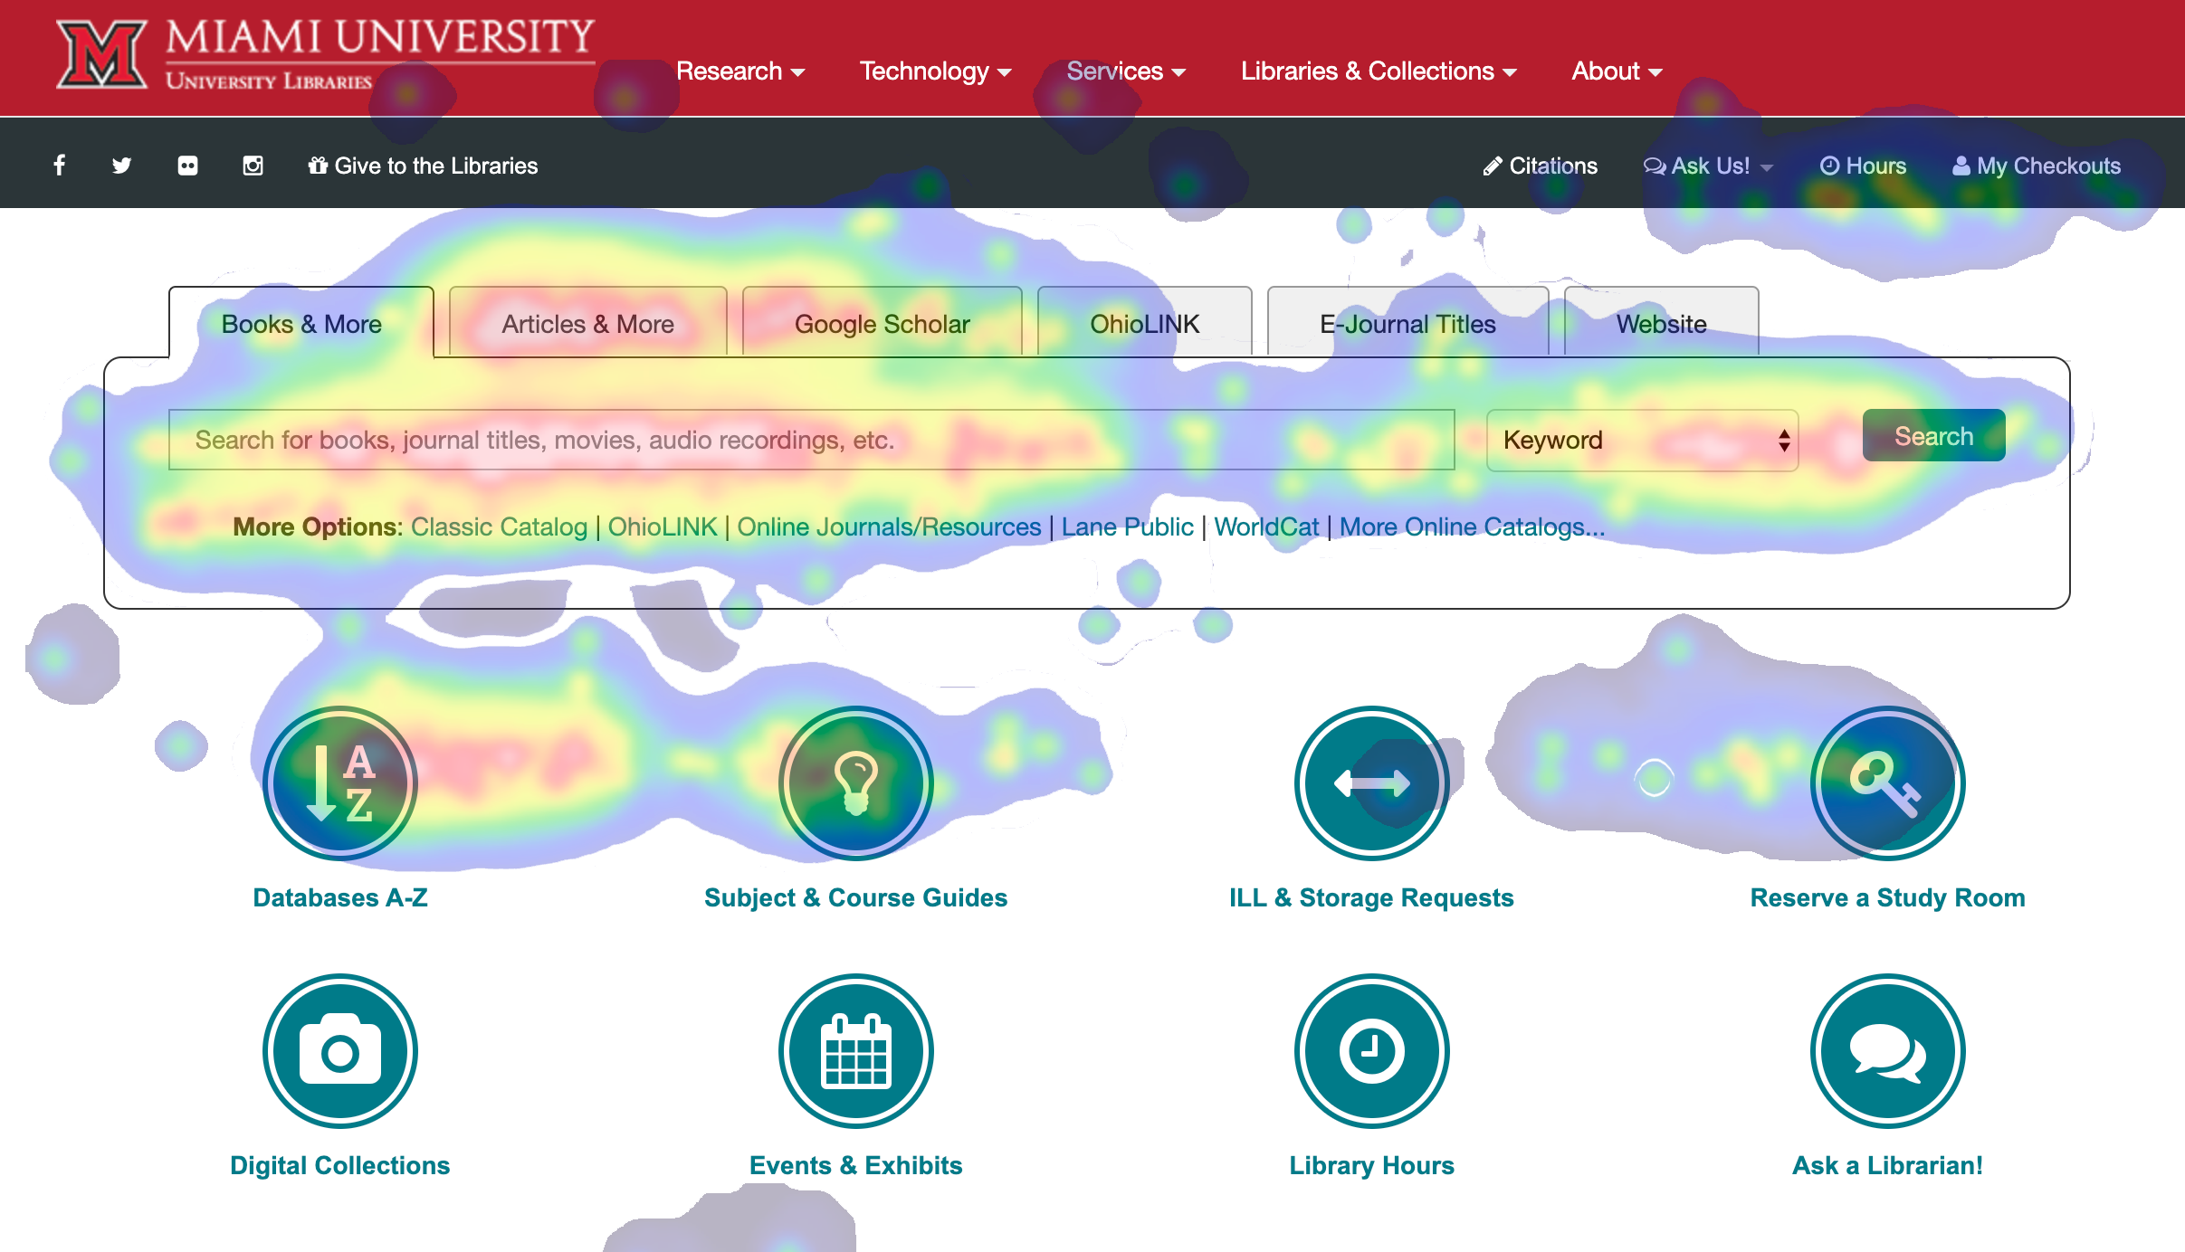
What are students doing?

Slide 7
#2
What type of widget?
We chose a pop-up widget

Slide 8
Why a Pop-Up Widget
Pro: Chat opens to new window by default.
Con: In Chrome, you can’t click anywhere
to dismiss the invite.

Slide 9
We’re in a redesign
Slide-out widget?
Pro: Has button to open chat to new window.
Pro: Perceived as less annoying.
Con: Widget is the absolute last in the keyboard-control tabbing order (accessibility).

Slide 10
#3
Where to put the widget?
We return to our web analytics.

Slide 11
Again, what are students doing?

Slide 12
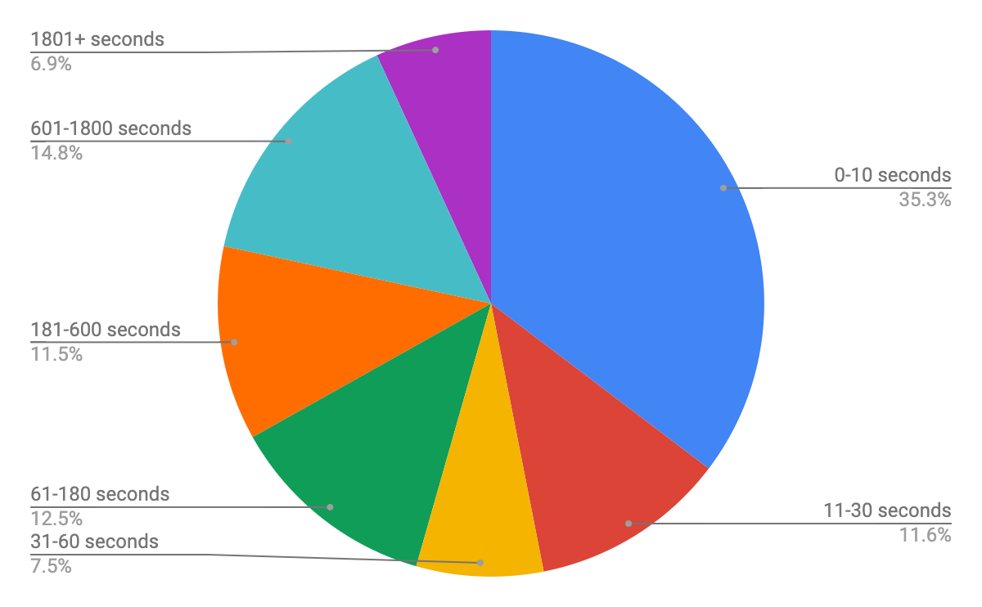
How long they are staying?
Take two
LibGuide page views tell a different story.
Now they are spending time with the material.

Slide 13
“What if I don’t want proactive chat on my LibGuide?”

Slide 14
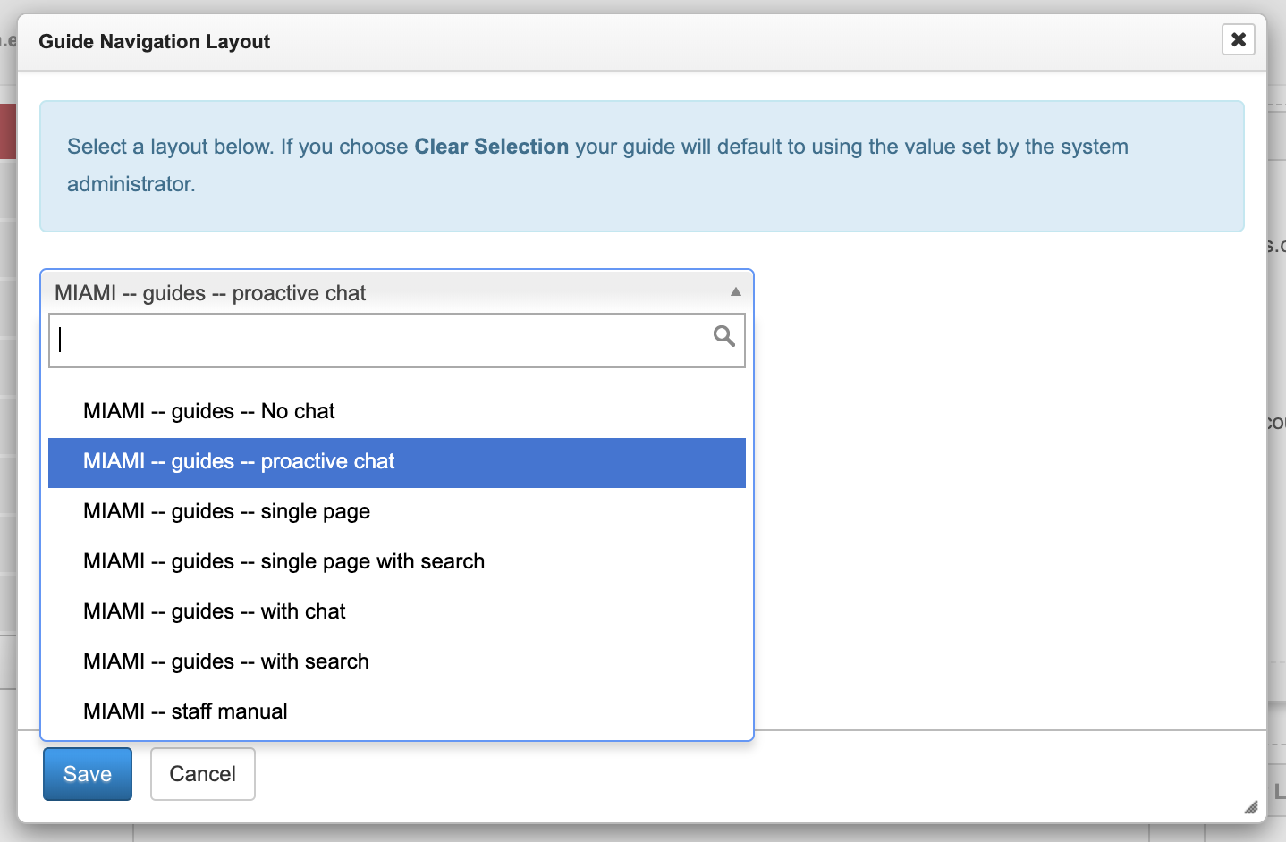
LibGuides allows for multiple templates

Slide 15
Effect of Proactive Chat

Slide 16
Spring 2018 vs. Spring 2019

Slide 17
The Big Numbers
2018: 581 Total Chat Interactions
2019: 1,635 Total Chat Interactions
Increase of 1,054 chats, or 181%

Slide 18
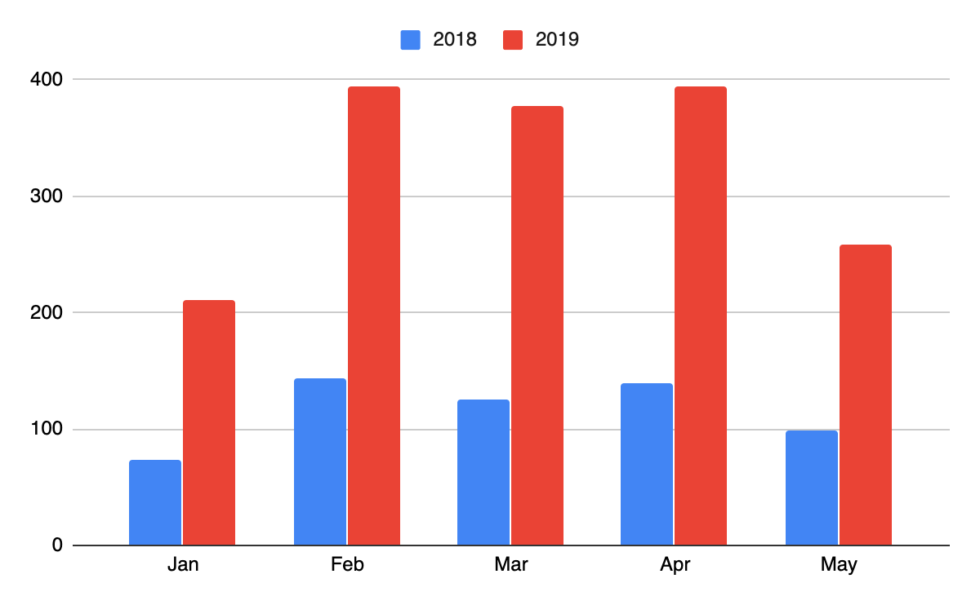
Number of Chat Interactions 2018 vs. 2019 by Month
Notes:
Average increase of 211

Slide 19
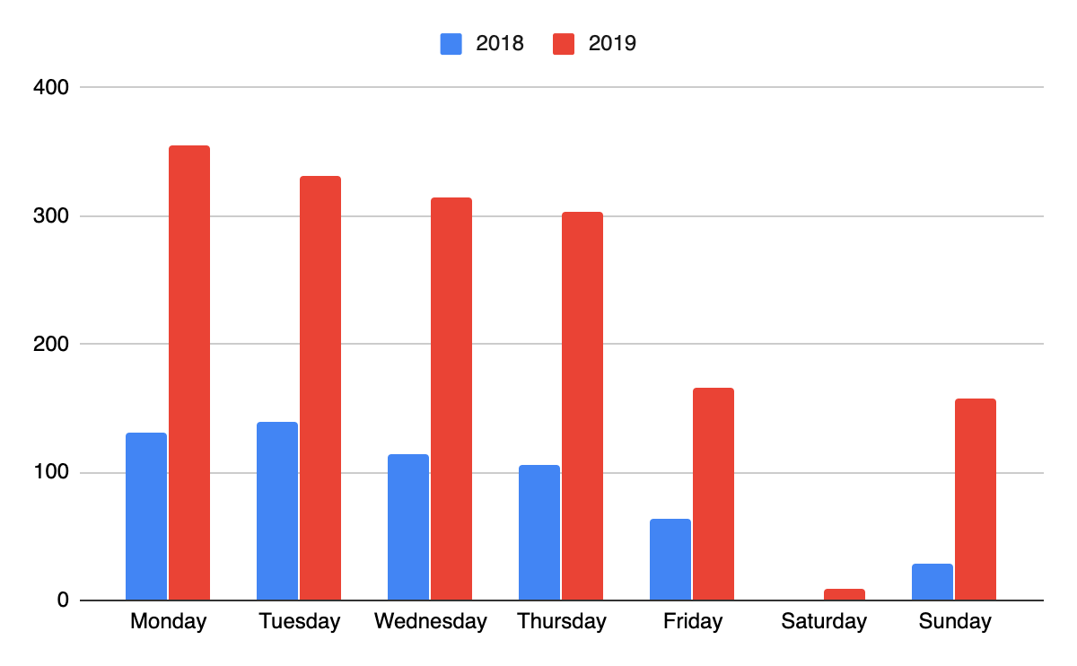
Chats by Day

Slide 20
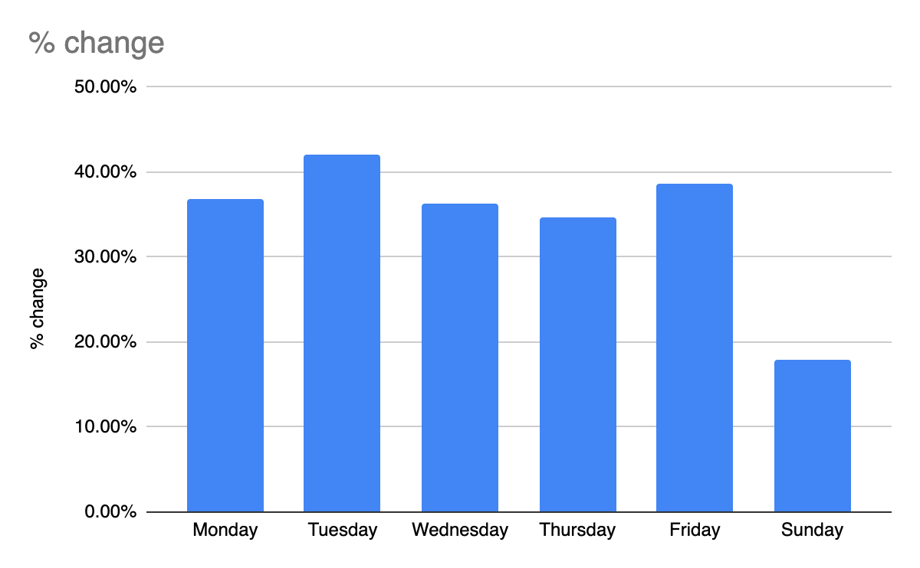
Percent Increase by Day

Slide 21
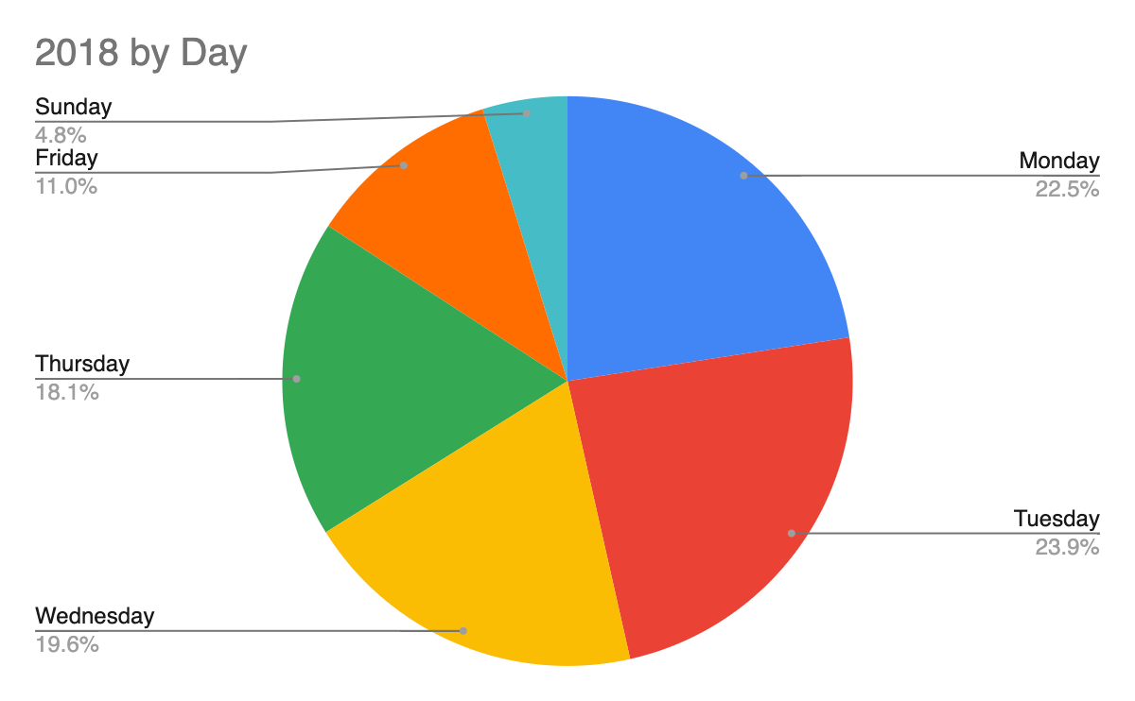
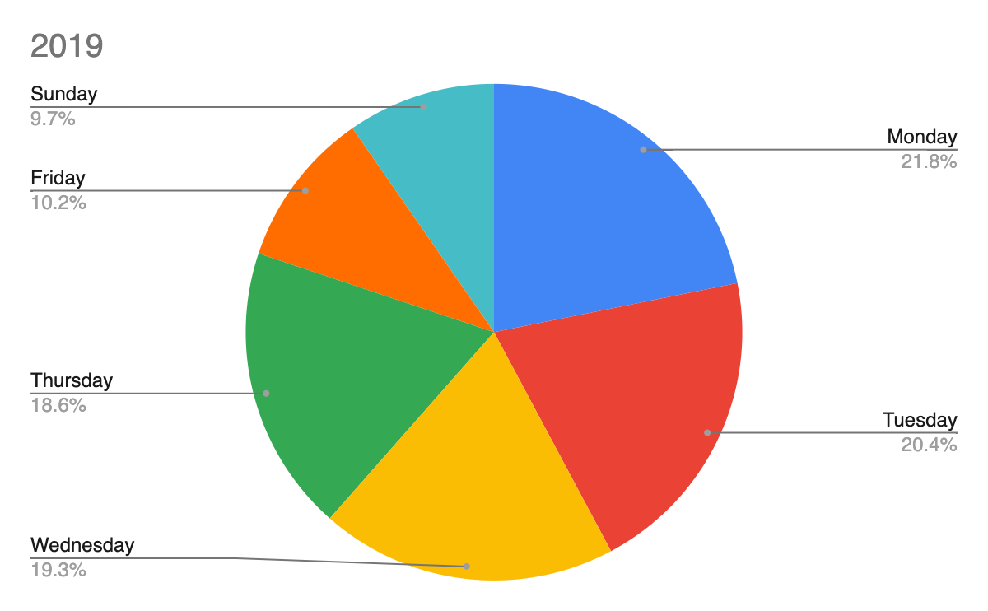
2018 vs. 2019 by Day
Notes:
Flow of the week and the semester didn’t change. Only the overall number of chat interactions did.

Slide 22
Where from and how Long
Referrer
In 2019, 577 chats came from the proactive chat widget. In 2018, we only had 581 chats total.
45% (477) of the increase in chat volume came through other methods.
Chat Duration:
Pre-Proactive-425.83 Seconds
Proactive-437.12 Seconds

Slide 23
Chat Contents 2018 vs. 2019

Slide 24
Text Analysis
We used Voyant Tools to analyze the contents of chat transactions
The data that we entered into the tool is the initial question of each transition
The entire transcripts produced a data set that was difficult with which to work.
We used a commons set of word to identify transactions that could be termed “reference” interactions and then used Voyant’s Relative Frequency measure to compare the appearance of these words in Spring 2018 and Spring 2019.
We then narrowed the terms to identify the type of help requested (article, book, printing, citation, textbook).

Slide 25
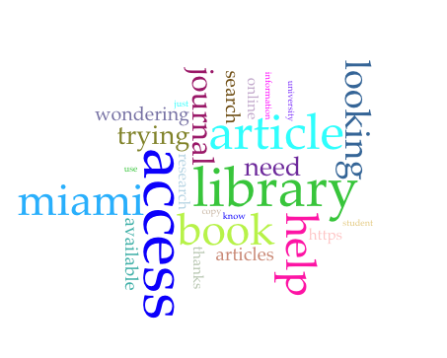
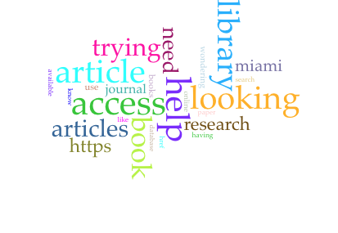
Most common word 2018 vs. 2019
2018
2019

Slide 26
Words I used to identify reference transactions
Article*
Access*
Help*
Book*
Journal*
Peer review*
Database*
Search*

Slide 27
Voyant Corpuses
2018
https://voyant-tools.org/?corpus=4cb93fdf4ff3a84352bc09b5adc1a682
2019
https://voyant-tools.org/?corpus=77f262002b83f4812d8b63b6db31d4a5

Slide 28
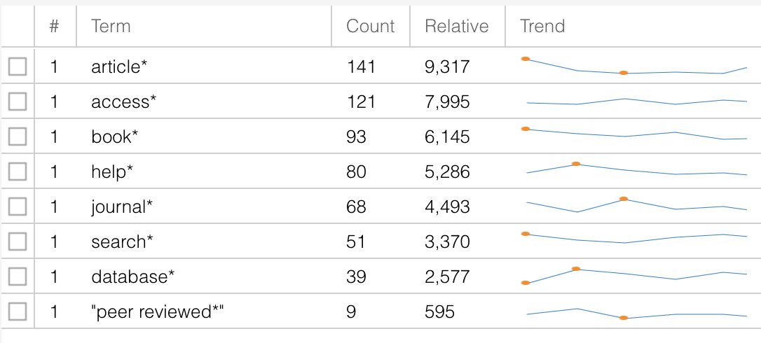
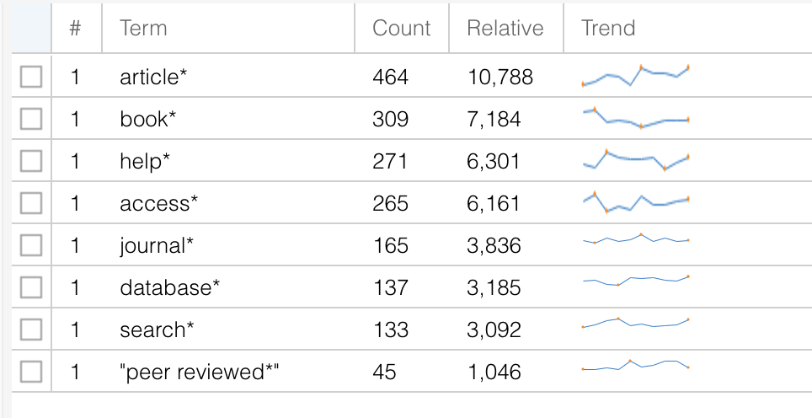
Reference Terms
2018
2019
Notes:
Slight uptick in many of the terms, but nothing to really indicate that proactive chat had an impact on the percentage of chats that could be termed “reference” interactions.

Slide 29
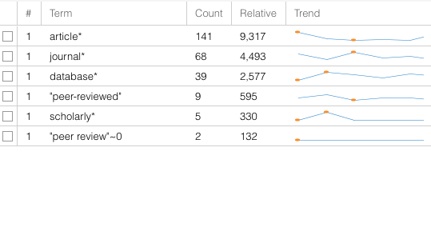
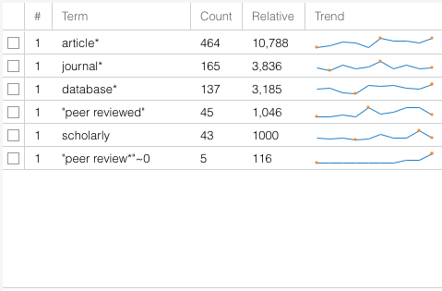
Words that Indicate an Article Search
2018
2019

Slide 30
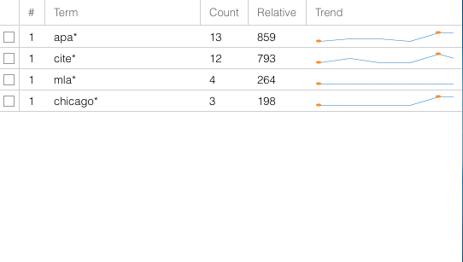
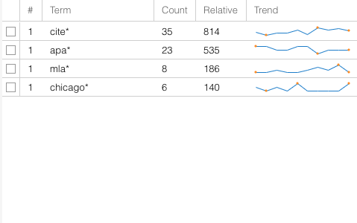
Words that Indicate Help with Citation
2018
2019

Slide 31
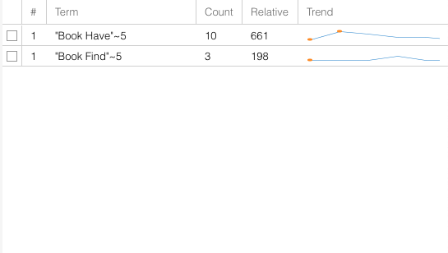
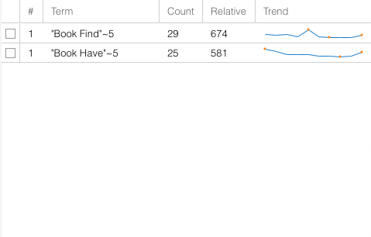
Words that Indicate a Book Search
2018
2019

Slide 32
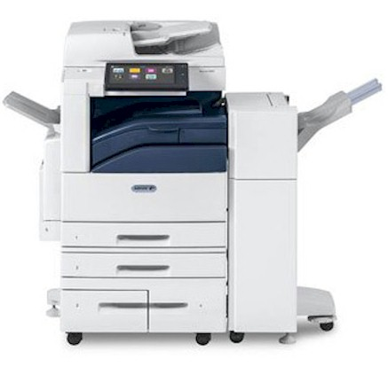
Increase in Printing Questions
2018: 3 (198 Relative)
2019: 22 (512 Relative)

Slide 33
Increase in Textbook Questions
2018: 4 (264 Relative)
2019: 22 (512 Relative)

Slide 34
Conclusion
Proactive chat increases the number of chats dramatically, but it does not affect the quality of the chat interactions. So, proactive chat increases the number of reference interactions between librarians and the university community.

Slide 35
Questions?

