Slide 1
Leading Together: Considering Academic Library Consortia Advocacy
Irene M.H. Herold
Librarian of the College
The College of Wooster
iherold@wooster.edu
On Twitter: ihero7

Slide 2
Definition of Consortium
Merriam Webster states the legal definition as:
“an agreement, combination, or group (as of companies) formed to undertake an enterprise beyond the resources of any one member.”

Slide 3
Definition of Advocacy
Using influence and persuasion
“Advocacy activities challenge people to step up and believe in the organization’s [work] – and to speak out for it.”
Koontz and Mon, (2014), Marketing and Social Media, 263.

Slide 4
Agreed upon goals of a consortia group
Goals
Student Success
Strategic Priorities
Budgetary
Legislative

Slide 5
Whatever the Goals You Need to Tell the Story

Slide 6
Some exemplars who tell their story well
LOUIS = The Louisiana Library Network
https://www.louislibraries.org/

Slide 7
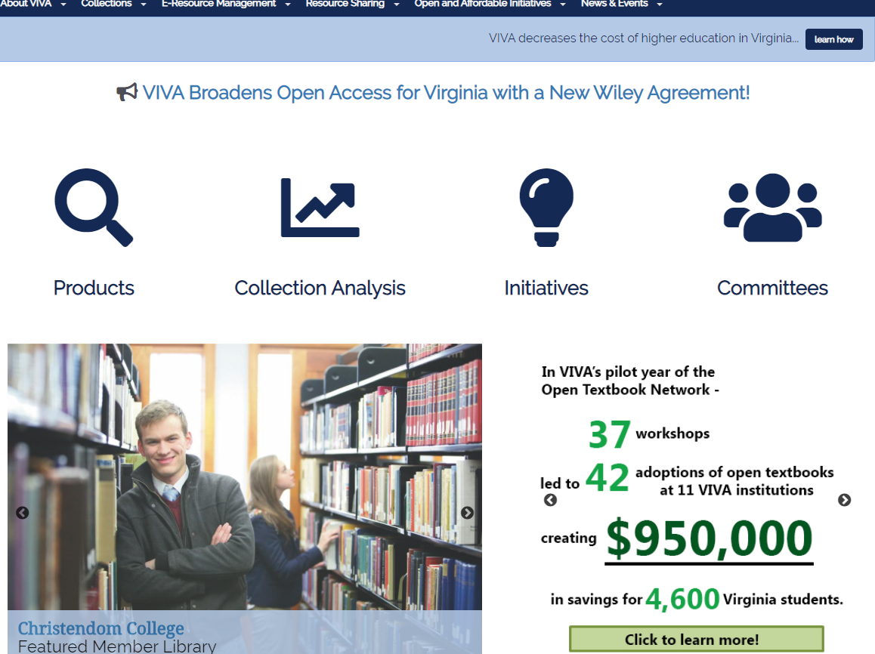
More exemplars who tell their story well
VIVA Virginia’s Academic Library Consortium
http://vivalib.org/c.php?g=833800&p=5953866

Slide 8
From a Press Release, February 2, 2018:
“VIVA Open Textbook Network: Student Savings Exceed Expectations in the Pilot Year!”

Slide 9
One more exemplar
Cooperating Libraries In Consortium
https://www.clic.edu/quick-facts

Slide 10
Considerations in Creating a Consortium Advocacy Plan
Process for Creating Change
What do we know about the landscape?
Notes:
Cr

Slide 11
Process of Creating Major Change via Leadership using John Kotter’s Model*
Establish direction
Align people (build your coalition)
Motivate and inspire (communicate the vision)
Other considerations:
Generate short term wins
Consolidate gains and produce more change
Anchor approaches in the culture
*Adapted from John P. Kotter, (1990), A Force for Change: How Leadership Differs from Management, New York: The Free Press & Leading Change (1996), Boston, MA: Harvard Business School Press.

Slide 12
Brainstorm the Changing Landscape:
What do we know about stakeholder needs and wants relevant to this question?*
What do we know about the current realities and evolving dynamics of our environment relevant to this question?*
What do we know about the capacity and strategic position of our organizations relevant to this question?*
What are the ethical implications?

Slide 13
Think, Pair, Share
Take 1 minute to think about something you want addressed at the consortium level
Take 1 minute to consider the landscape questions:
What do we know about stakeholder needs and wants relevant to this question?
What do we know about the current realities and evolving dynamics of our environment relevant to this question?
What do we know about the capacity and strategic position of our organizations relevant to this question?
What are the ethical implications?
Take 3 minutes to share with someone/someones seated near you
We will take 6 minutes to hear what a few of you wish to share

Slide 14
Matching the Media with the Message
Social Media
Following to be informed
Using that knowledge
Where do you place information?
Push?
Pull?
Interactive?

Slide 15
Attention Grabbers/Not Passive
Who do you have telling the story?
Include uses
Recruit voices of superstars
Contextualize your data

Slide 16
You already have conveyed the consortial value. So how does that translate into what your top administrators care about?
Tell THAT story.
You might find Kurt Lewin’s Force Field Analysis a useful tool.

Slide 17
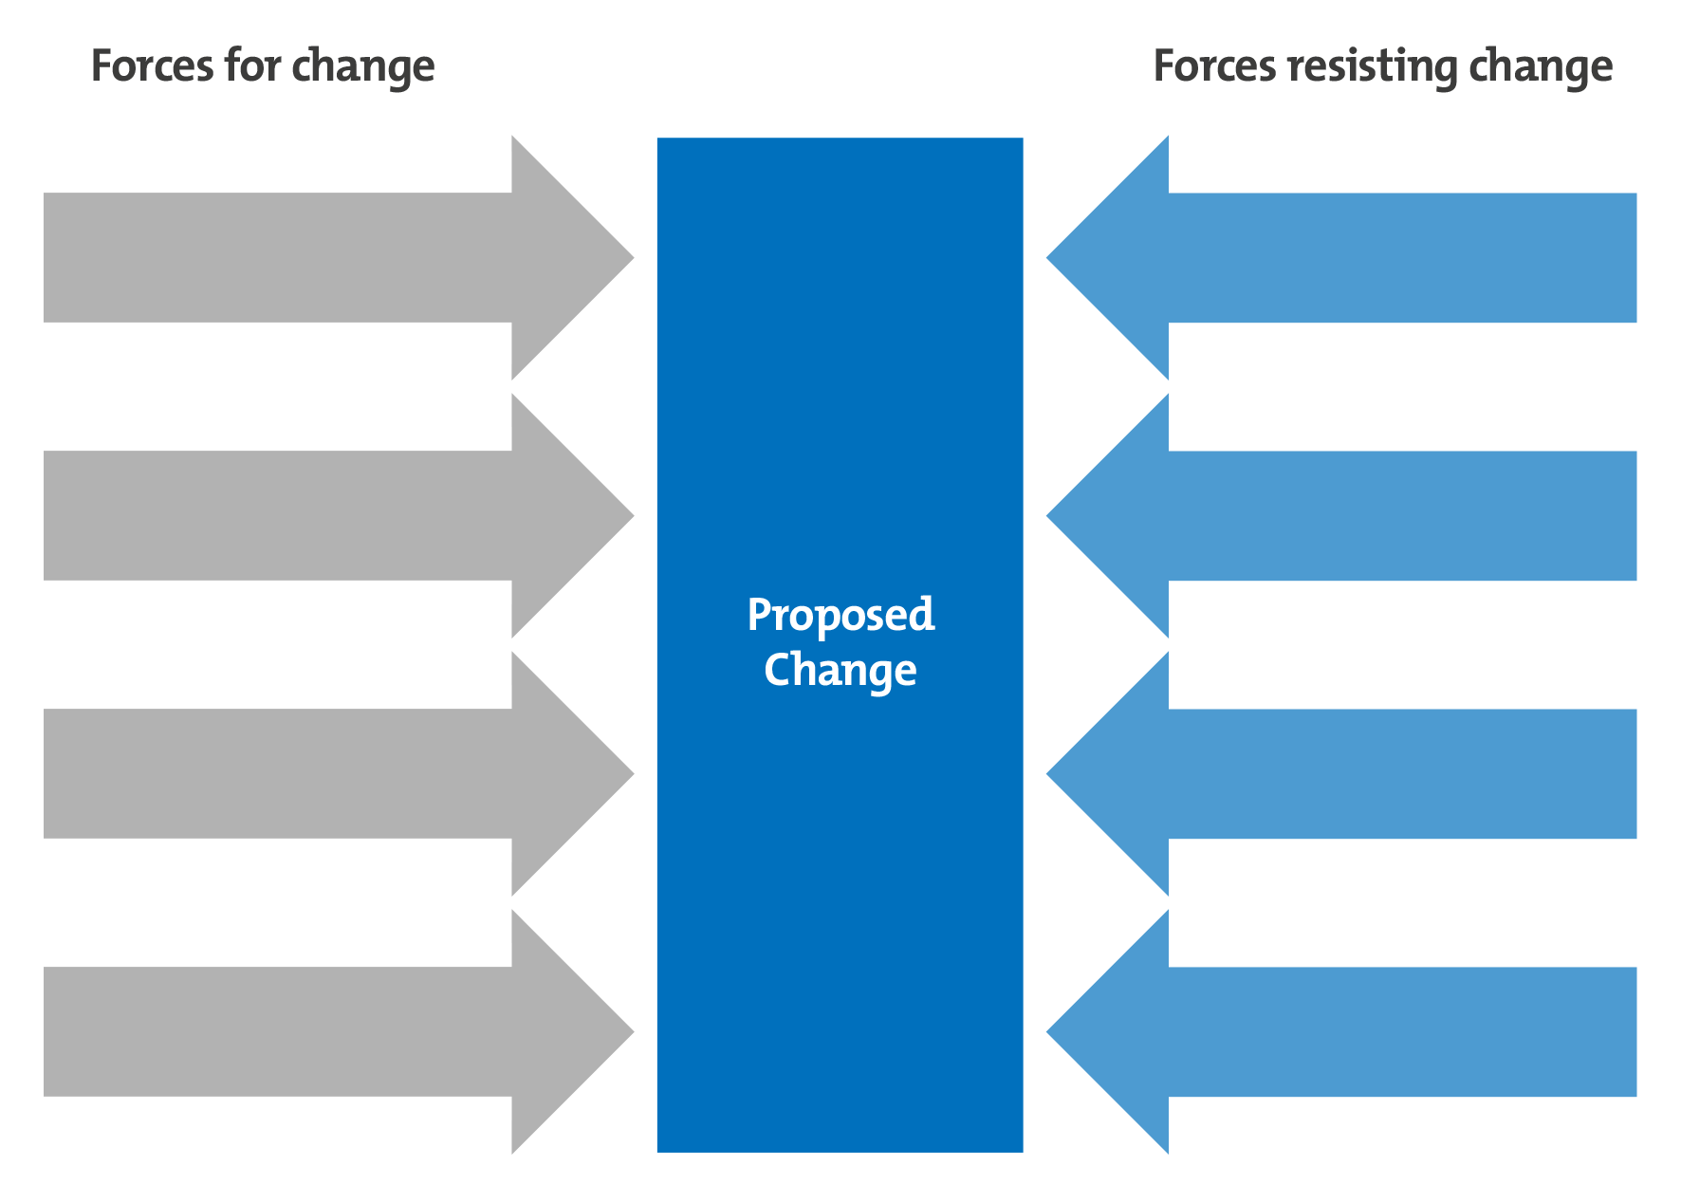
Image from: https://www.mindtools.com/pages/article/newTED_06.htm

Slide 18
Provide a place for community to provide feedback, stories, new ideas
What is the message?
How can the Libraries as a consortium connect their messages to it?
Which departments/institutions have messaged successfully?
What did they do?

Slide 19
Your Plan: Five Steps
Vision
Articulation of Needs
Design of Scripts
Format
Schedule

Slide 20
Assessing Success
Was there a change?

Slide 21
My case study
What happened when I worked with a state-wide academic library consortium and the outcome

Slide 22
Questions? Thoughts on what you might do next?
Thank you!

