Slide 1
Learning to Listen Up: Advocating for & Collaborating with Student Employees for a More Effective Workforce
Heidi Gauder, Heather Ruch, Cristin Bushnell 2019 ALAO conference

Slide 2
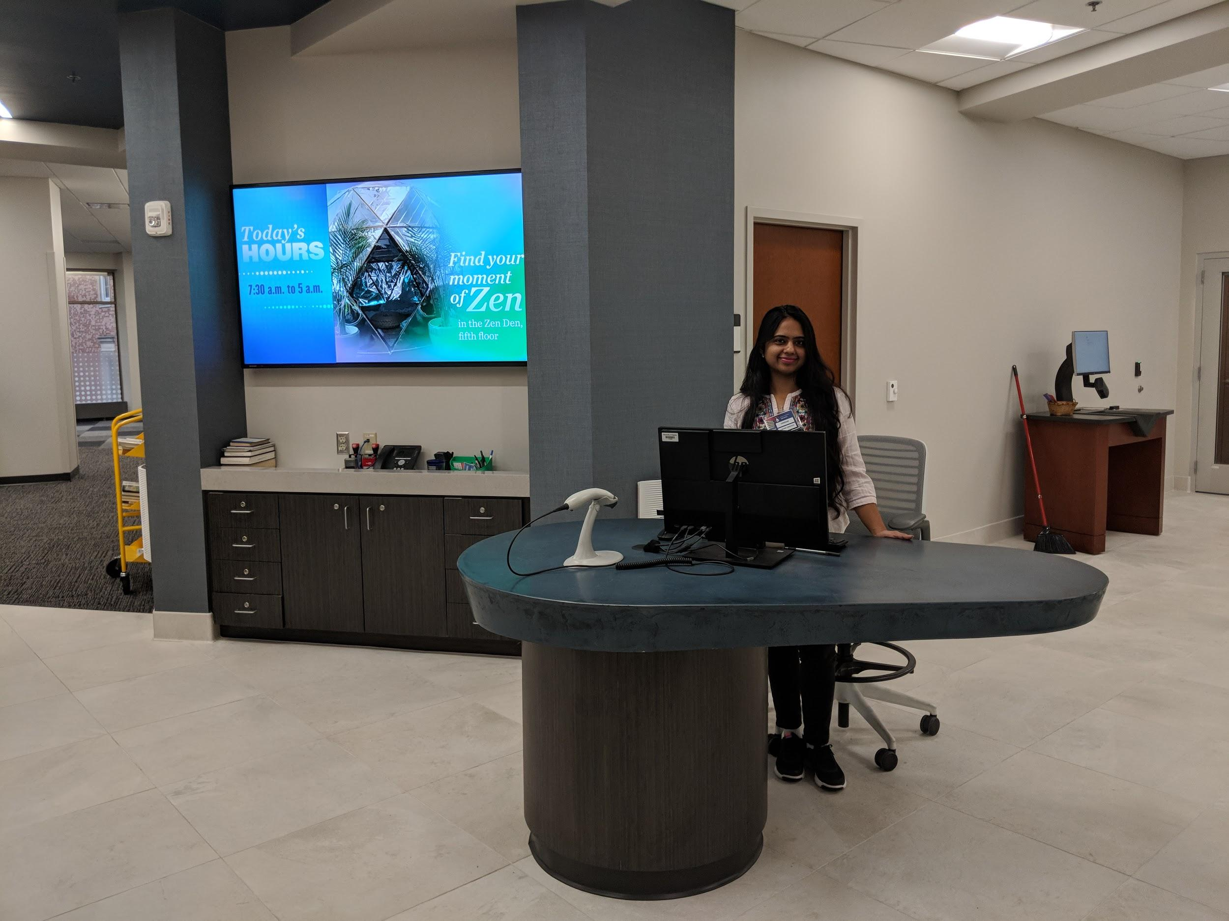
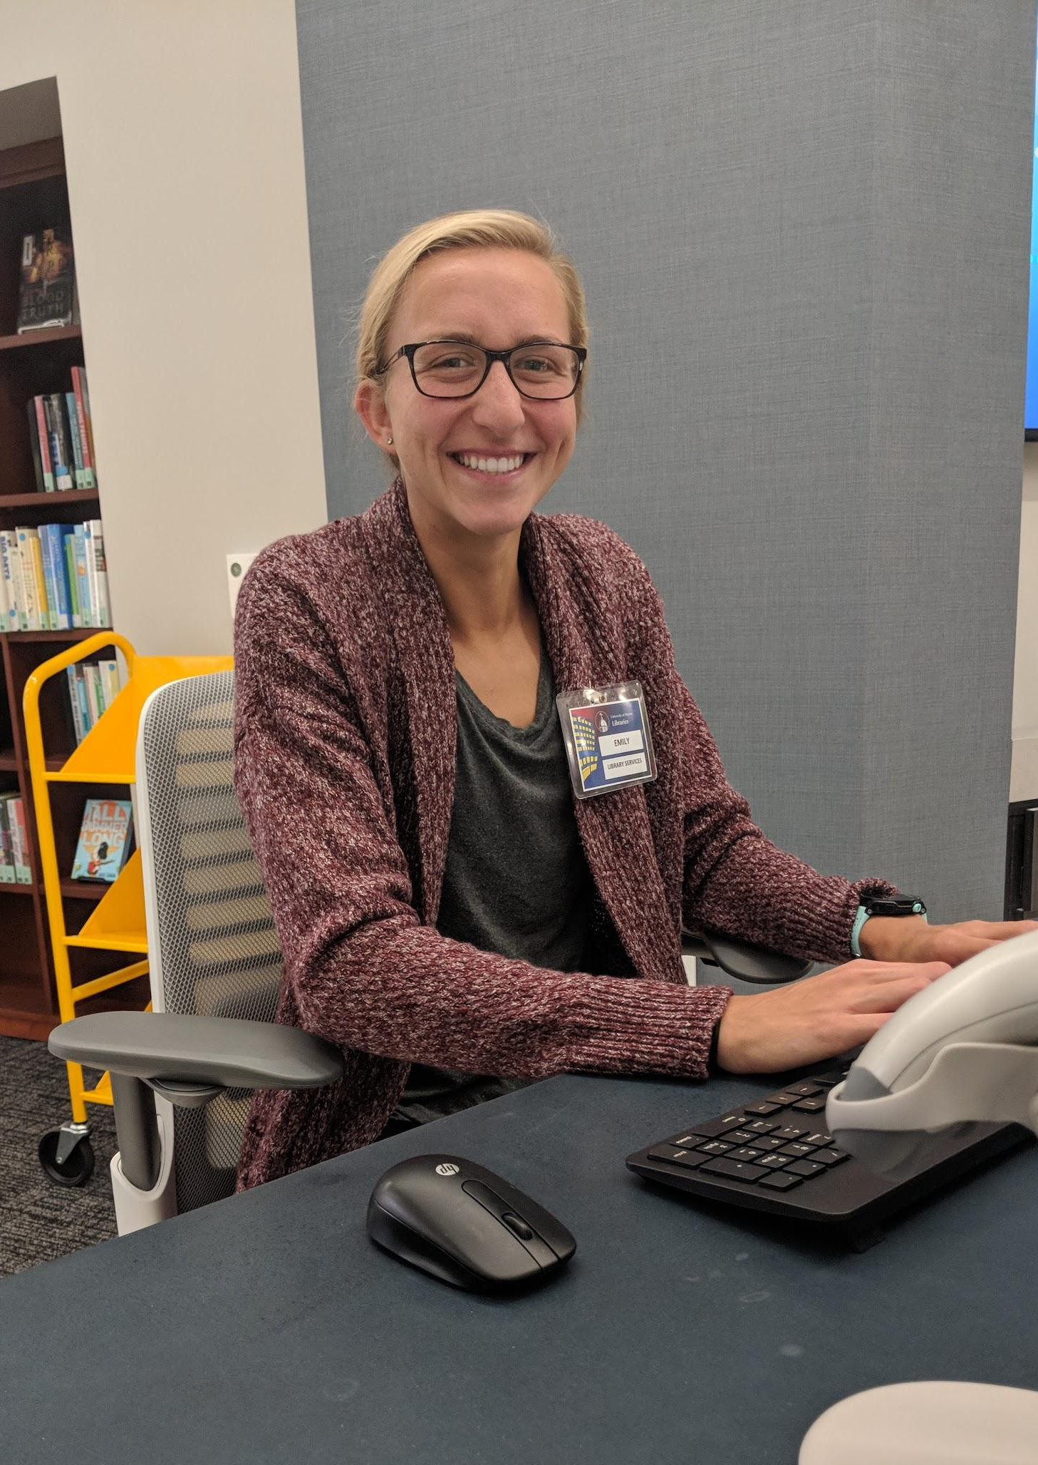
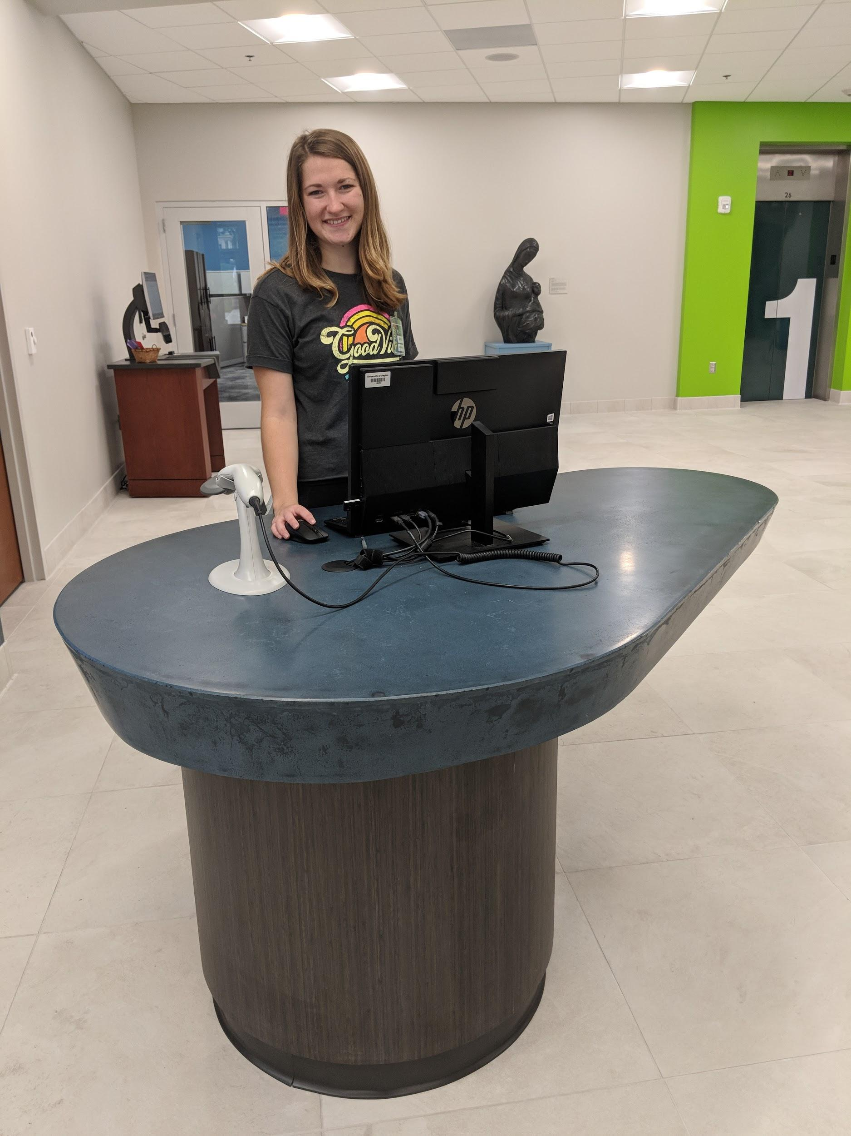
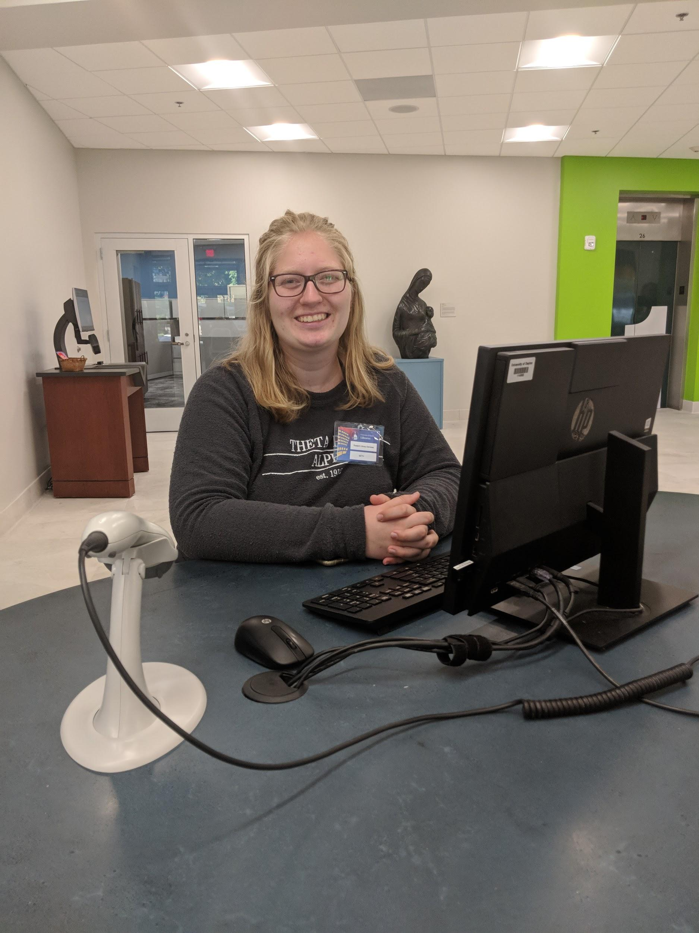
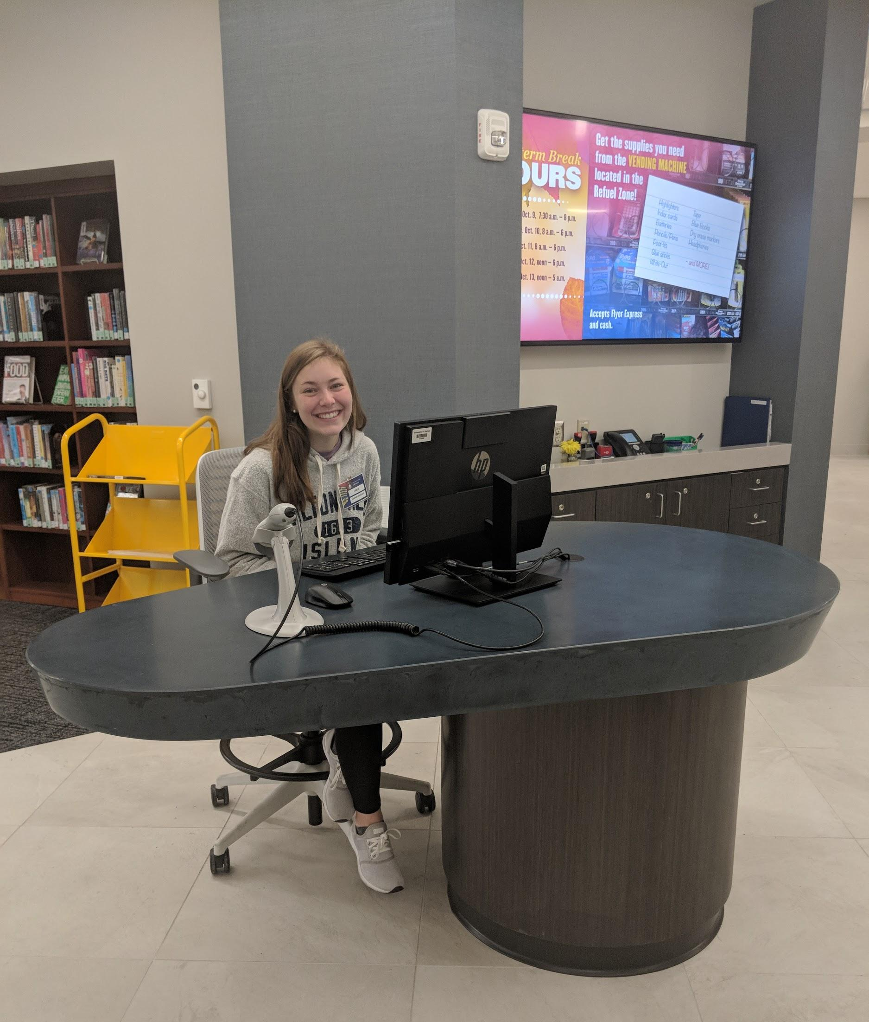
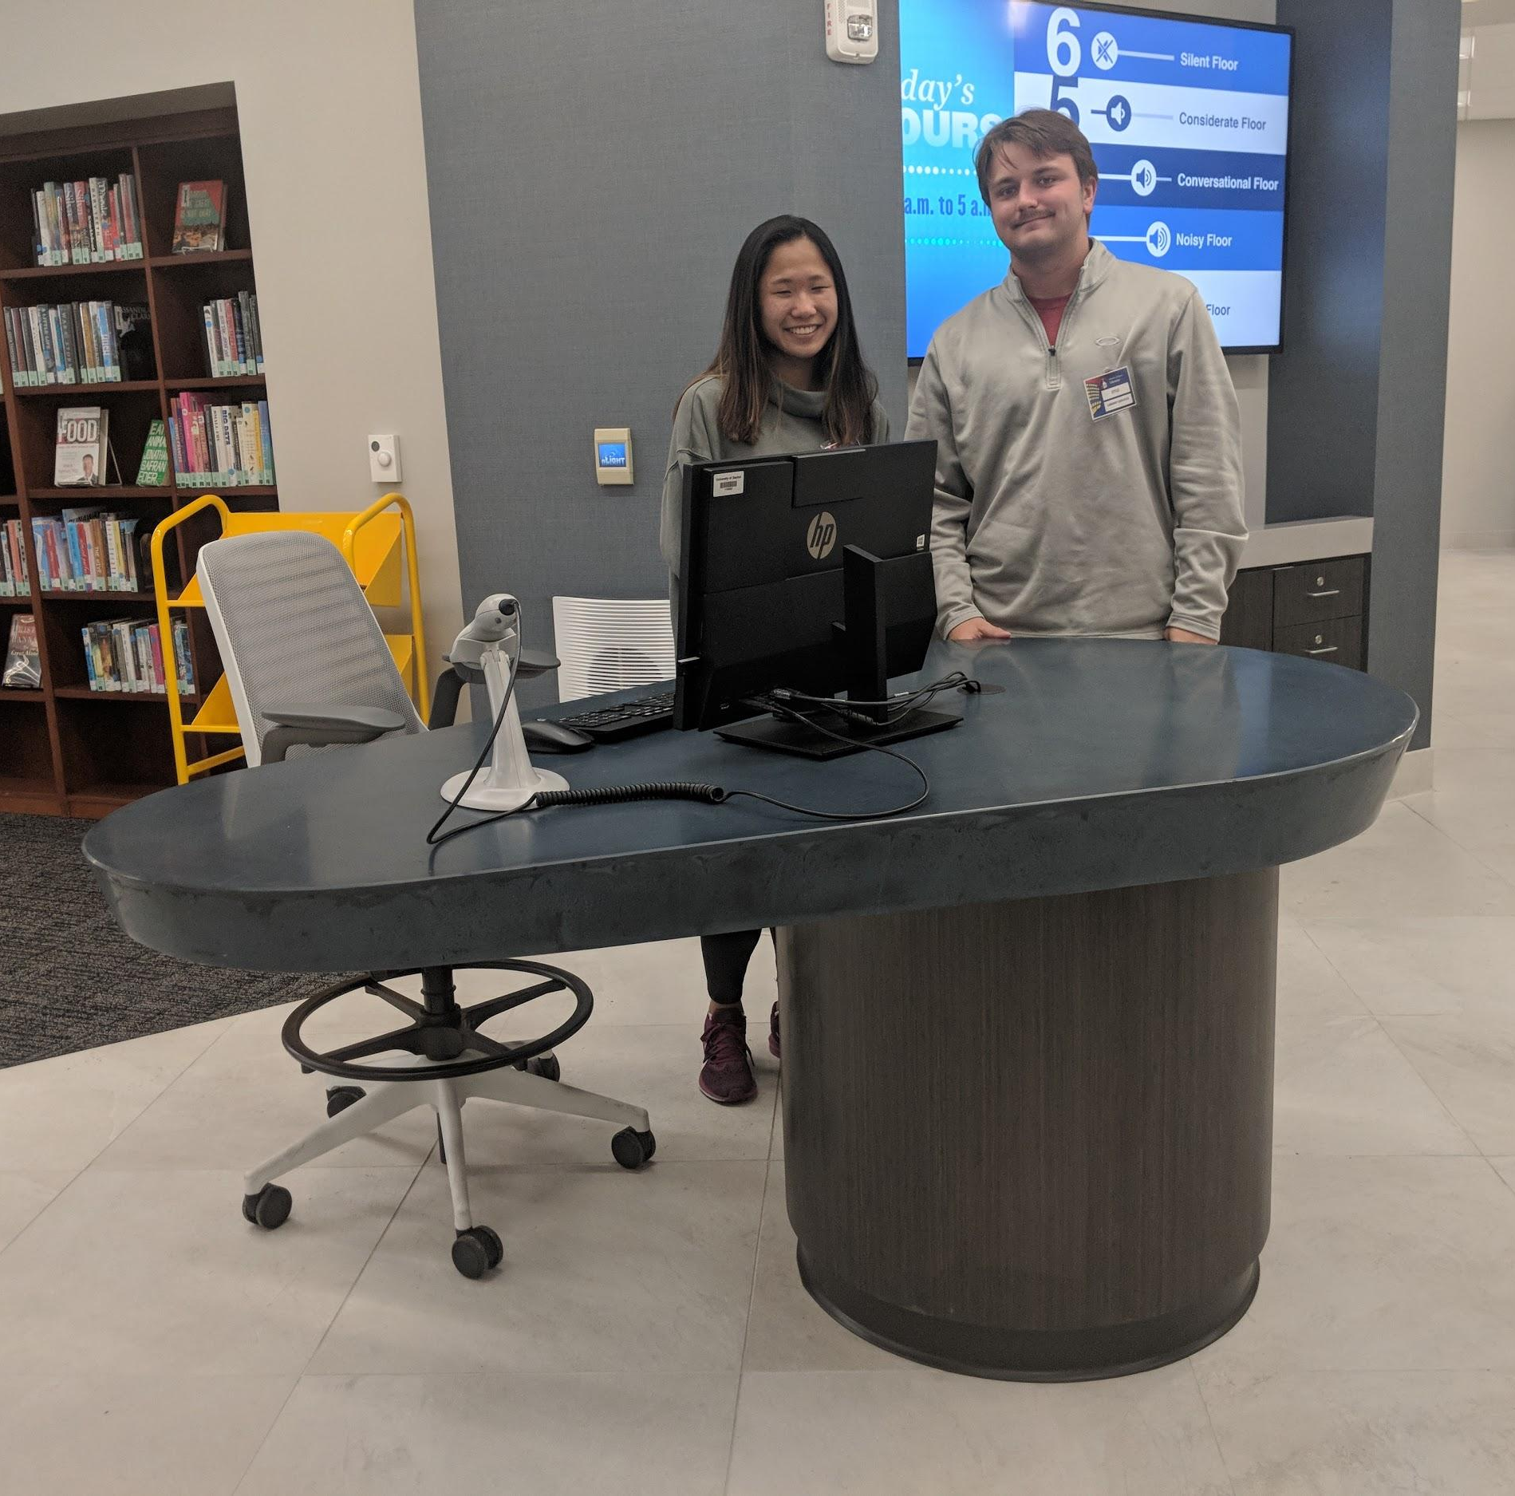
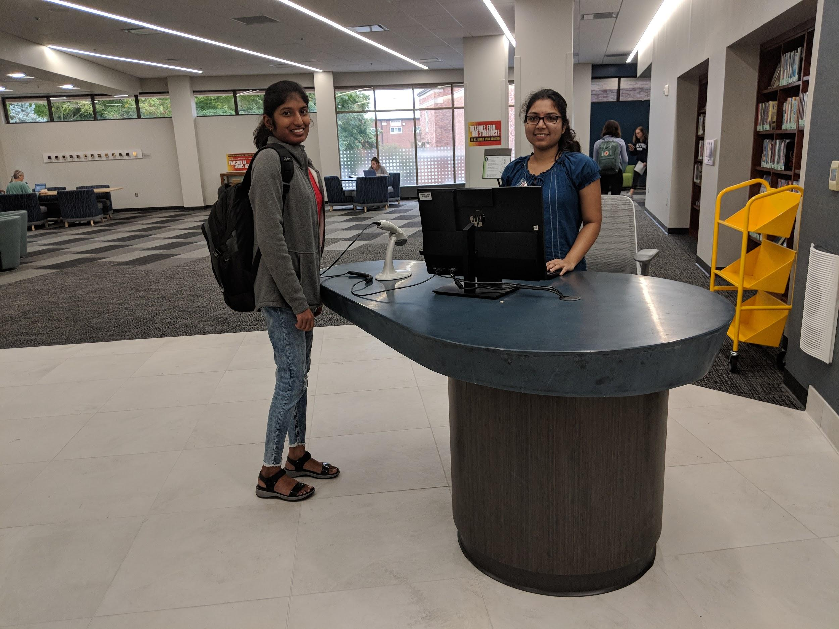
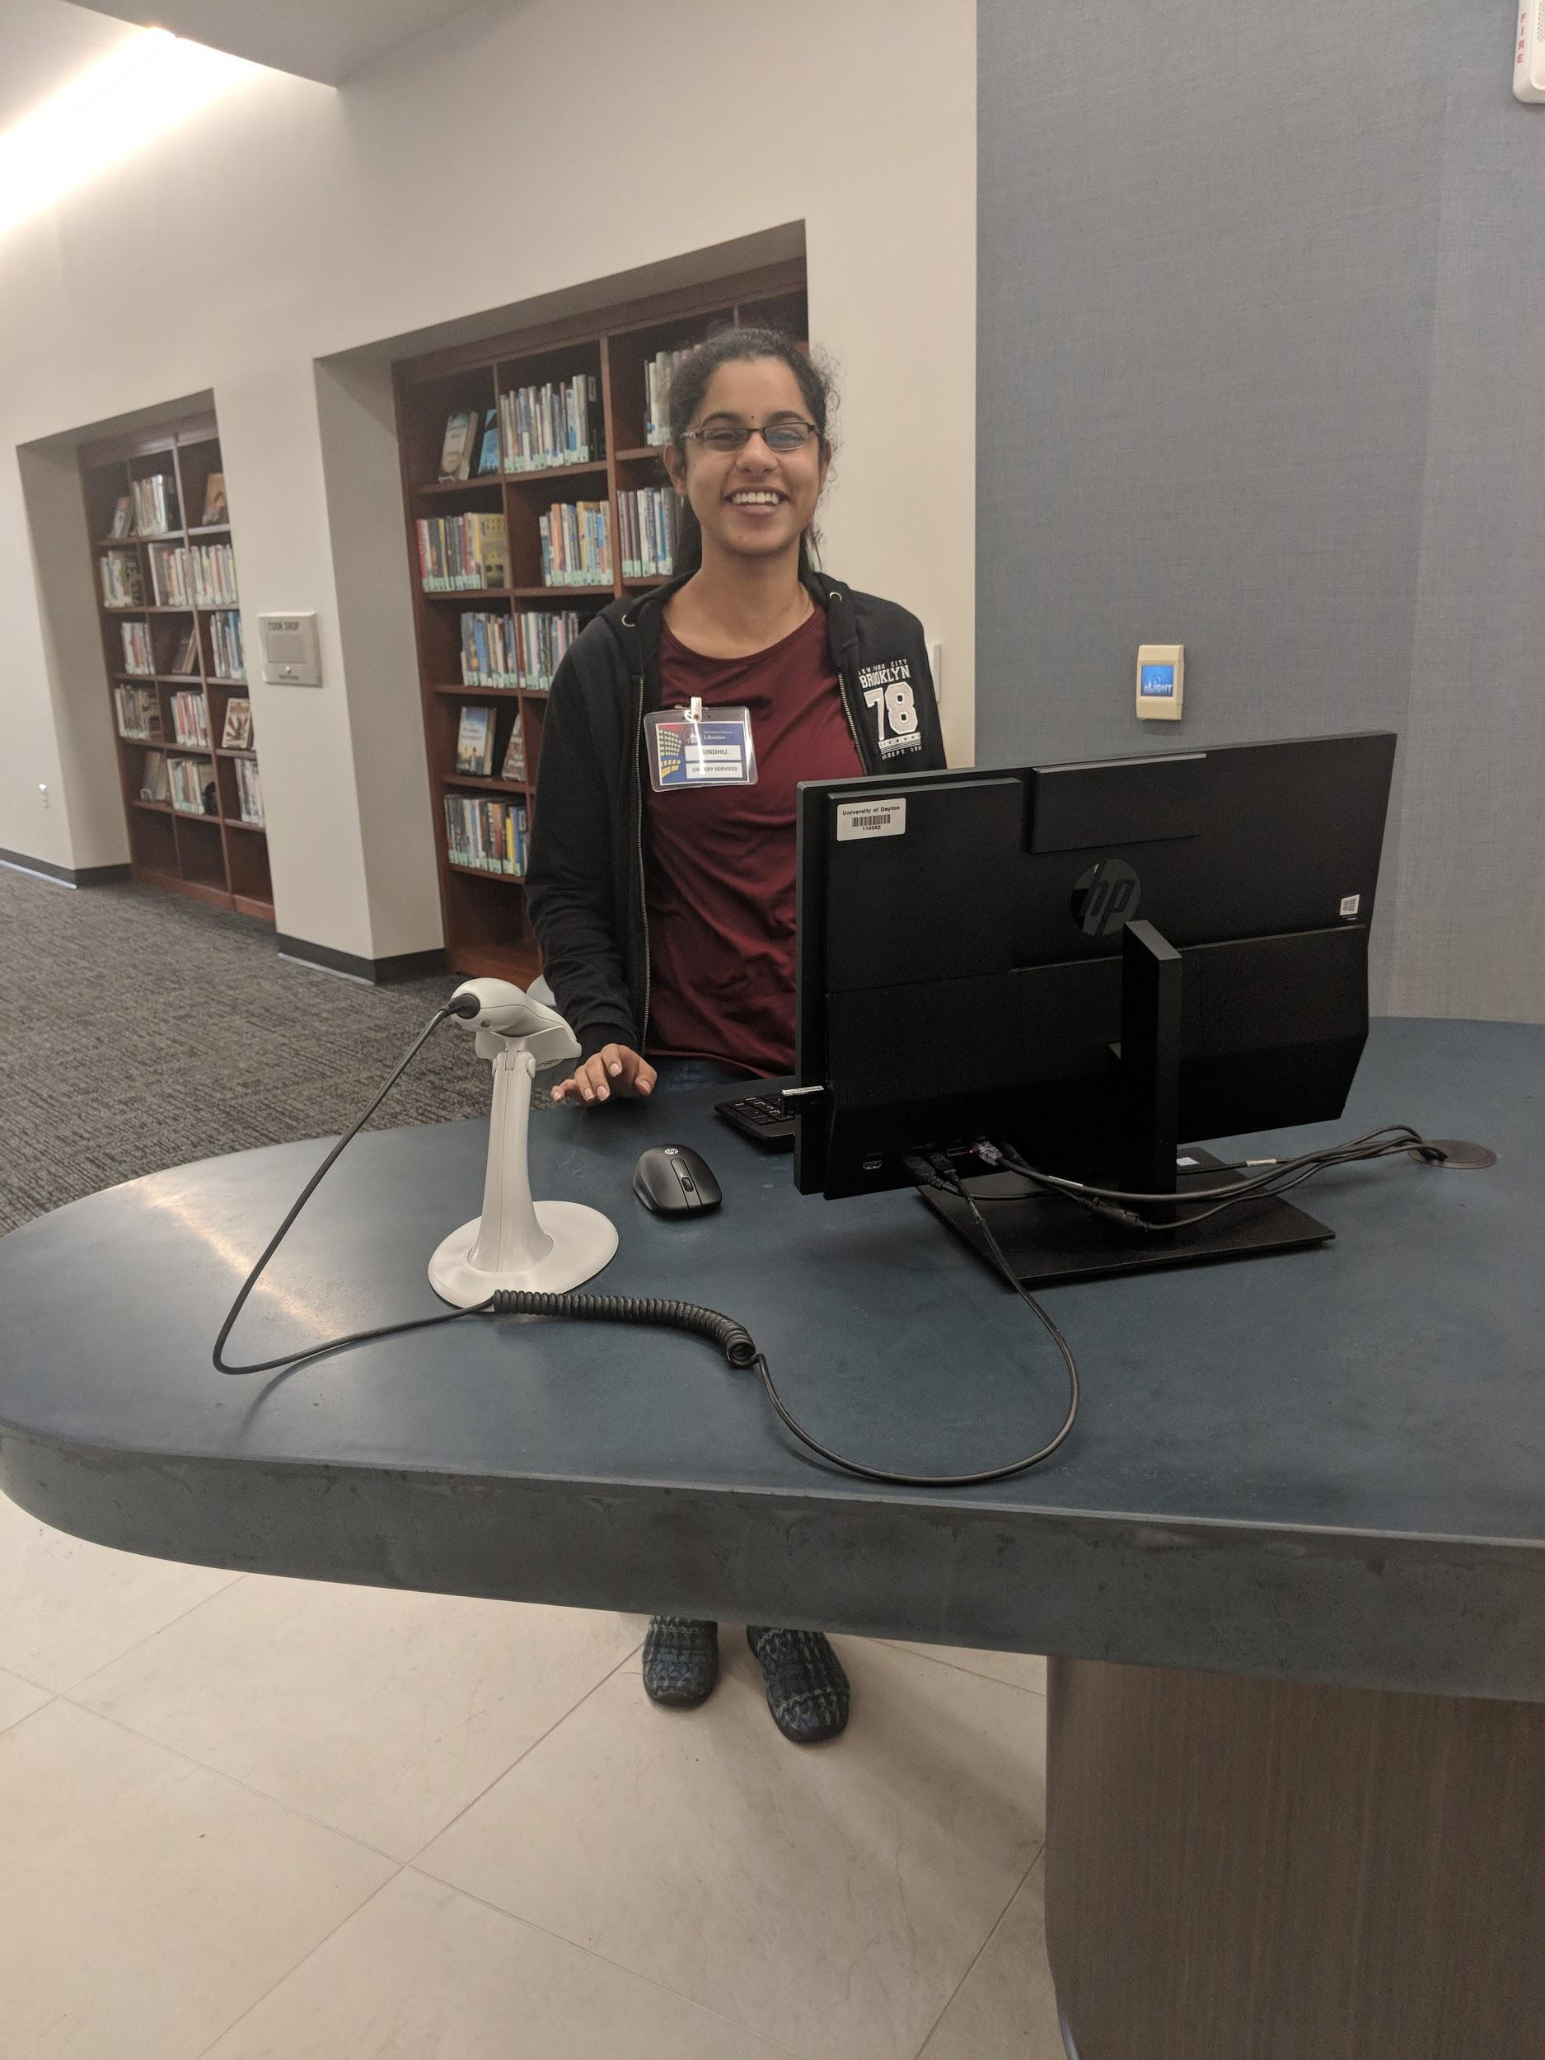
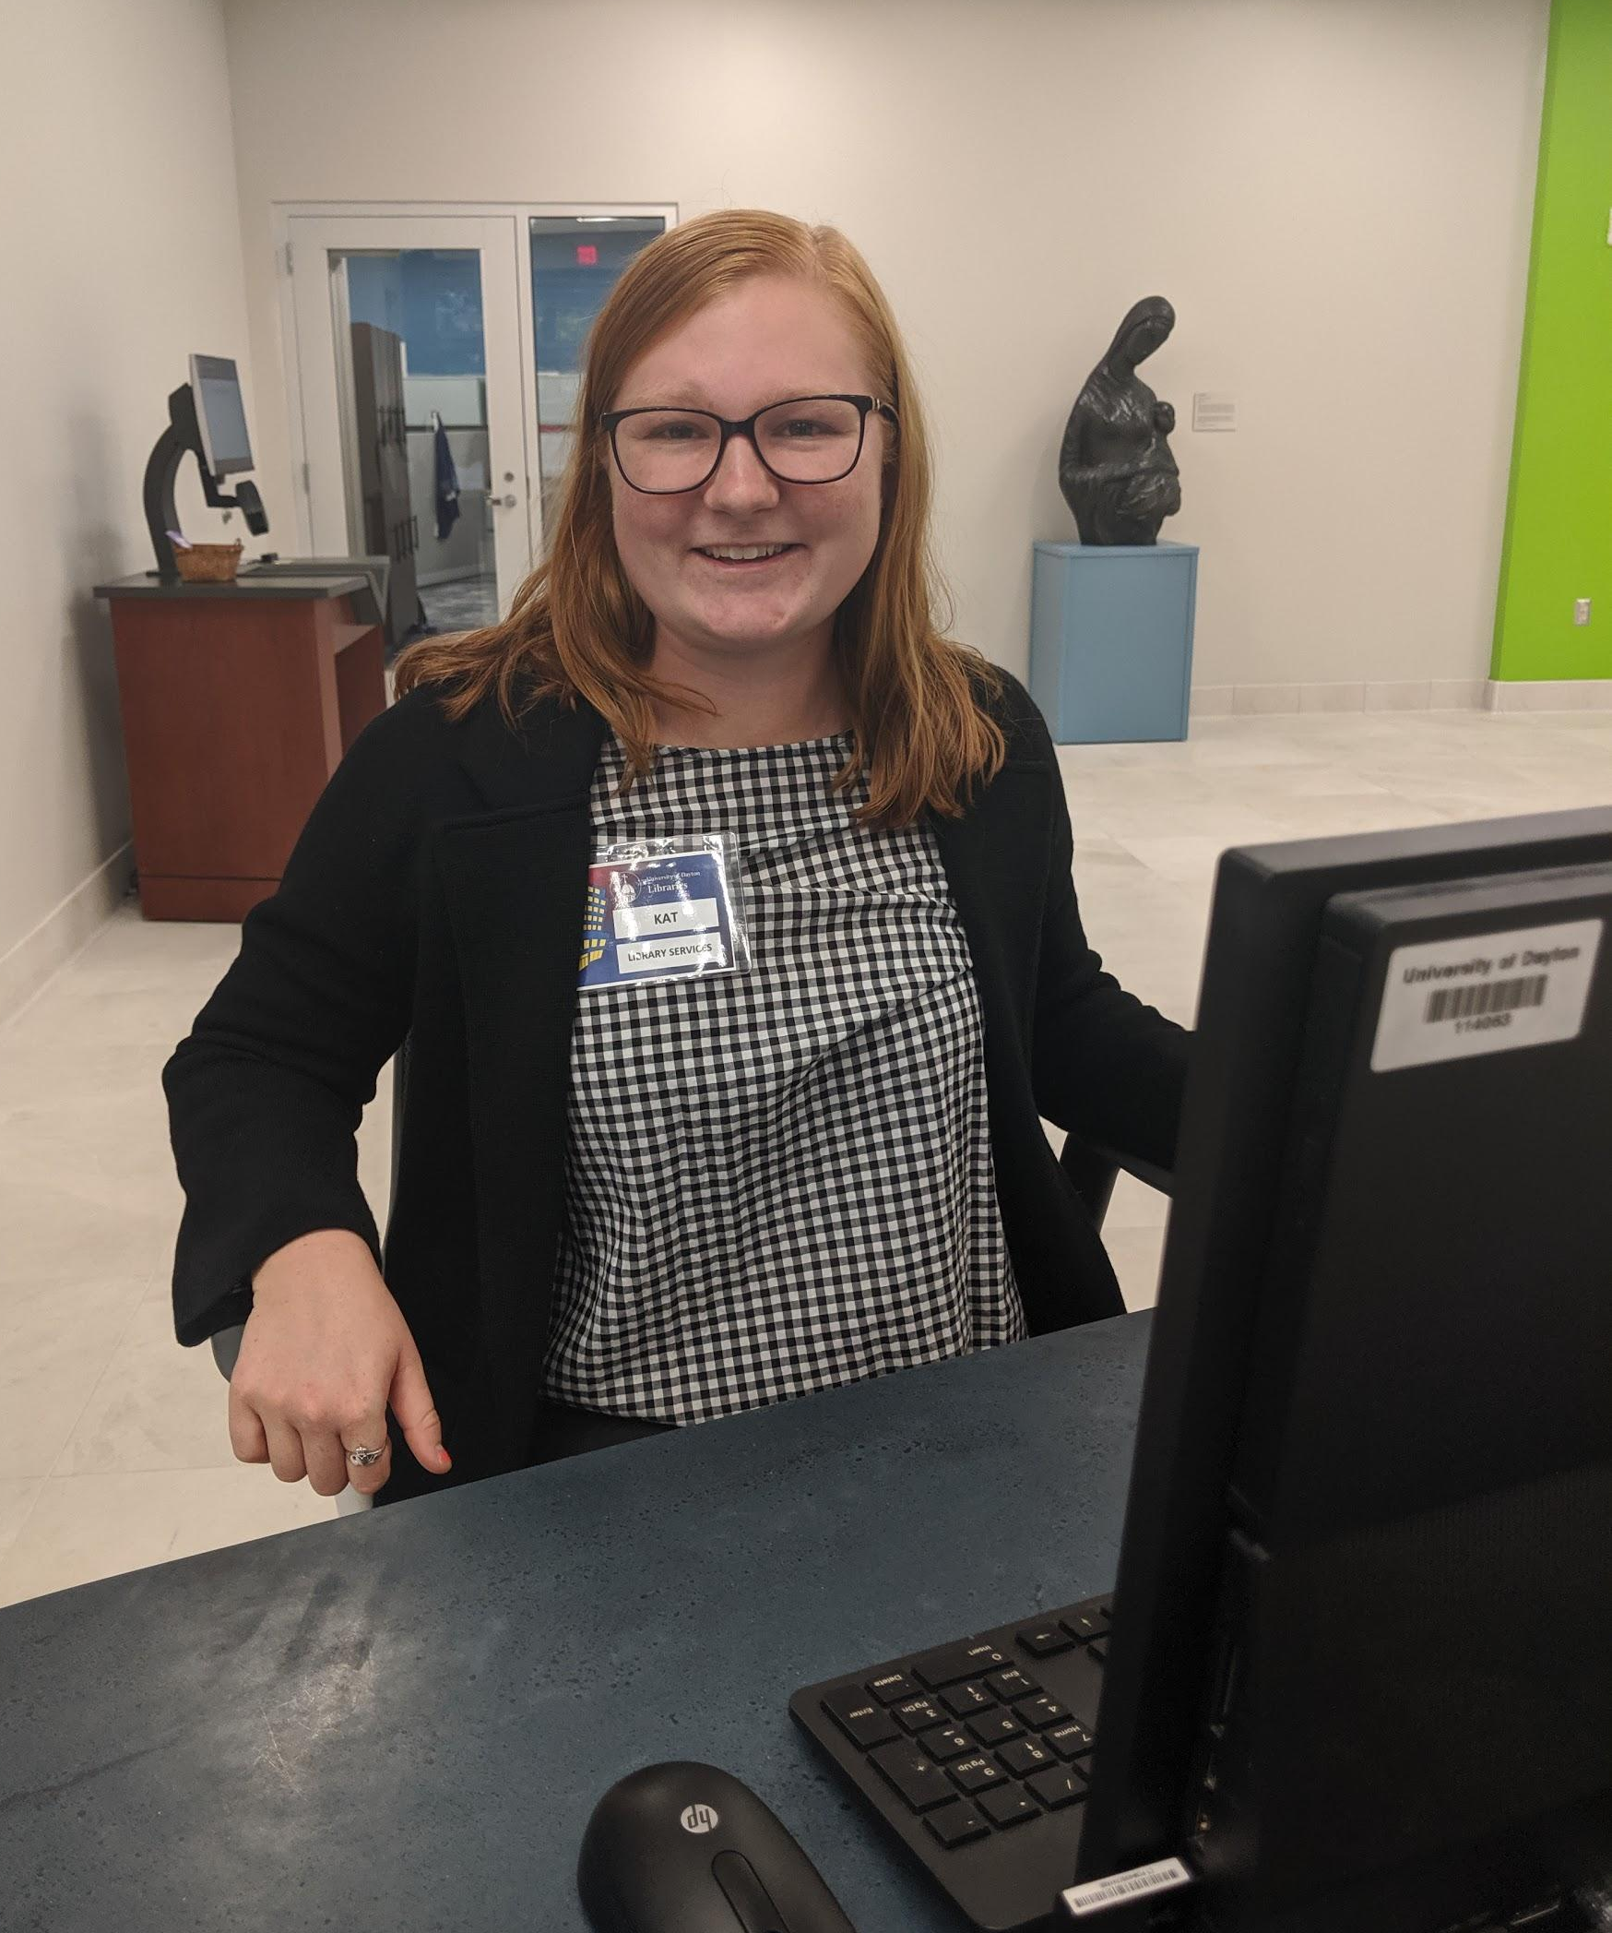
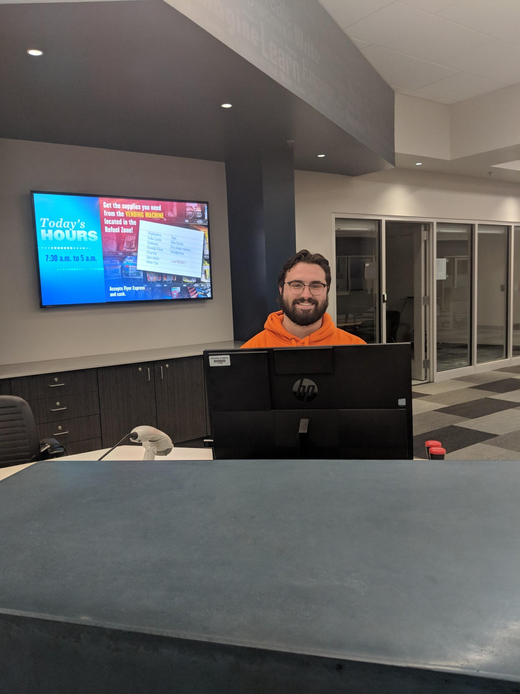
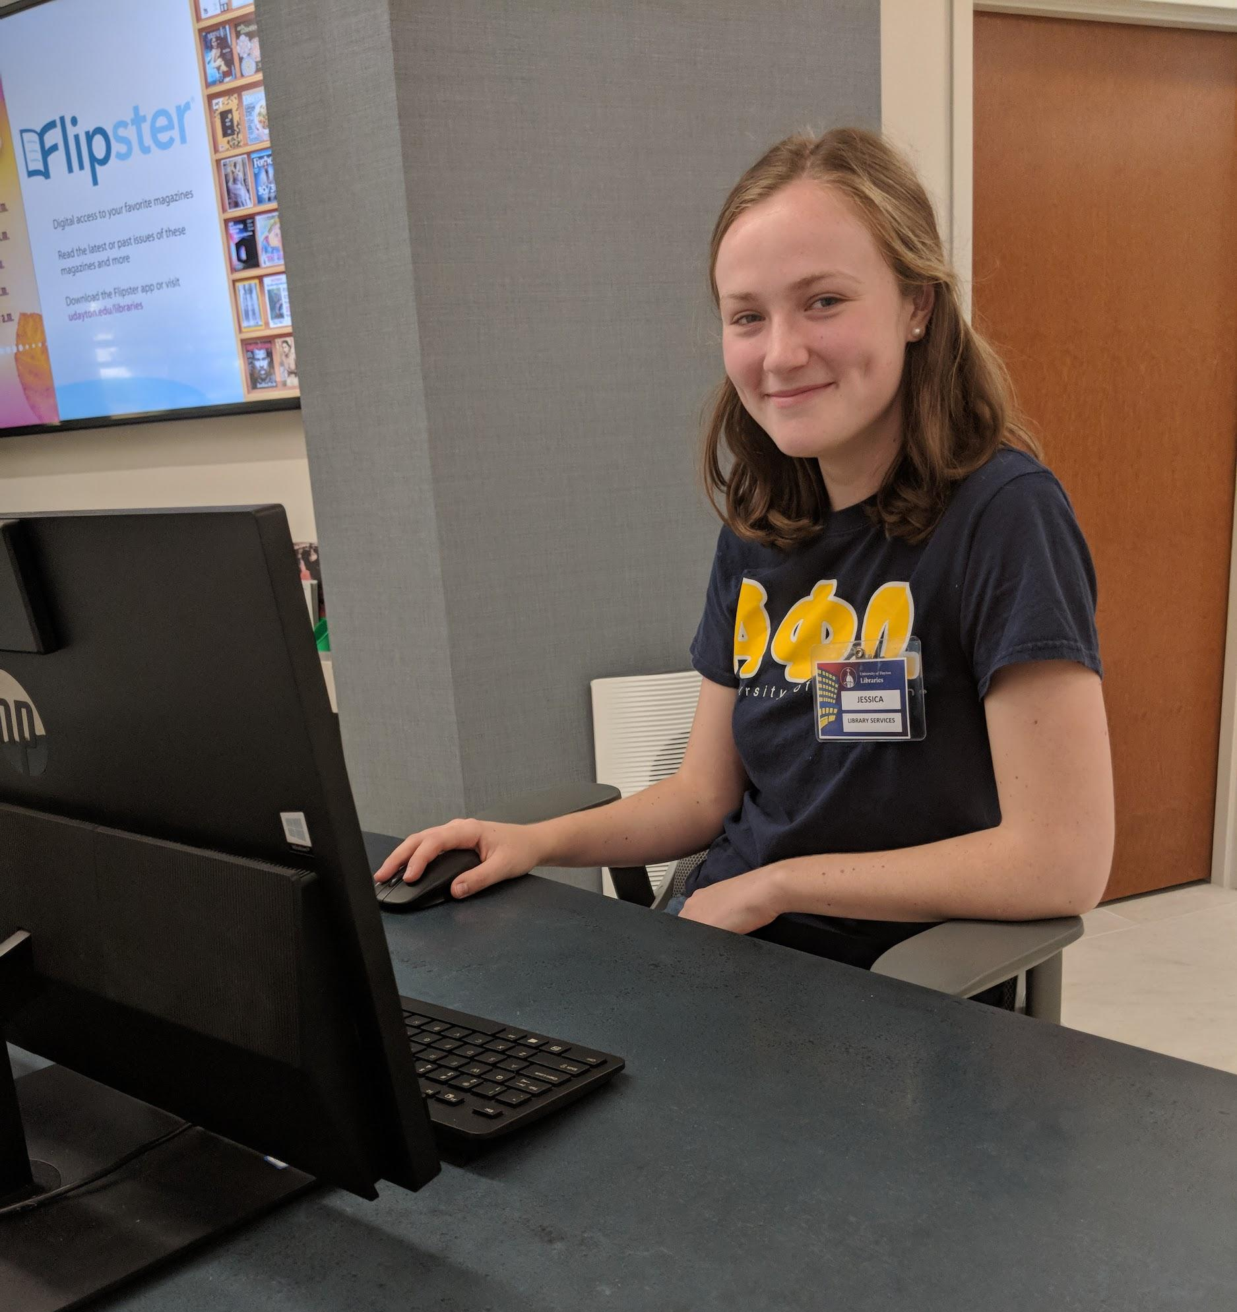
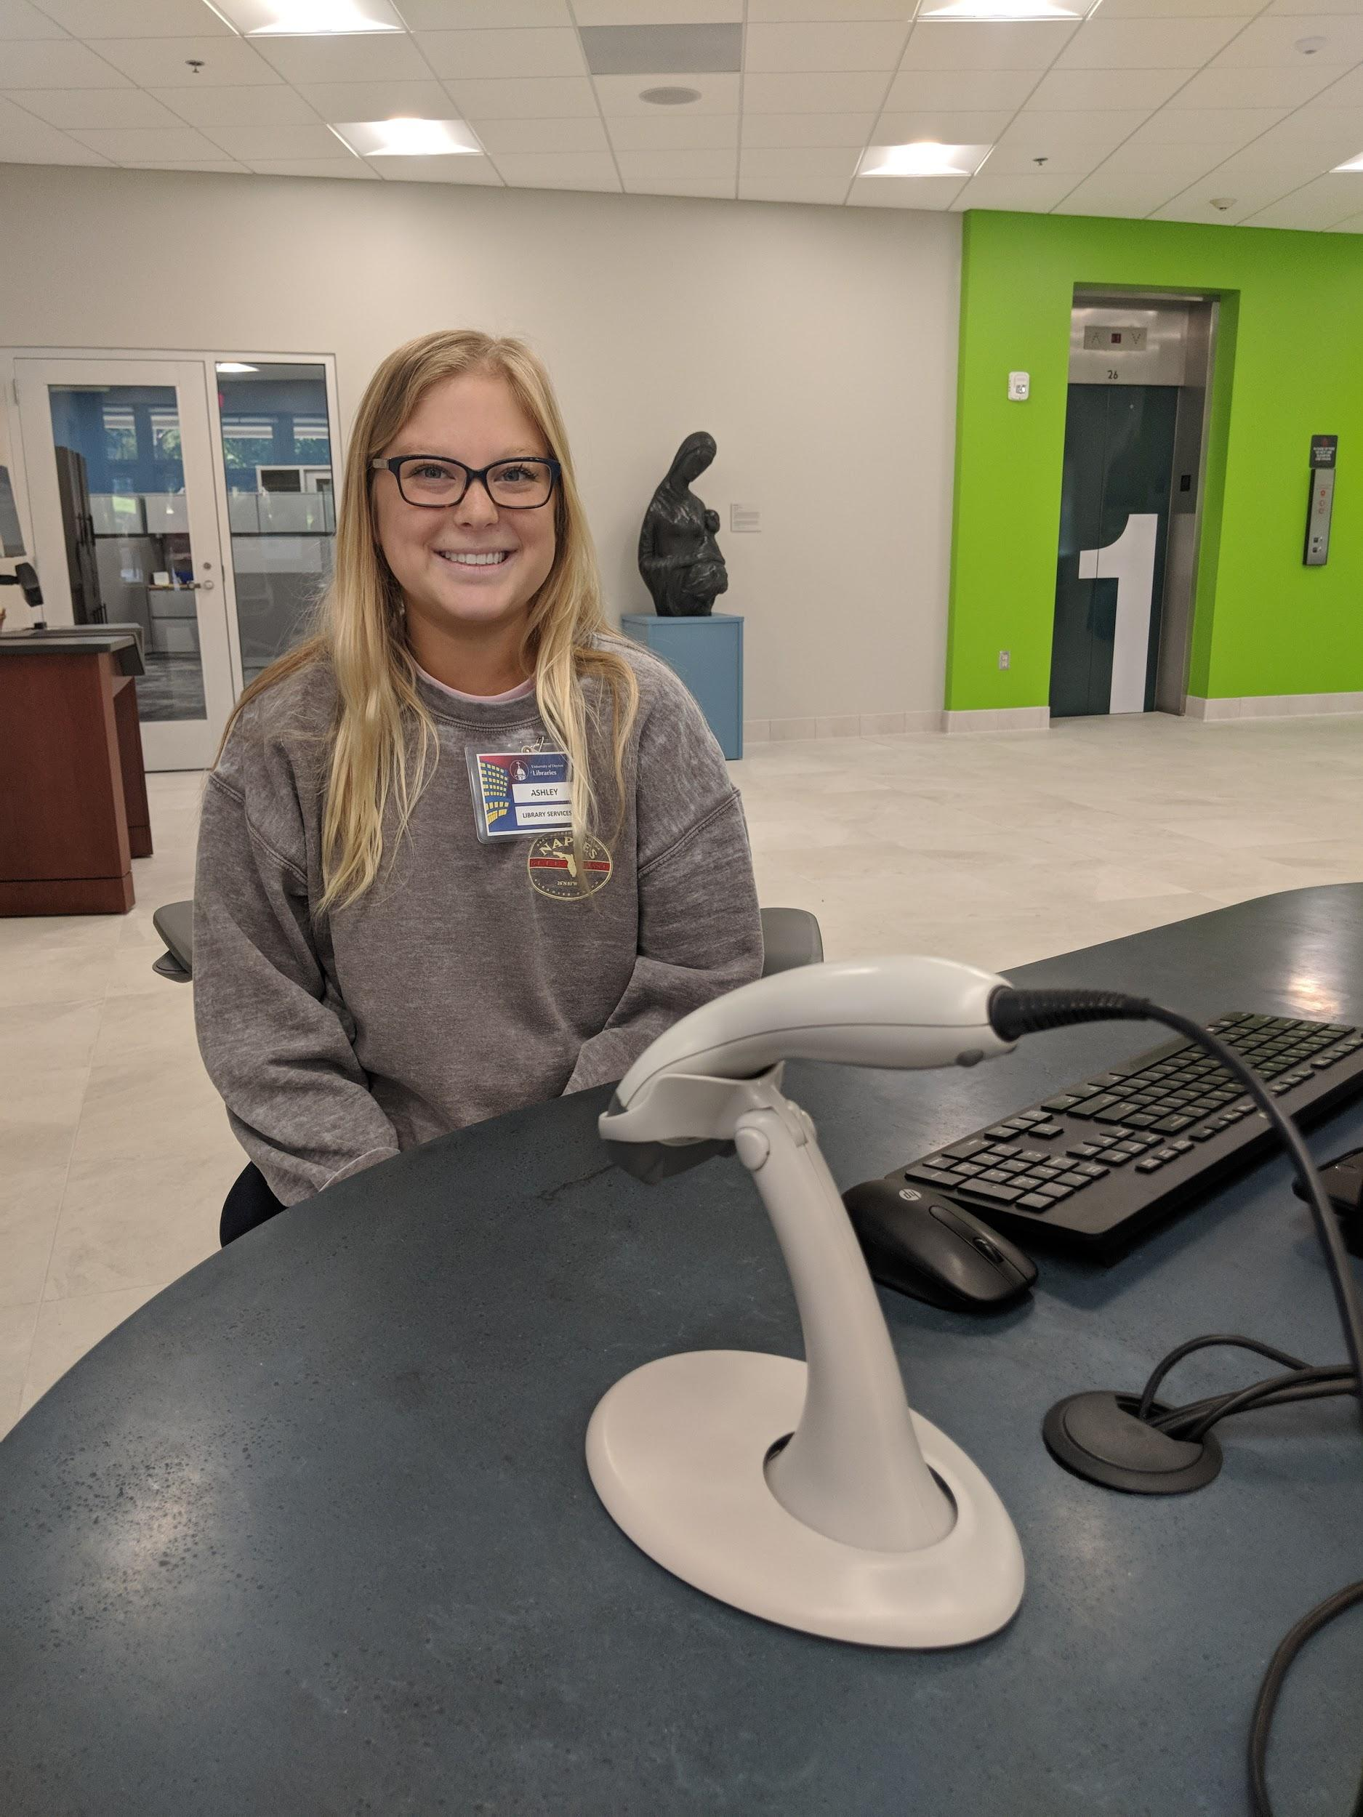
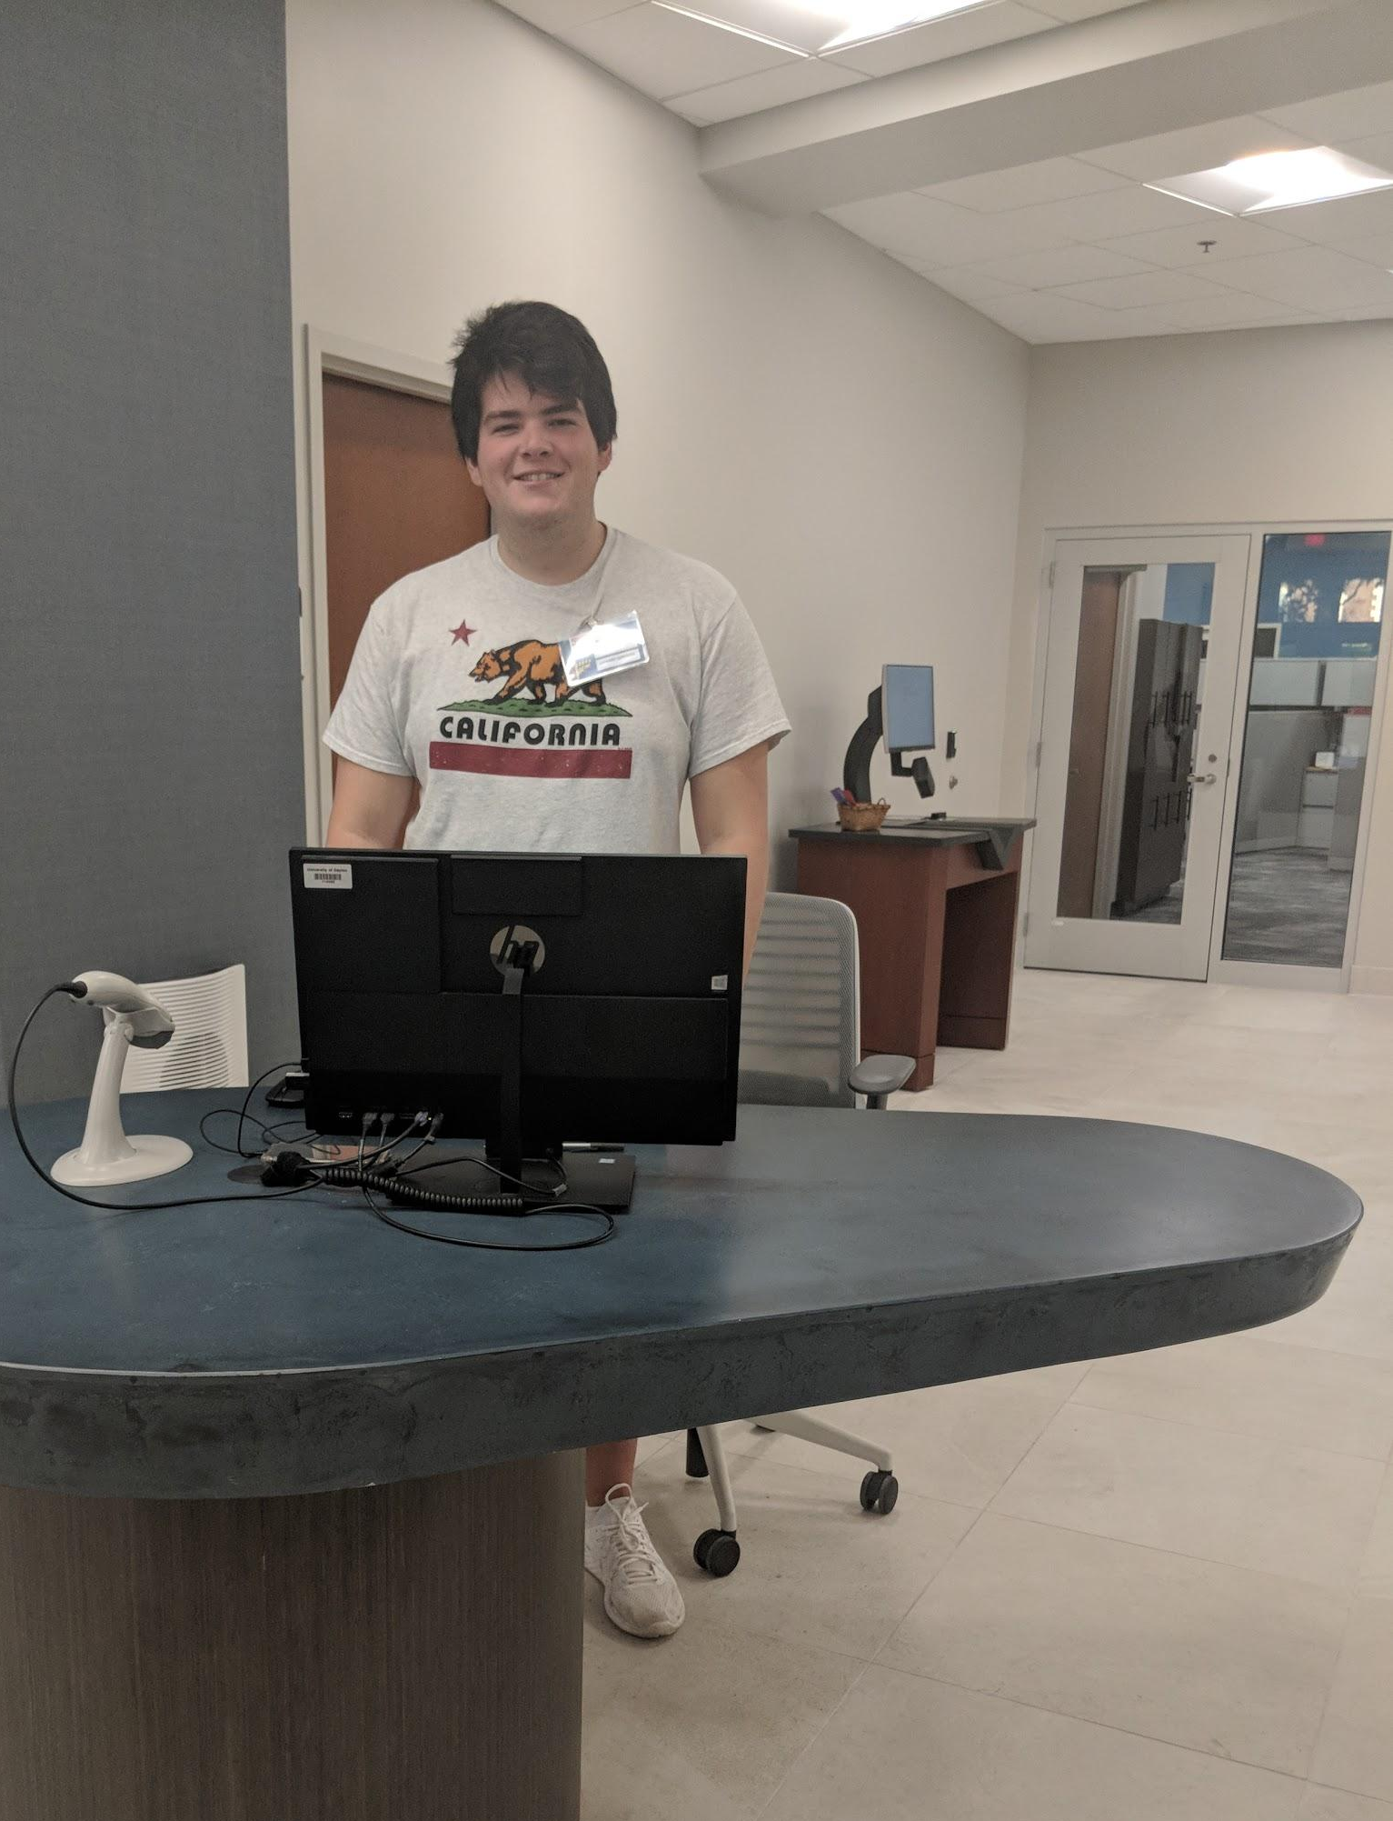
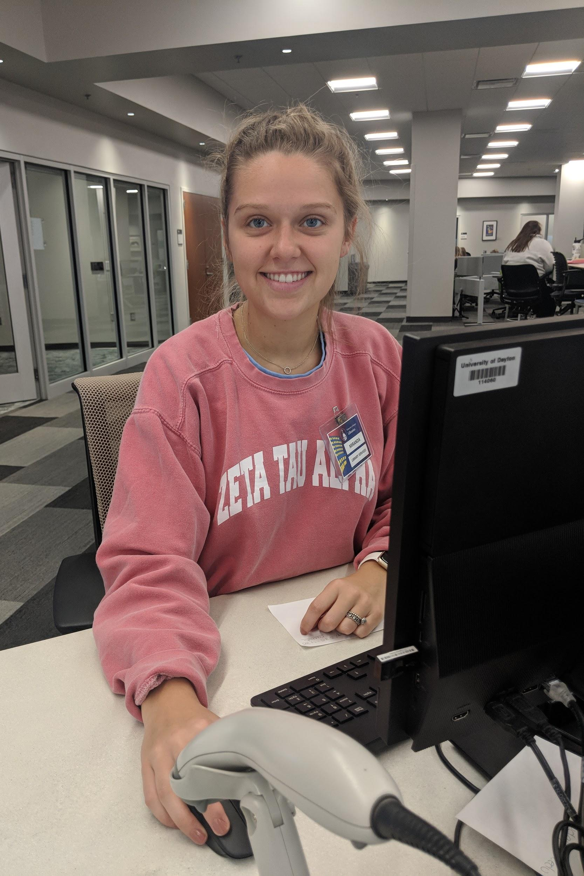
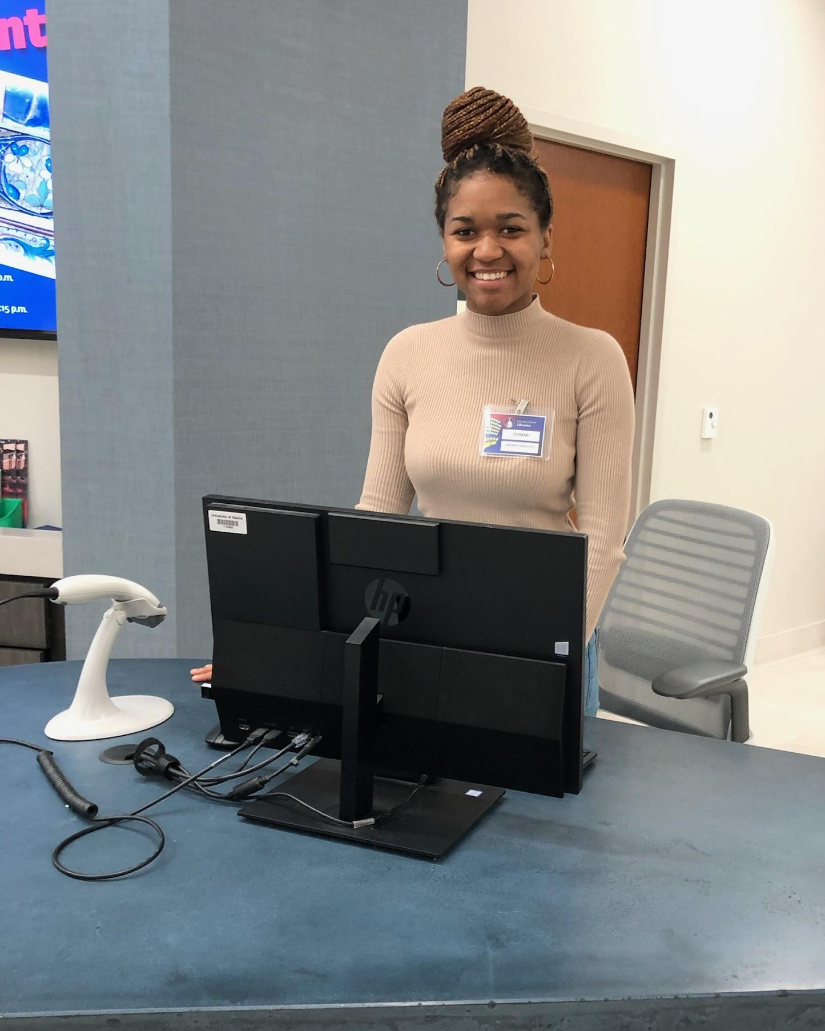
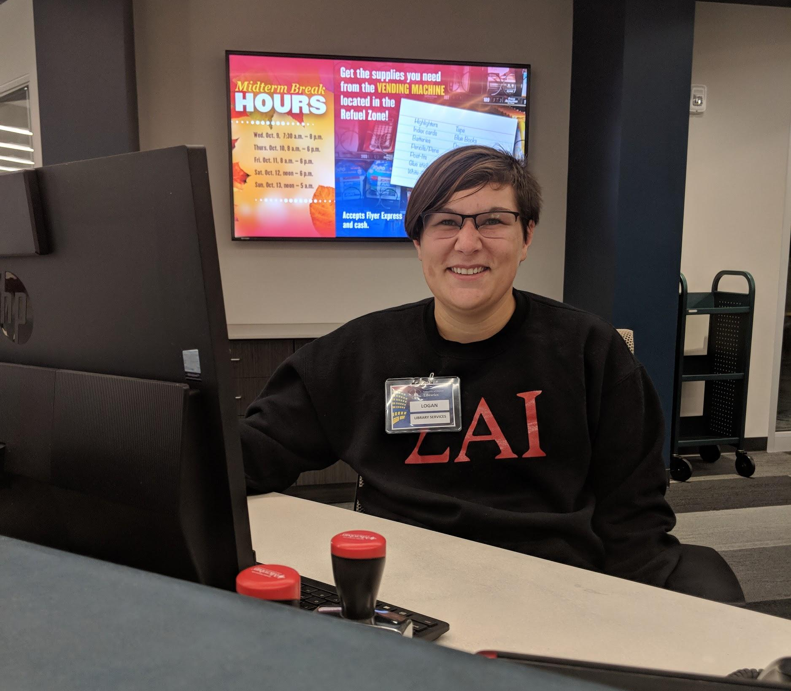

Slide 3
Campus- & Library-wide Values
High-impact practice
Student employee programs across campus
Library strategic plan: “Create structured, dynamic professional development & leadership training for Libraries’ student employees.”
Heather Ashley

Slide 4
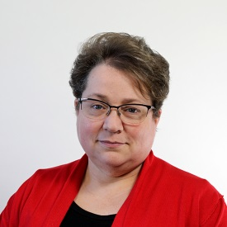
Department Org Chart
COORDINATOR FOR RESEARCH & INSTRUCTION
STUDENT EMPLOYEES (30)
STUDENT COORDINATOR FOR PUBLIC SERVICES
RESEARCH TEAM (7)
LIBRARIANS (4) + RESEARCH ASSISTANT (1)
DIRECTOR
ACCESS SERVICES TEAM (6)
“Advocate for Student Employees”
ACCESS SERVICES COORDINATOR
ACCESS SERVICES STAFF (5)

Slide 5
Growing Recognition + Change
2018: Before
Research Services student employees (10)
Access Services student employees (24)
Both teams: emphasis on training, celebrations, value of student employees
2019: Renovation & After
Student employees merged into 1 team
Combined work functions between teams
Ryan Reed

Slide 6
Student Employees
2 separate service desks, 225 hours/week
Large knowledge base: 7-story building, plus another student support unit in garden level
Sierra functions, basic OPAC functions
Printer & software trouble-shooting skills
Customer service
Luis Feliciano

Slide 7
Student Staff Empowerment
Student workflow contributions & insights
Resume-ready experiences
Student initiatives
Kelly Howard & Kyle Renneker

Slide 8
Student Insights, Changes
Weekly quizzes
“They were helpful but they need to target problems that many students are having trouble with..”
“Every other week maybe? not as often”
Scheduling
"make sure you have it set straight for what seniority means, aka working more semesters, hiring date...it needs to be clear across the board."
Himani Singla

Slide 9
Student insights
“...[a] Printer Troubleshooting Flowchart / cheat sheet for those working the service desk would be a good idea I believe because sometimes patrons are impatient when trying to troubleshoot the printers... Definitely wouldn't hurt to have something to lean back on!”
“There needs to be more collaboration of research librarians and access services. There's trainings together but even with that, the "EID" department feels very separated.”
Lauren Croll

Slide 10
Workflow contributions
“Shifts shorter than 2 hours are pointless/a hassle. In trading asking for one hour can make sense, but otherwise 2/4 hour blocks of time make much more sense....”
“Is there a way we can have a chat that connects us to the other desks? There have been many situations where I have had to call upstairs and interrupt other employees helping patrons to ask non-emergent but necessary questions.”
“Not a question - just letting you know that hello desk hours on libguides is incorrect! closes at 7pm on saturdays”
Miranda Roskow

Slide 11
Supervisor students
Application: Cover letter addressing experience, plus resume
Then: Formal interview
About this position: Open only to current EID student employees.
Opening / closing the Library building
Serves as main point of contact for other student employees when regular staff are not scheduled
Beth Hosek

Slide 12
Resume-ready experiences
Summer students → writing contributions
Know thy Staff
Use the Library, Save Money
Special summer projects
Super students → training & supervision
“Secret shopper” on Library H3lp
Communication/management via Google Hangouts
Jaxie Brokamp

Slide 13
Career Workshops
Spring 2019, Fall 2019: Workshop to translate work tasks into language suitable for other employers
Paid attendance
Presented by Library & Career Services
Spring 2020: Dining etiquette
Jessica Gill

Slide 14
Student-initiated Presentation

Slide 15
Management -- Training
Monthly student employee team meetings
Speakers: Dean of Libraries, campus IT, Librarians, Access Services, etc
Focus on group discussions
On-one-on training, start of semester
Bi-weekly quizzes
Modules in campus LMS (Sakai)
Logan Symons

Slide 16
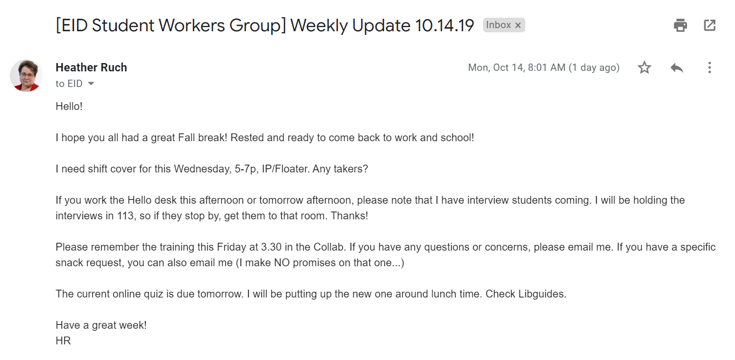
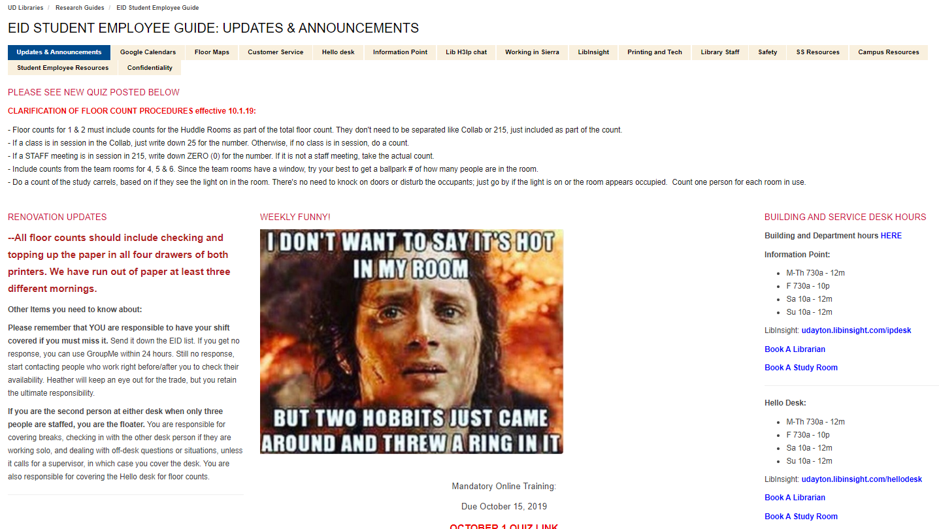
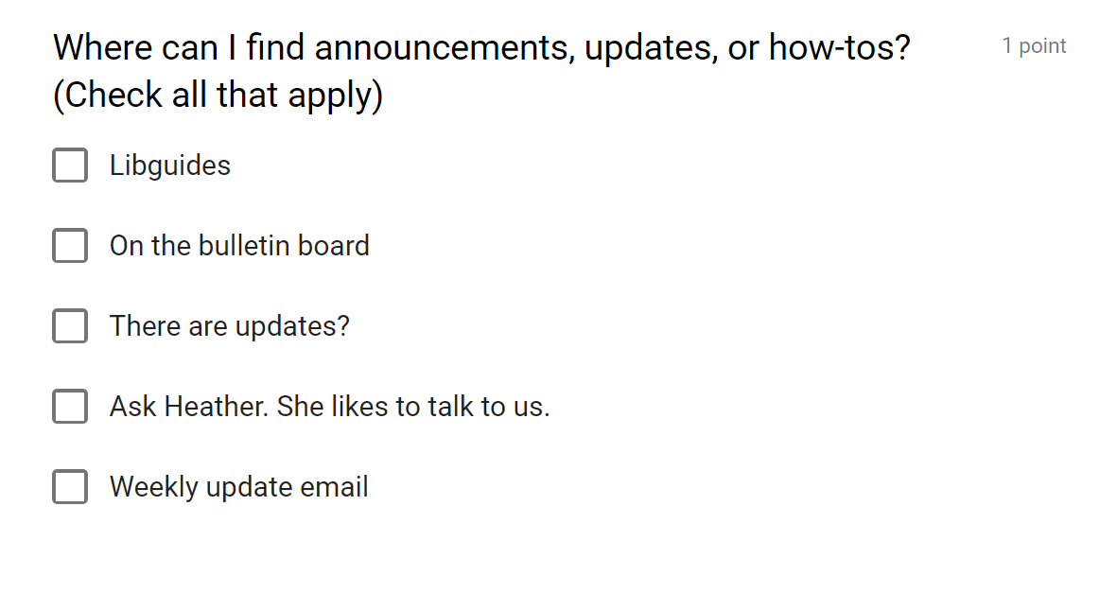
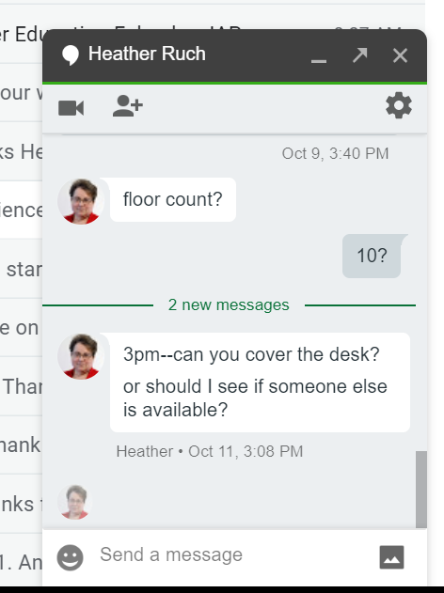
Management -- Communication

Slide 17
Management -- Coaching
Philosophy: ensure student employee success on the job but address issues that interfere with effective service
Would rather students own the decision to discontinue employment instead of library forced to decide
Tomaiya Robinson

Slide 18
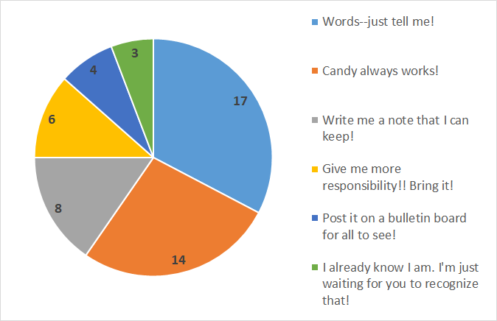
Management -- Recognition

Slide 19
What are you doing to help your student employees become invested in the library and its success?
What opportunities do you provide for your student employees?
How do you advocate for your student employees?
Varija Goli

Slide 20
Thank you!
Cristin Bushnell: bushnellc2@udayton.edu
Heidi Gauder: hgauder1@udayton.edu
Heather Ruch: hruch1@udayton.edu

