Slide 1
Strategic Plan as Communication Plan
Melissa Cox Norris
Director of Library Communications, University of Cincinnati
November 2, 2018

Slide 2
My role is to raise the external profile of UC Libraries in order to increase and improve collaboration, participation and support.
So what does that mean?

Slide 3
What?
10 Libraries – Walter C. Langsam Library (main) + 9 College & Departmental Libraries
Henry R. Winkler Center for the History of the Health Professions
Elliston Poetry Room
University of Cincinnati Press
People, Services, Collections of UC Libraries
Major Initiatives: Strategic Plan, Repository, DH/DS, Informatics, Scholar@UC digital repository, etc.

Slide 4
What Not?
Law Library
UC Blue Ash Library
UC Clermont College Library
UC Foundation / Campaign

Slide 5
Who?
Primary Audience:
Internal
UC Students
UC Faculty
UC Staff and Administrators
UC Libraries Staff
External
Library/ARL/OhioLINK Directors
Global Collaborators
Secondary Audience:
Cincinnati Community
UC Alumni
UC Donors
Potential Employees
Non-UC Students and Researchers
Why Them?

Slide 6
The Strategic Plan
Its mission, vision, tenets and four pillars determine the content, messaging and audiences of all communications activities.

Slide 7
Mission
The University of Cincinnati Libraries empower discovery, stimulate learning and inspire the creation of knowledge by connecting students, faculty, researchers and scholars to dynamic data, information and resources.
How Does That Translate?

Slide 8
What I Communicate About…
The University of Cincinnati Libraries empower discovery, stimulate learning and inspire the creation of knowledge by connecting students, faculty, researchers and scholars to dynamic data, information and resources.

Slide 9
Who I Communicate To…
The University of Cincinnati Libraries empower discovery, stimulate learning and inspire the creation of knowledge by connecting students, faculty, researchers and scholars to dynamic data, information and resources.

Slide 10
What I Say…
The University of Cincinnati Libraries empower discovery, stimulate learning and inspire the creation of knowledge by connecting students, faculty, researchers and scholars to dynamic data, information and resources.

Slide 11
Vision
How I Say It…
The University of Cincinnati Libraries will become the globally engaged, intellectual commons of the university—positioning ourselves as the hub of collaboration, digital innovation and scholarly endeavor on campus.
Notes:
How I say it.

Slide 12
Messaging
Experienced-based Learning
Collaboration
Connecting the World Inclusion
Global
Collaborators
Digital Innovation
Scholarly Endeavor / Discovery
Key words from the Vision:
Global
Collaborators
Digital Innovation
Scholarly Endeavor/Discovery
UC’s beliefs represented in our messaging:
Experience-based Learning
Collaboration
Connecting with the World
Inclusion

Slide 13
Pillars
Themes of What I Communicate About…
Digital Technologies and Innovation
People
Space
Data to Information to Knowledge

Slide 14
Putting It into Action
Primary Communications Vehicles

Slide 15
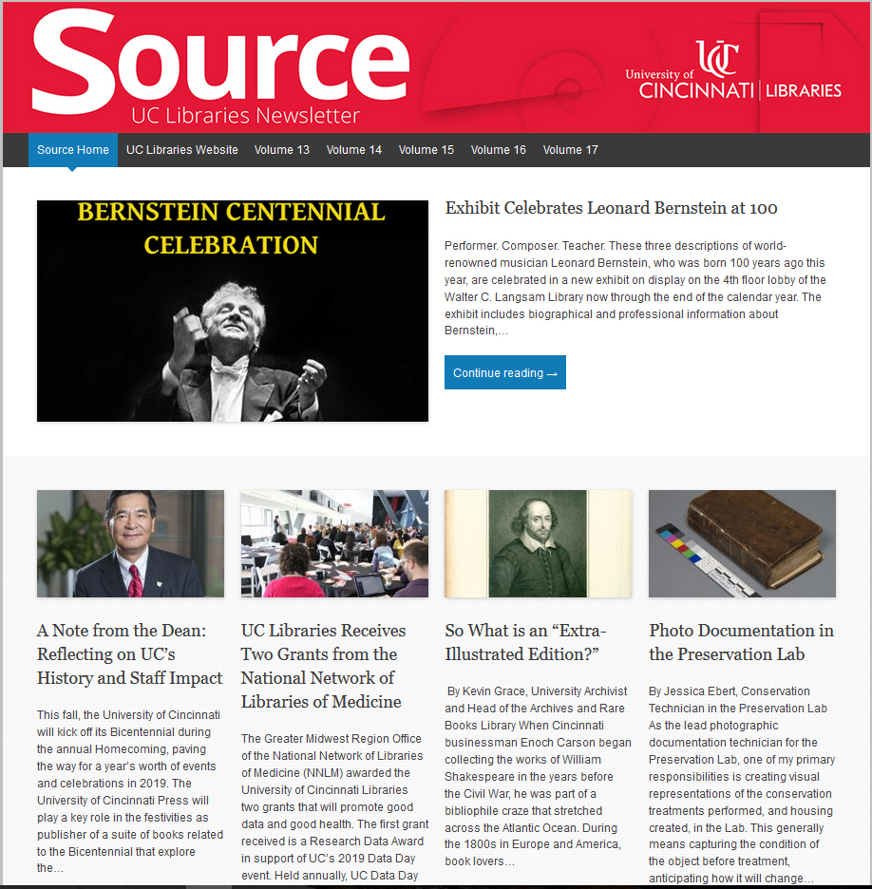
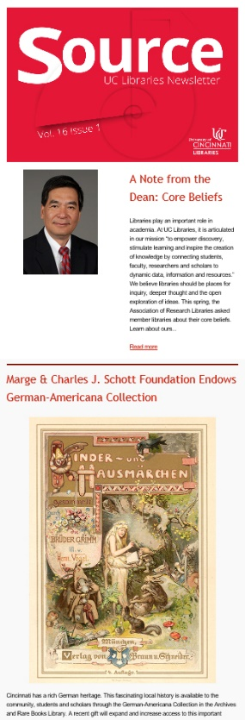
Source
E-mailed 3x a year to 60K
Donors, Graduate Alumni, Emeriti Faculty, ARL & OhioLINK Directors, UC Deans, Directors and Department Heads, Outside Colleagues, Affiliates, Friends
Externally Focused
News, Features, Staff Profiles, Events, Collection Highlights, Dean’s Note
Articles featuring the projects, initiatives and results of the SP

Slide 16
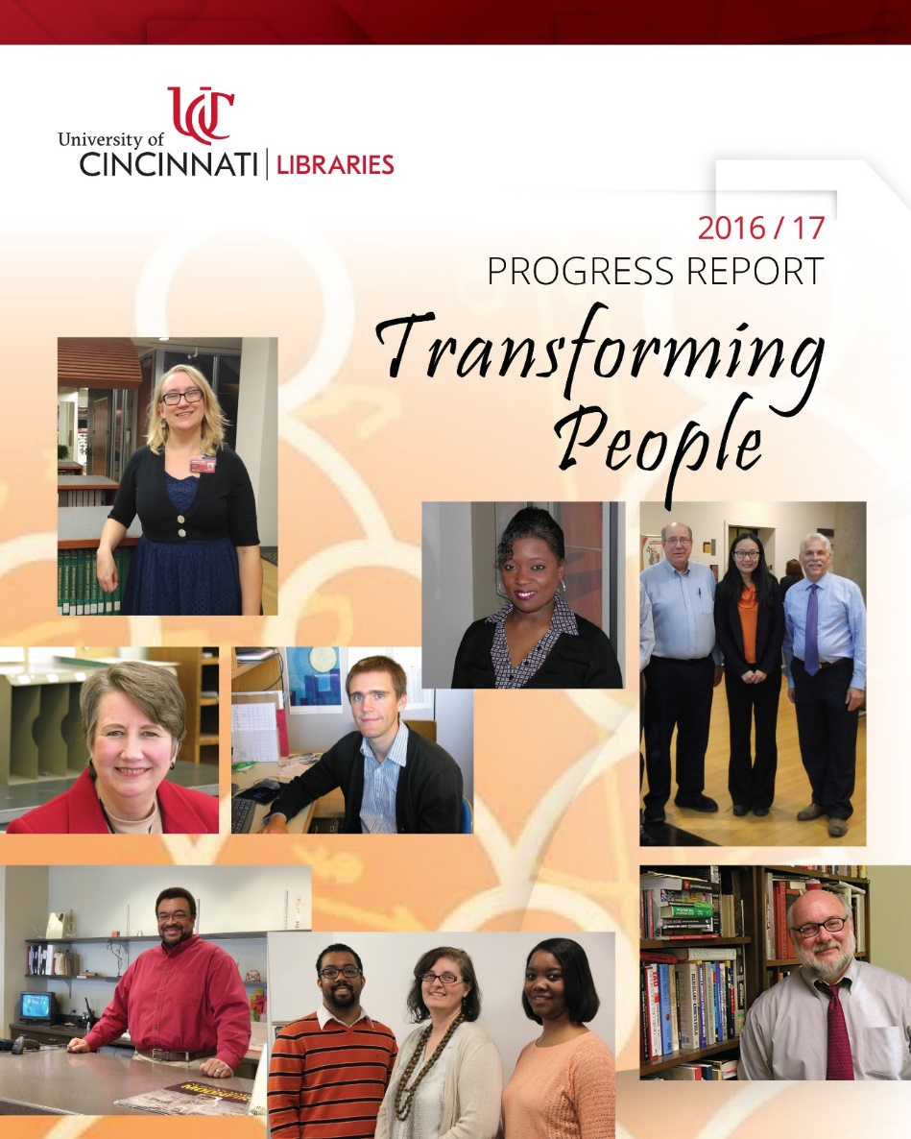
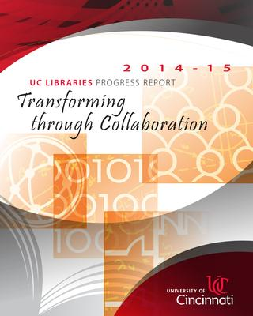
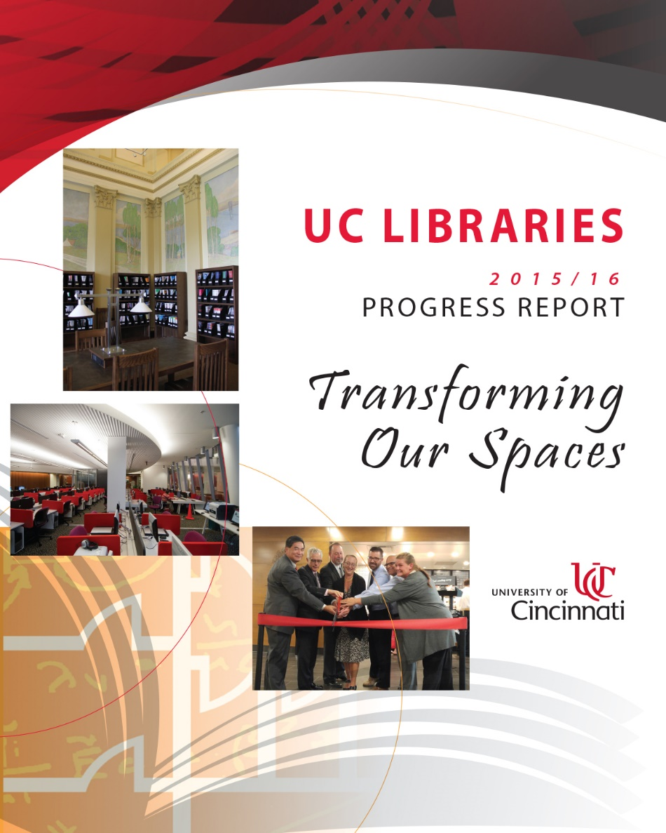
Annual Progress Report
Print 2,500 Mailed to:
Donors, ARL & OhioLINK Directors, UC Deans, VPs & Administrators, Outside Colleagues, Affiliates, Foundation Board
Available Electronically via ISSUU and Promoted Publicly - https://issuu.com/uclibraries
Externally Focused
Focus is results of the SP and what’s next:
News, Stats and Updates from Previous Year as well as Highlights of Upcoming Initiatives
Each year focuses on a different pillar of the SP

Slide 17
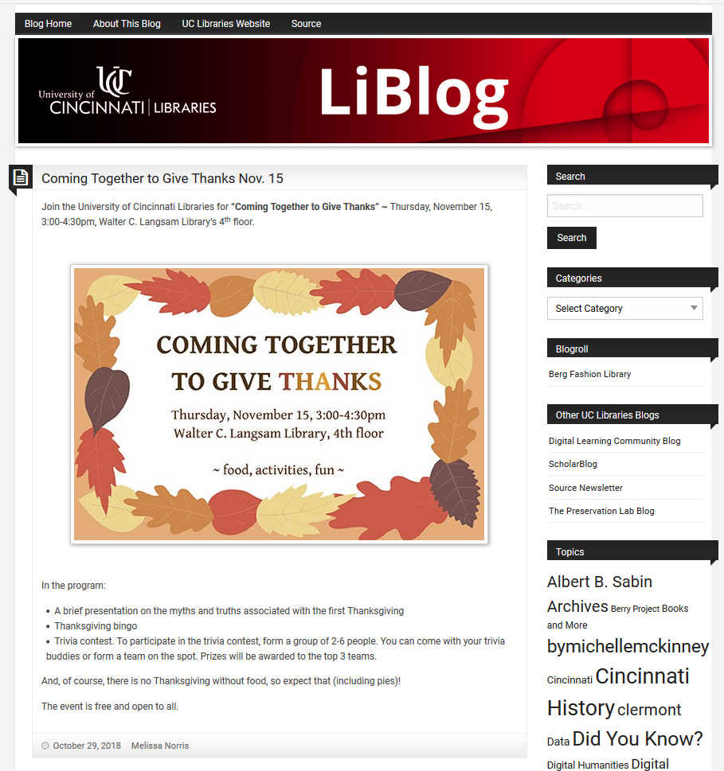
LiBlog
Includes the Official News as well as Features, Highlights and Staff Profiles
Externally and Internally Focused
Articles featuring the projects, initiatives and results of the SP
Topic tag cloud highlights SP initiatives and pillars

Slide 18
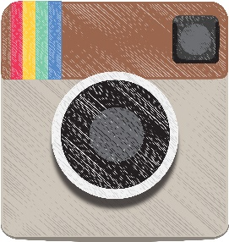
Social Media
Target Audience: Students
LiBlog - libapps.libraries.uc.edu/liblog/
Twitter- twitter.com/uclibraries
Facebook - facebook.com/uclibraries
Instagram - instagram.com/uc_libraries/
ISSUU - issuu.com/uclibraries
Content
News, Events, Features, Collections, Services, Resources
Engaging, Responsive, On Point, On Message

Slide 19
Tenet Social Media Campaign
11 tenets of our Strategic Plan
Lead, Partner, Collaborate, Build, Learn, Teach, Steward, Innovate, Explore, Thrive, Transform
Fall ‘17 tweeted one per week as part of ALA’s Core Beliefs campaign
#ucltenets
Impressions = 5,000
Learn
Lead
Explore

Slide 20
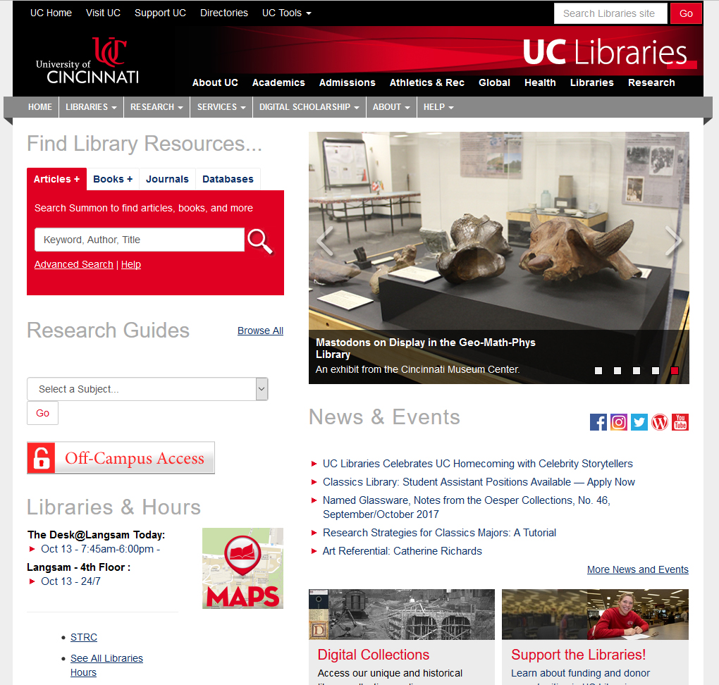
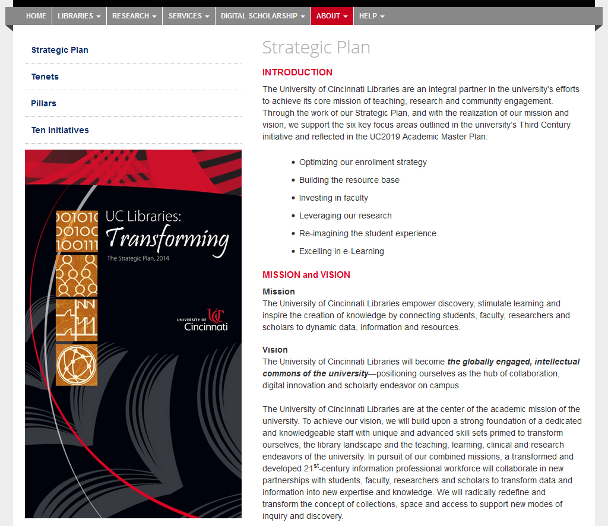
Website
News & Events featuring SP stories
Strategic Plan - libraries.uc.edu/about/strategic-plan.html
Link to SP when appropriate
Candidates and outside collaborators visit SP site

Slide 21
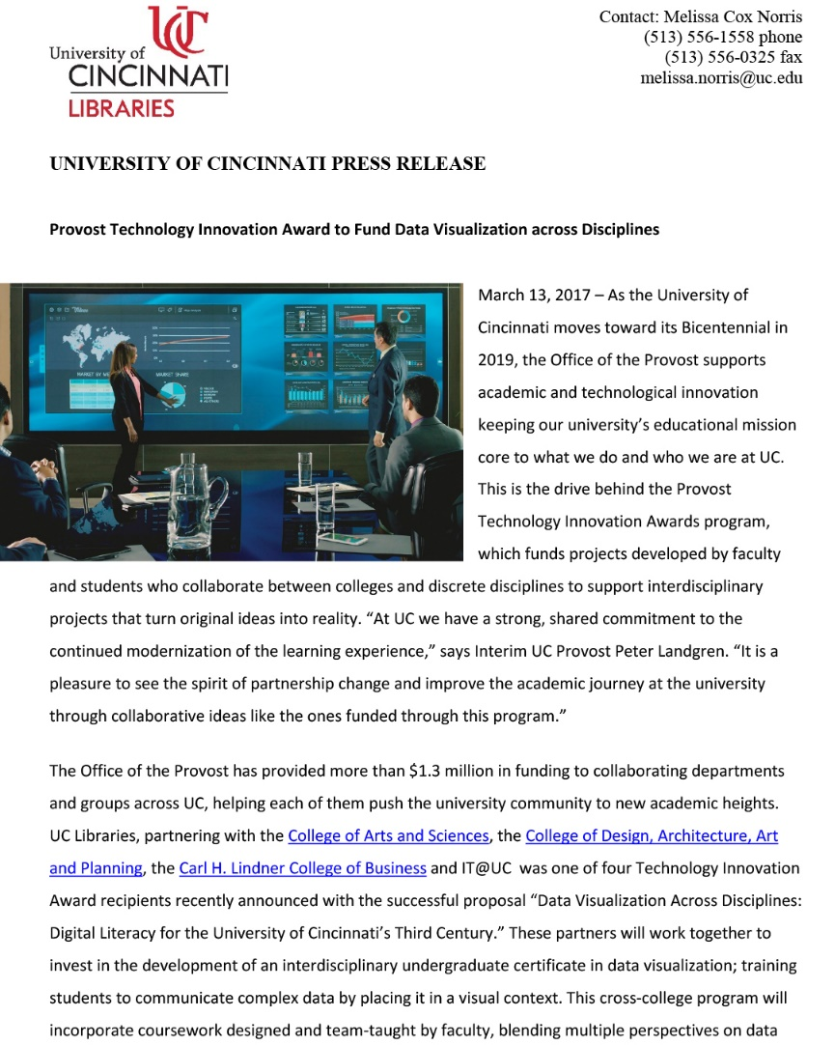
Press Releases
Official News from UC Libraries
Submit to UC News Database for Distribution to Media & UC Communication Vehicles
Articles featuring the projects, initiatives and results of the SP
Include SP language in quotes

Slide 22
“Open access to information has long been a tenet of libraries as it provides opportunity for students and scholars alike in both the sharing and availability of research and data. With UC Libraries moving into the second year of our strategic plan implementation, and with significant digital infrastructure and partnership build up, we are primed to be a catalyst for promoting open access, open education and open data across the university.”
“The University of Cincinnati Press supports the Libraries’ vision to become the globally engaged, intellectual commons of the university—positioning ourselves as the hub of collaboration, digital innovation and scholarly endeavor on campus.”
“These two projects, while different in scope and reach, are outgrowths of UC Libraries mission to empower discovery, stimulate learning and inspire the creation of knowledge by connecting students, faculty, researchers and scholars to dynamic data, information and resources.”
“Digital humanities/digital scholarship, which includes efforts in digital humanities, research data management, digital repositories, born-digital archives management and long-term digital assets preservation, are core components of UC Libraries’ current Strategic Plan.”

Slide 23
Videos
Promotes the Strategic Plan
Includes mission, vision and pillars
Post on website, plug on social media and play at New Student Orientation
https://www.youtube.com/watch?v=iWYIljOIY4c&list=UULOFcrbLUUYisxTzOaTiFuA&index=5

Slide 24
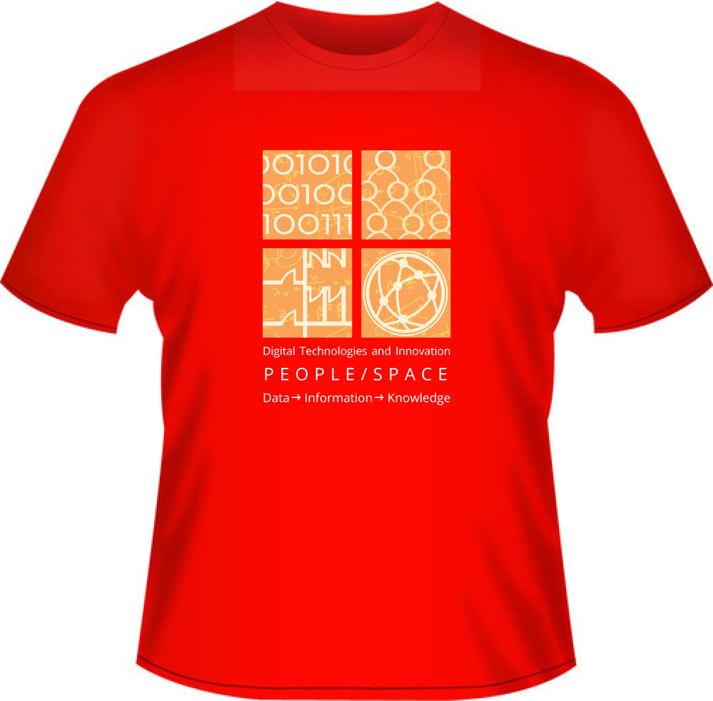
T-Shirts
Given to all Libraries staff
Worn during New Student Orientation
Given as prizes and gifts to visitors

Slide 25
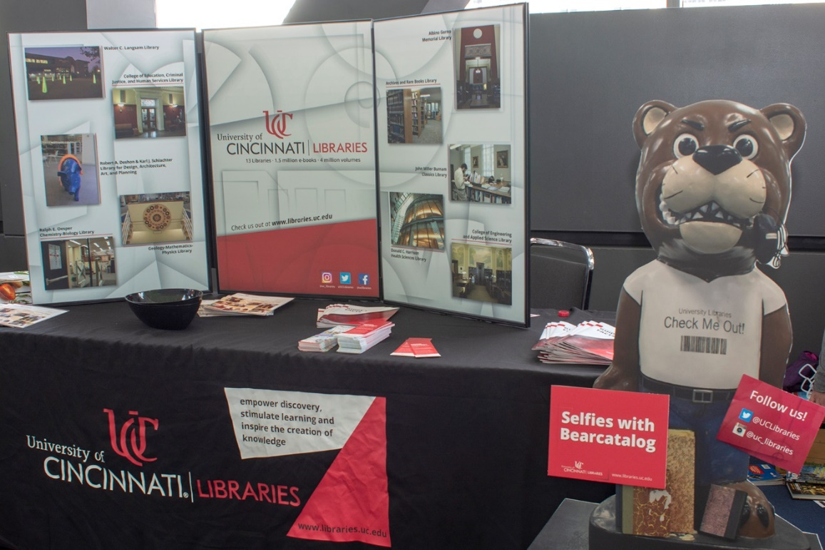
Events & Exhibits
Show in tangible ways how we are the “globally engaged intellectual commons of the university.”

Slide 26
Results

Slide 27
Tangible / Measurable:
Attendance at Events
Gate Count:
2014 = 1,378,224 vs. 2017 = 1,941,554
LiBLOG Hits:
June ‘16 to June ‘17 = 81,010 views
Average 5,000 a month
Source Stats:
Web:
Feb. ‘18 = 1,634 views
June ‘18 = 1,698 views
Sept. ‘18 = 1,751 views
E-mail (2,500 mailed via Mail Poet): above 30%/3% excellent
Feb. ‘18 = Open 32.2% / Click 8.4%
June ‘18 = Open 16.6% / Click 5.9%
Sept. ‘18 = Open 26.3% / Click 6.9%

Slide 28
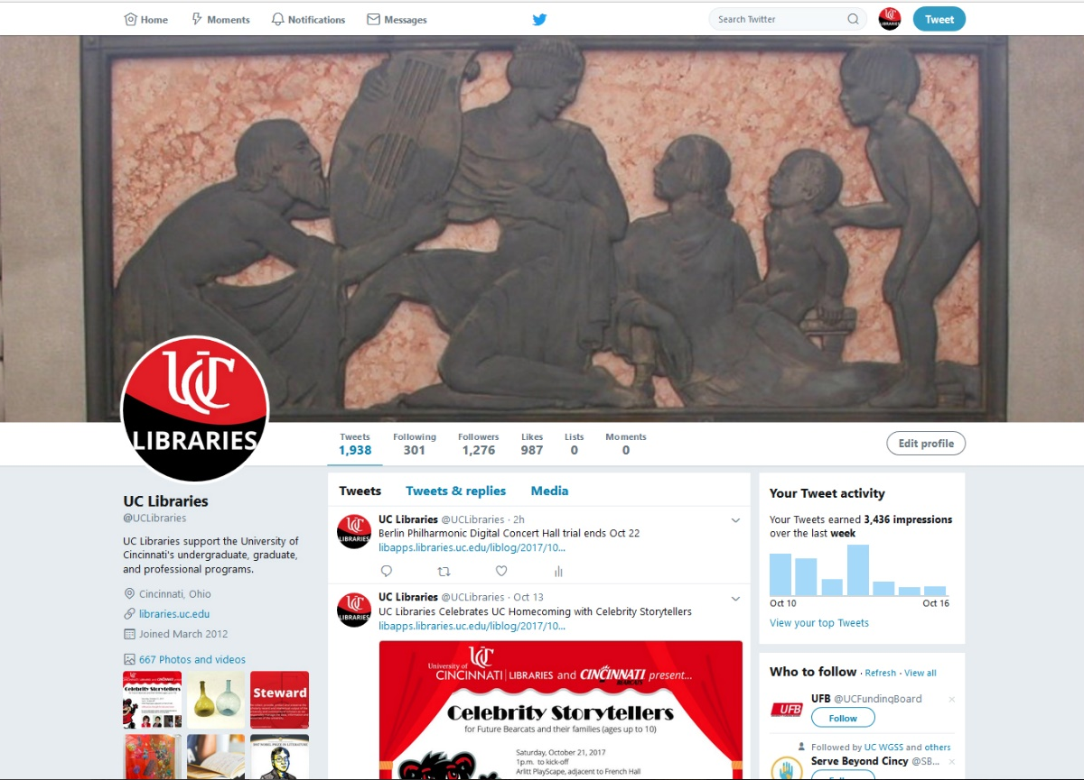
Twitter
2,500 tweets and 1,400 followers
Oct. ‘18 = 29.6K impressions
#BoldyBearcat in Shanghai (9,091)
Lego at work in UC Libraries (998)
The Great American Read
Sept. ‘18 = 24K impressions
Aug ‘18 = 26.1K impressions

Slide 31
Intangible / Harder to Measure:
Heightened Awareness
Comments
Heard / Anecdotal
Social Media
Website
Recruitment Success
Requests to Partner & Collaborate
General Favorable View

Slide 32
Why Strategic Plan as Communications Plan?
Promotes the efforts of the Strategic Plan
Helps make the Strategic Plan relevant – not just on the shelf
Focuses my Communications efforts
Assists my Communications efforts by providing the audience, themes and messaging

Slide 33
Comments?
Questions?

