Slide 1
Partnering with Students to Improve Library Spaces and Services through Design Thinking
Michelle Chronister
Associate Dean
mchroni@bgsu.edu
Kari Johnson
Programs & Facilities Manager
karij@bgsu.edu
Linda Rich
Reference Services Coordinator
lrich@bgsu.edu

Slide 2
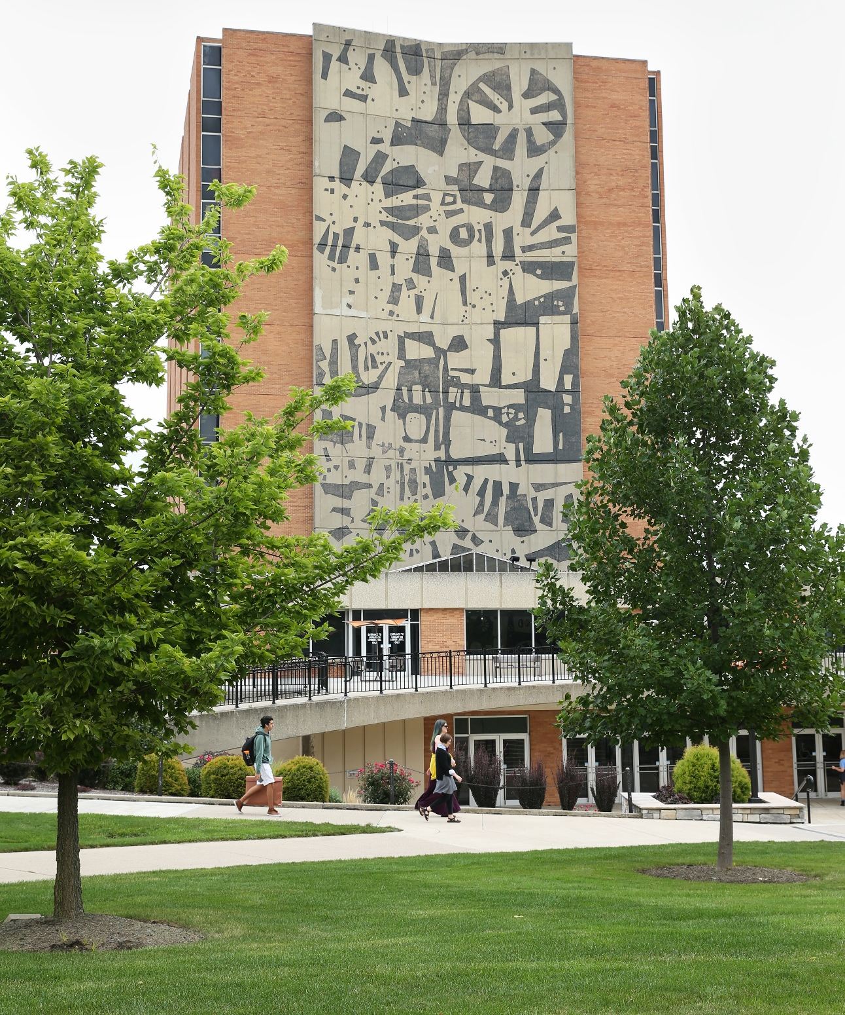
History
What is BGSU BIZX?
How did the University Libraries (UL) become a BIZX client?
Notes:
Contacted in Spring of 2017 to partner with the Applied Business Experience course (BIZX) . BIZX is a applications based series of courses where students come up with an innovation idea that would enhance an already existing campus service business. Curriculum of these courses teaches the students business design thinking and asks them to use those concepts to observe and interview consumers using a campus service business. From the observations and interviews we are able to gather data that not only helps us understand who the customer is, but also shows the pains & gains the consumer experiences when utilizing that campus service business.
Data gathering began occurring since the spring of 2016. Over 1 year of student data was collected. Students wanted to share that data with the principle decision makers at Jerome Library. The instructor encouraged principle decision makers to attend student presentations of the data gathered at the end of this semester. The original BIZX concept was one class with three clients (Rec-Well, BTSU, Library). We were able to hear relevant student data.

Slide 3
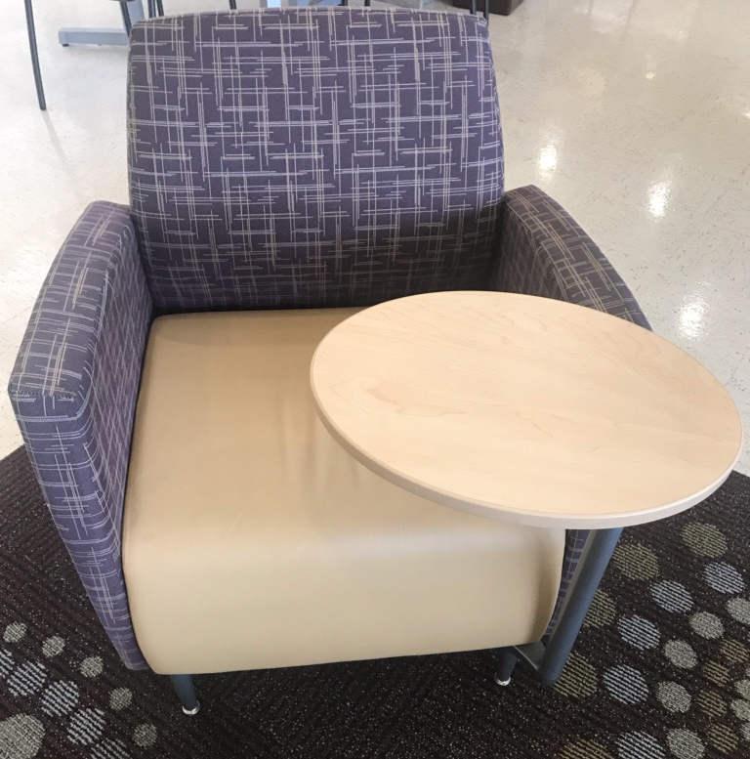
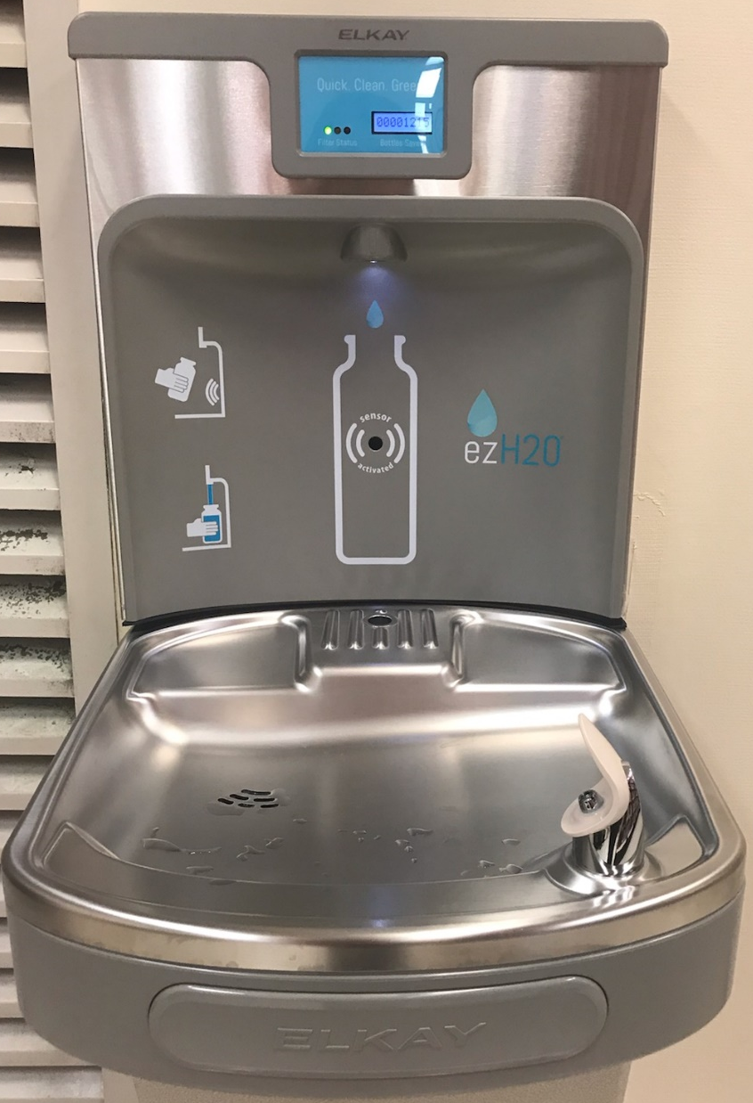
BIZX Data
What did we learn and what did we do?
Next Steps
Notes:
One presentation consisted of a group of students that prototyped the Jerome Library; specifically the 1st and 7th floor.
The students were elated to present to folks who had a direct impact on their recommendations. We offered important questions that were a great "real world" learning experience for every student in the class. Gave recommendations on the client relationship.
Was told that 18 new BIZX2200 sections would be created for spring 2018 and the CBA would like to incorporate a similar experience into the student curriculum. Were permitted to use these courses as a project management or test experience for any upcoming changes we would foresee making to the campus student experience or physical changes.
BIZX1100 - "real world" data gathering projects
Were able to formulate potential project ideas into assignments that accomplish our intended data gathering and/or prototyping goals as well things that were controllable. Want to offer the students the best experiences possible.

Slide 4
BIZX and Design Thinking
Empathize
Define
Ideate
Prototype
Test
Notes:
This is the Stanford d.school design thinking process. When we worked with the BIXZ classes, they separated the steps of the process into multiple classes. For instance, empathize, define, and ideate were part of BIZ 1100. Then ideate, prototype, and test were part of BIZ 2200.

Slide 5
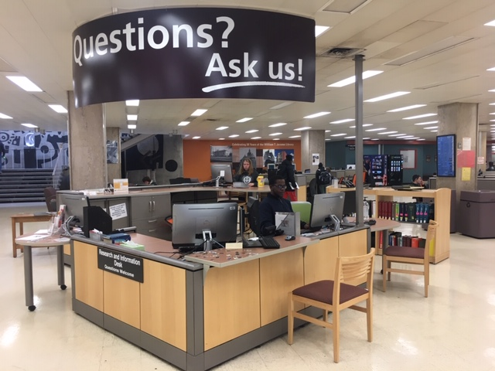
The BIZX 1100 Client Experience Why do Students not use the Research & Information Desk?
Scope of Work Document & Contract
Class Sessions
Project Intro
Mid-point check-in
Final Presentations
Notes:
Be sure to mention:
All of the BizX classes were 1 credit hour, 8-week courses that met twice each week.
Each BizX instructor had the freedom to organize their course section as they wanted.

Slide 6
The BIZX 1100 Client Experience What did we learn?
The majority of students are either unaware or have never asked a question at the Research & Info Desk; Or do not understand the extent of services offered.
Students who have asked questions at the desk feel it has value and are happy with the service received.
Students prefer online assistance.
Notes:
Our biggest takeaway was that our students are largely unaware of the types of research assistance they can receive in the library at our Research and Information Desk.
Another discovery that seemed to surprise the student investigators was that there were some students who actually came to our desk and were quite happy with the service they received!
Another common theme was that students preferred online assistance.
While variation among the groups’ findings, most recommendations revolved around ways to promote our services. Most felt that students would ask for assistance at the desk if they knew about the services we offered.
Notice no stats given? Compiling data from all groups was impossible.
BizX student investigators reached more students than I would ever have been able to reach on my own! Even with questionable data, there were clear overarching themes that emerged.

Slide 7
The BIZX 1100 Client Experience Using what we learned
Regular outreach efforts should include info about in-person, drop-in reference services
Course syllabi, campus updates, new faculty
Planning new promotions
Moo cards, door hangers, social media
Planning new signage at the desk
Notes:
Still a work in progress

Slide 8
Suggested Syllabus Language
“For help finding relevant, scholarly sources for your paper, ask at the Jerome Library “Questions? Ask Us!” desk. No appointment necessary! Make good use of your time between classes!”

Slide 9
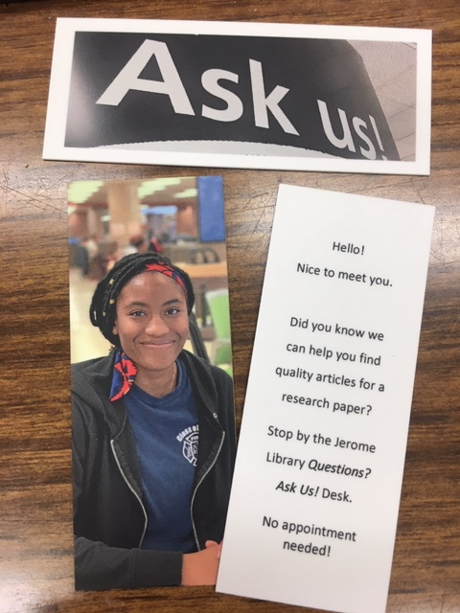
Moo Cards
“Can you help me find scholarly resources for my research paper?”
What is a peer-reviewed journal article?
Desk Signage

Slide 10
Themes Across Projects
BIZX 1100 – Data Gathering
General perceptions of the library
Expanding building hours
Signage
Thinkers@Outtakes Cafe
Collab Lab
Learning Commons
1st floor computer lab
1st floor study space
Reference services
Buying textbooks
BIZX 2200 – Prototyping
7th floor – group study
8th floor – quiet study
Research and Information Desk
Notes:
To date, we’ve worked with BIZX classes on 15 projects. As Linda alluded to, every class gathered data in different ways.
A few instructors assigned each group to interview a sample of students from every college on campus
But most of the instructors assigned each group to a college and they could only interview students in that college
A few instructors had the class come up with standard questions that every group asked
But most instructors allowed each group to determine their own interview questions
This means that using the data generated for each project was difficult because methods and questions varied. However, there were clear themes that emerged in each project and clear themes that emerged across projects.
These are the top 3 themes from all projects:

Slide 11
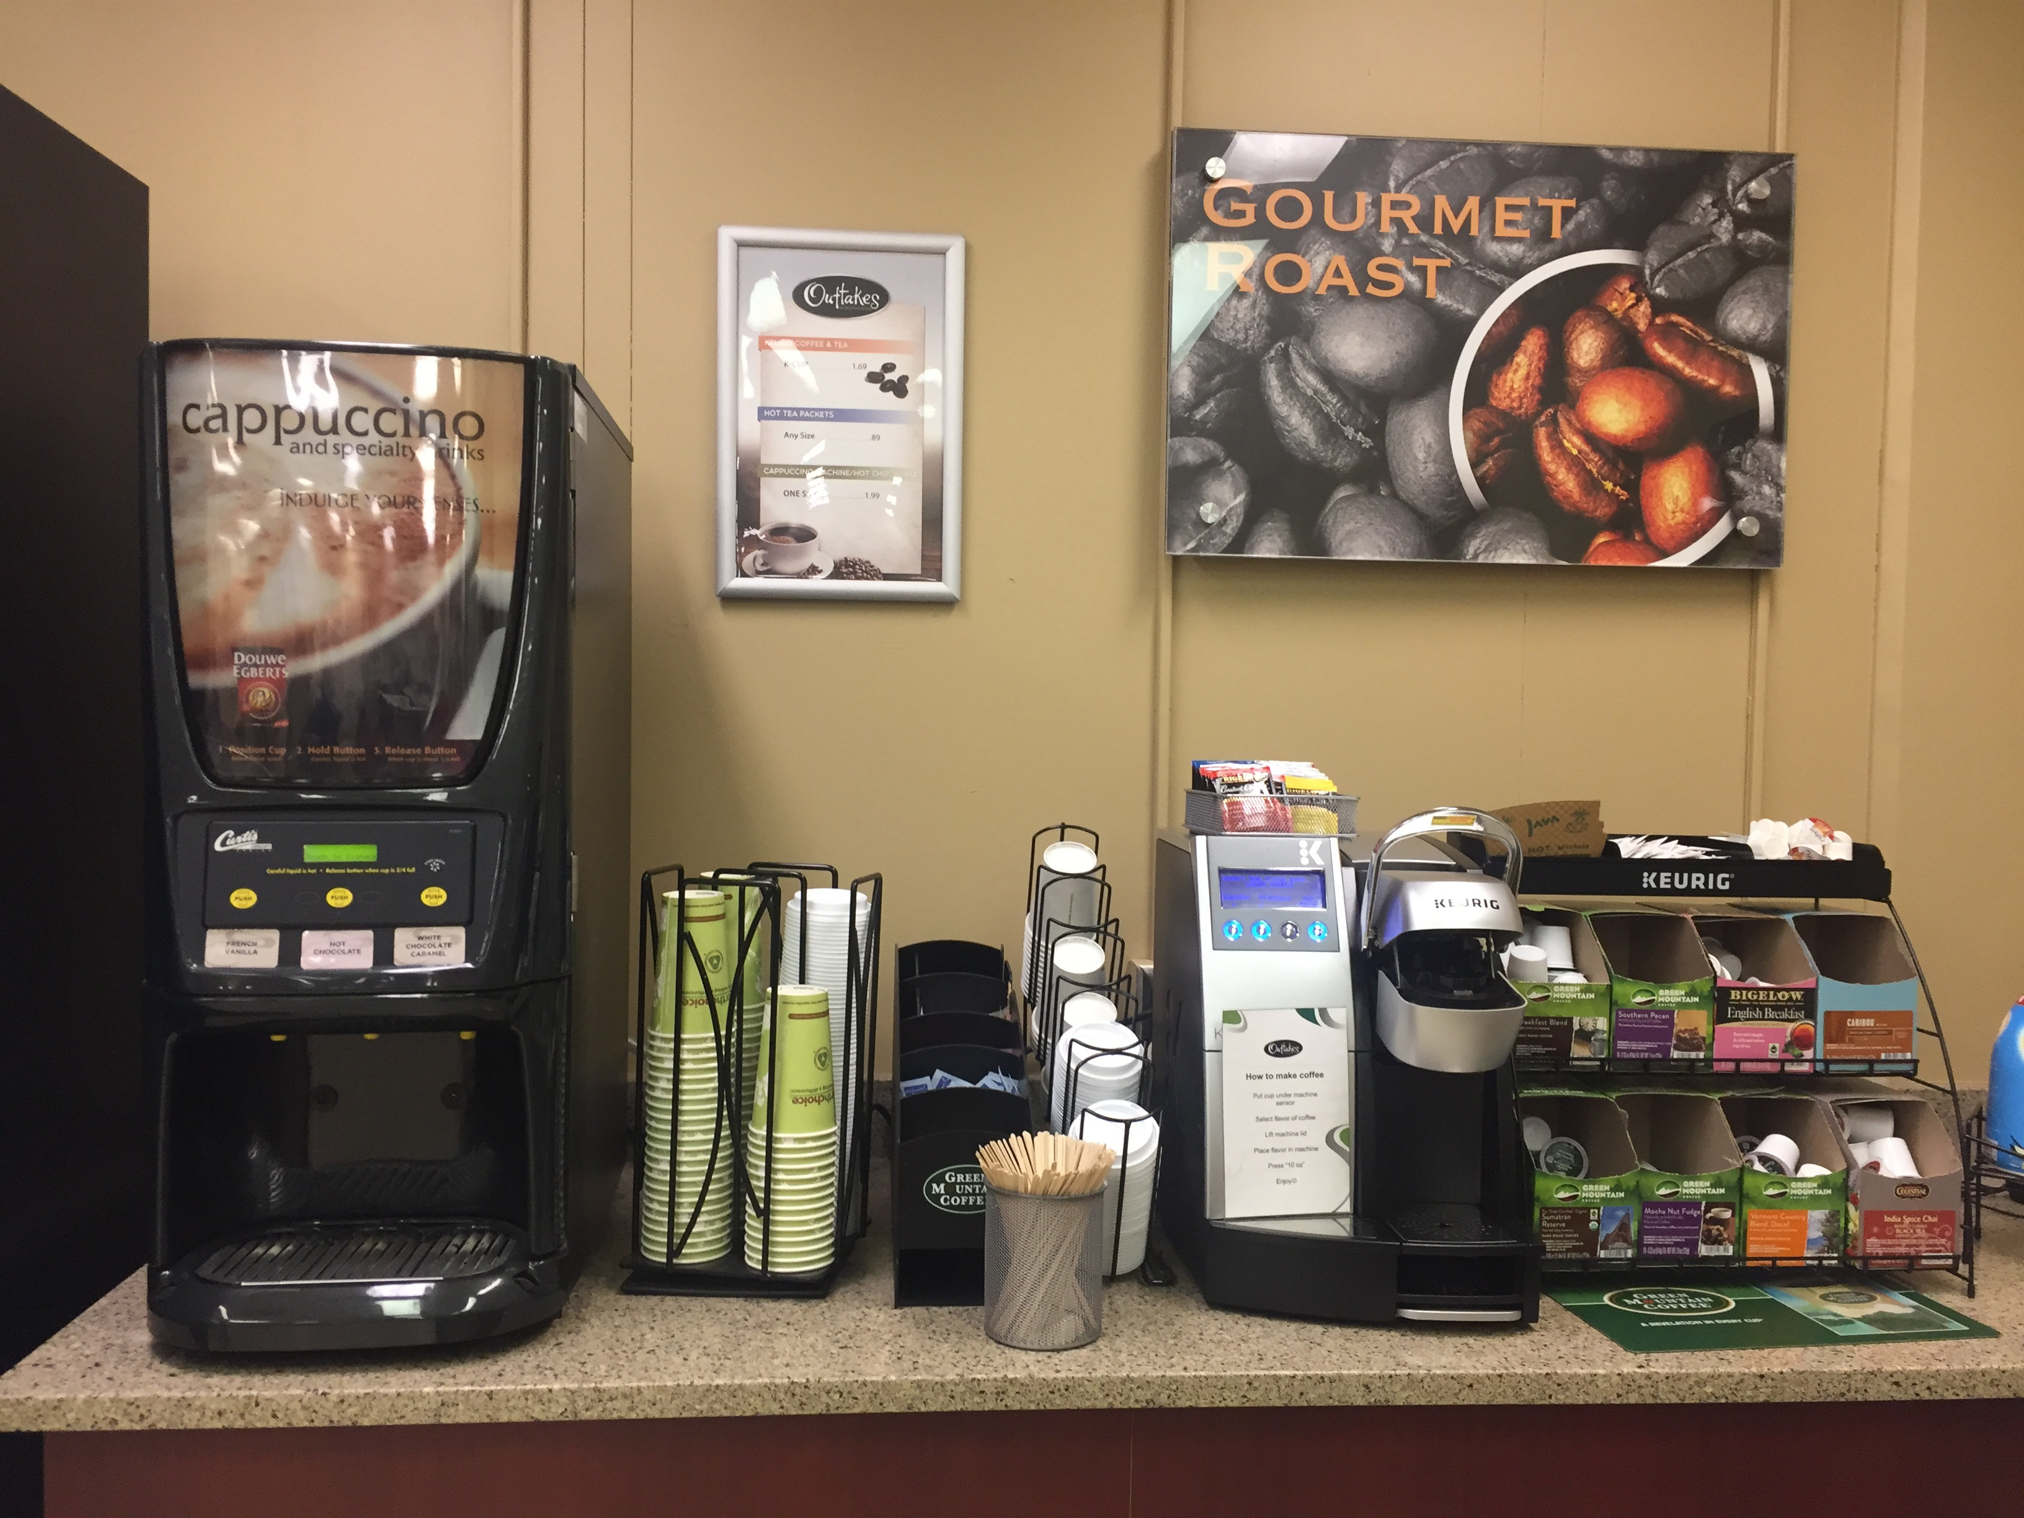
Notes:
Students want more coffee options in the building.
Currently, there is a Keurig and hot chocolate/cappuccino machine on the 1st floor in Thinkers@Outtakes cafe.
They would love a coffee cart or full-service café.

Slide 12
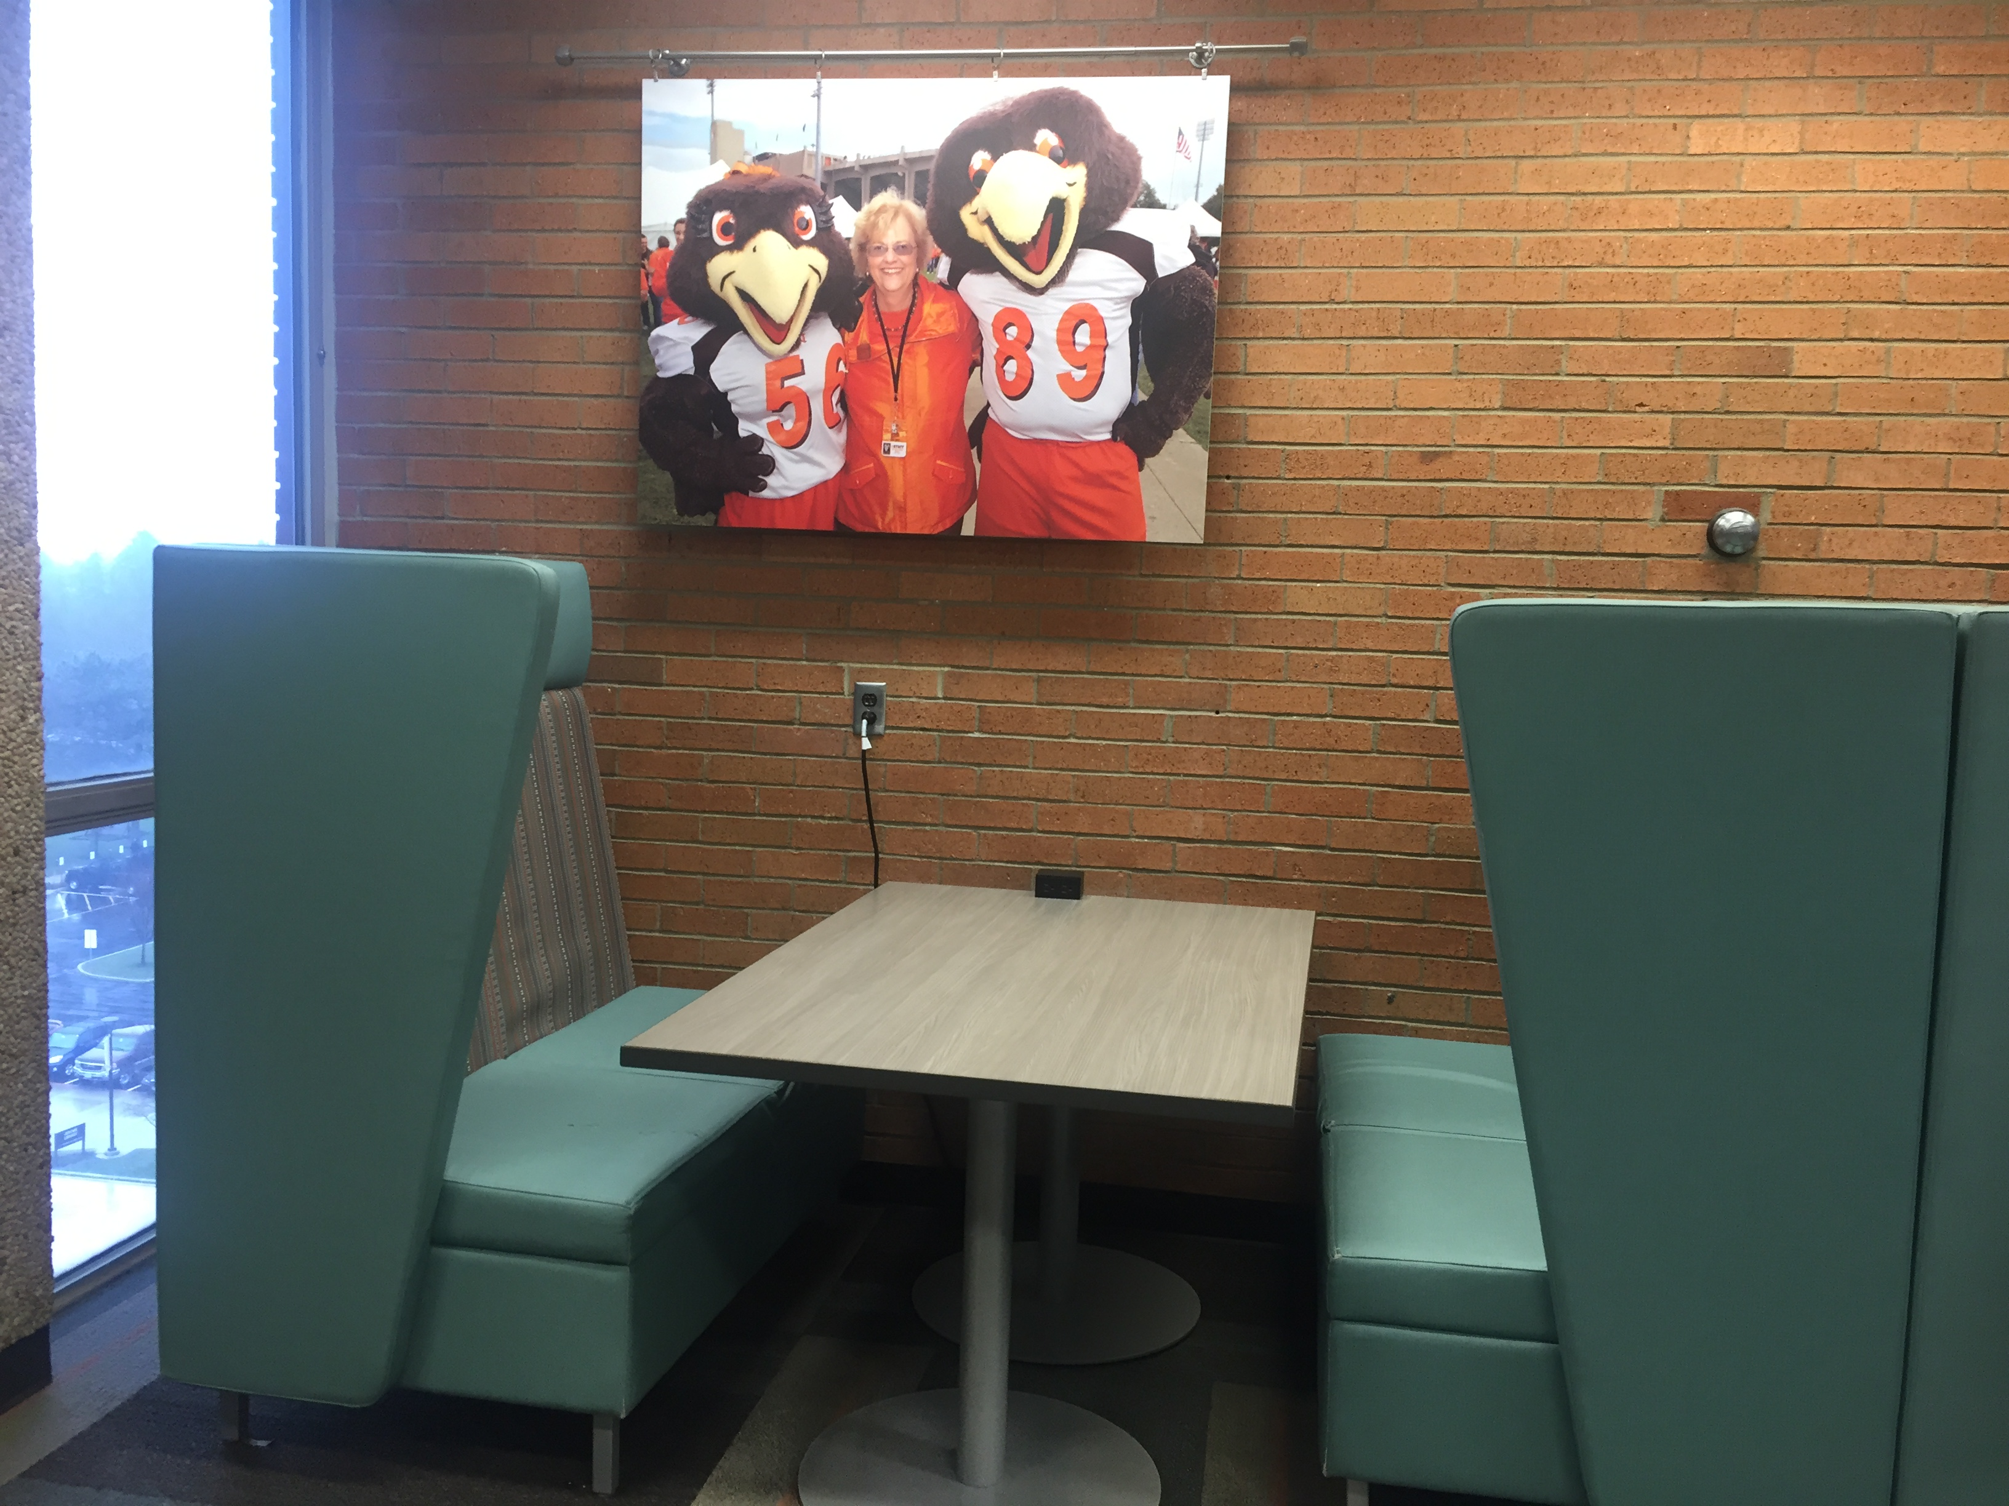
Notes:
We learned a lot about furniture preferences:
Students love booths and want more of them. Why? Space to spread out, comfortable, privacy.
They generally like comfortable and flexible furniture and want more of it in all areas across the building.
Students generally prefer low, square tables as opposed to round or high top tables. They like square because they are easier to push together for larger groups. They like low tables because it’s easier to access their bags and power outlets.

Slide 13
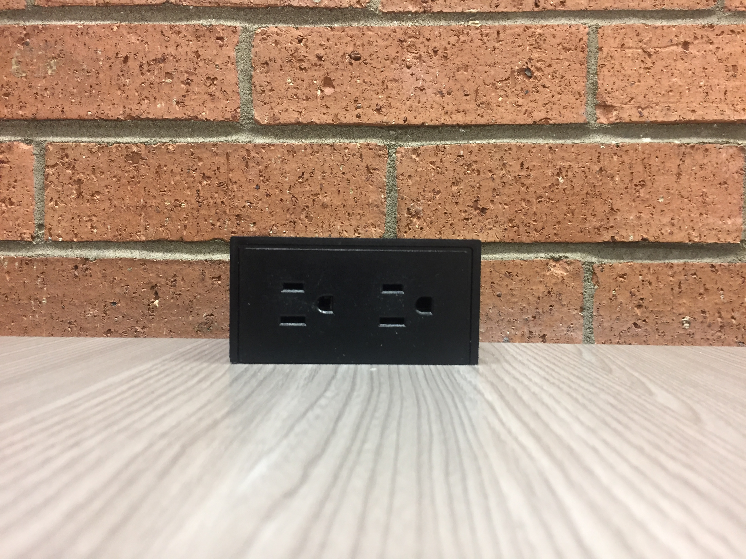
Notes:
They want power to charge all of their devices, and they want it conveniently located in all floors of the building.
These are the top themes across projects, but we heard many more including:
They want more food options, including hot food, a greater variety of cold food, and healthier choices
More computers and in more locations across the building. Including group computer areas
More whiteboards, including whiteboard tables
Bottle fillers on every floor - which we were able to accomplish
We were also able to help implement another change that came out of the classes that looked at our Thinkers@Outtakes café. Thinkers increased their hours as a result of the student feedback.
Because we take the feedback seriously and have implemented some of the suggestions, the class coordinator from the College of Business wants to continue to work with us and we’re planning projects for spring 2019 now. The College of Business is also revamping the course to last an entire semester and each group will focus on one project and client throughout the 15 weeks.

Slide 14
Starting a Collaboration
Look for classes that teach design thinking, innovation, or similar areas
Start with realistic expectations and be ok with failure
Find trends across groups and across projects
Notes:
You might be able to form a similar partnership between your library and a program on your campus.

Slide 15
Thank you!
Michelle Chronister
Associate Dean
mchroni@bgsu.edu
Kari Johnson
Programs & Facilities Manager
karij@bgsu.edu
Linda Rich
Reference Services Coordinator
lrich@bgsu.edu

