Slide 1

Debra Gilchrist, Ph.D. Pierce College
Lakewood, Washington
Notes:
Great day and eve with some of you yesterday and with the conference committee last night. Thank you for the hospitality and the opportunity to be here.

Slide 2
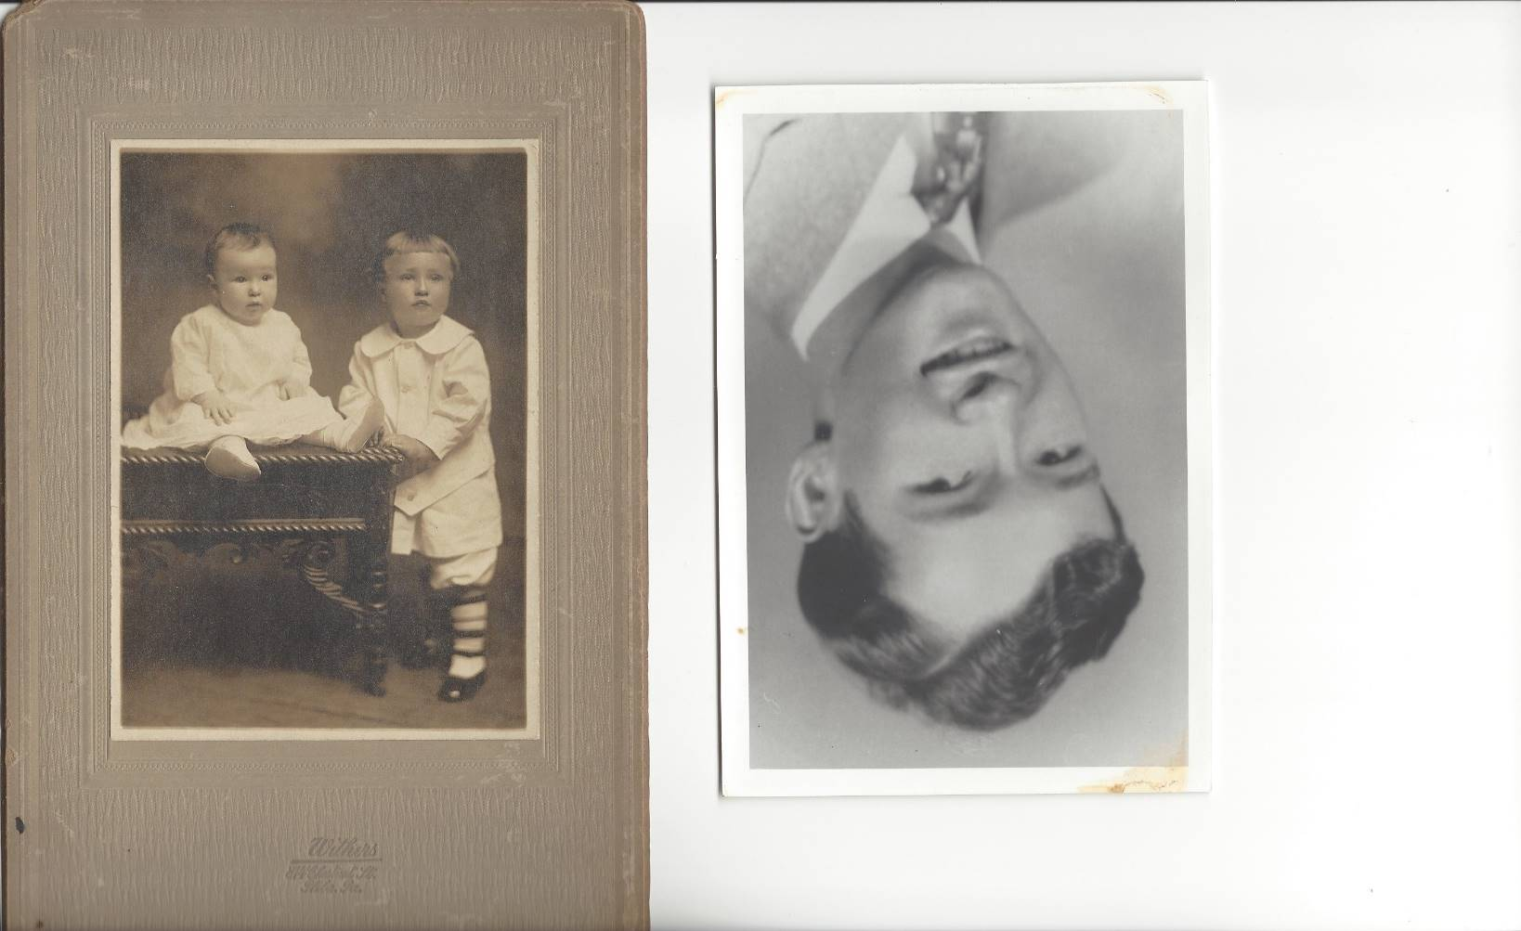
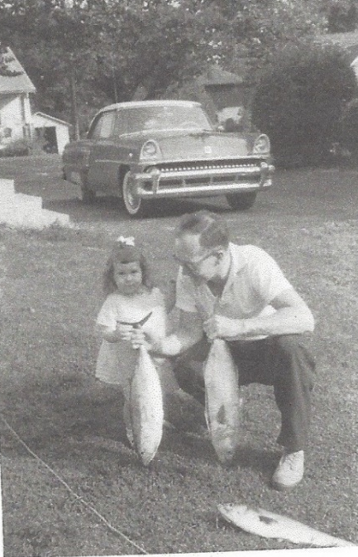
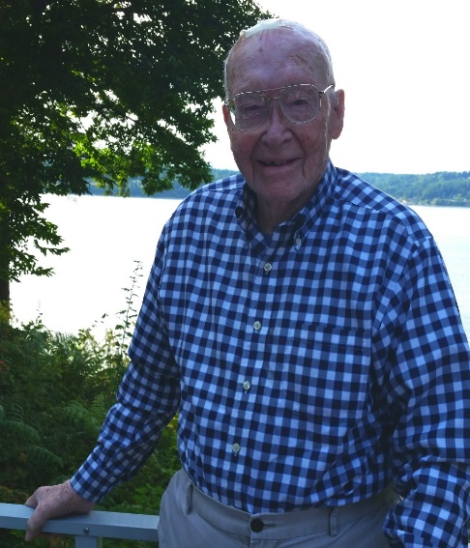

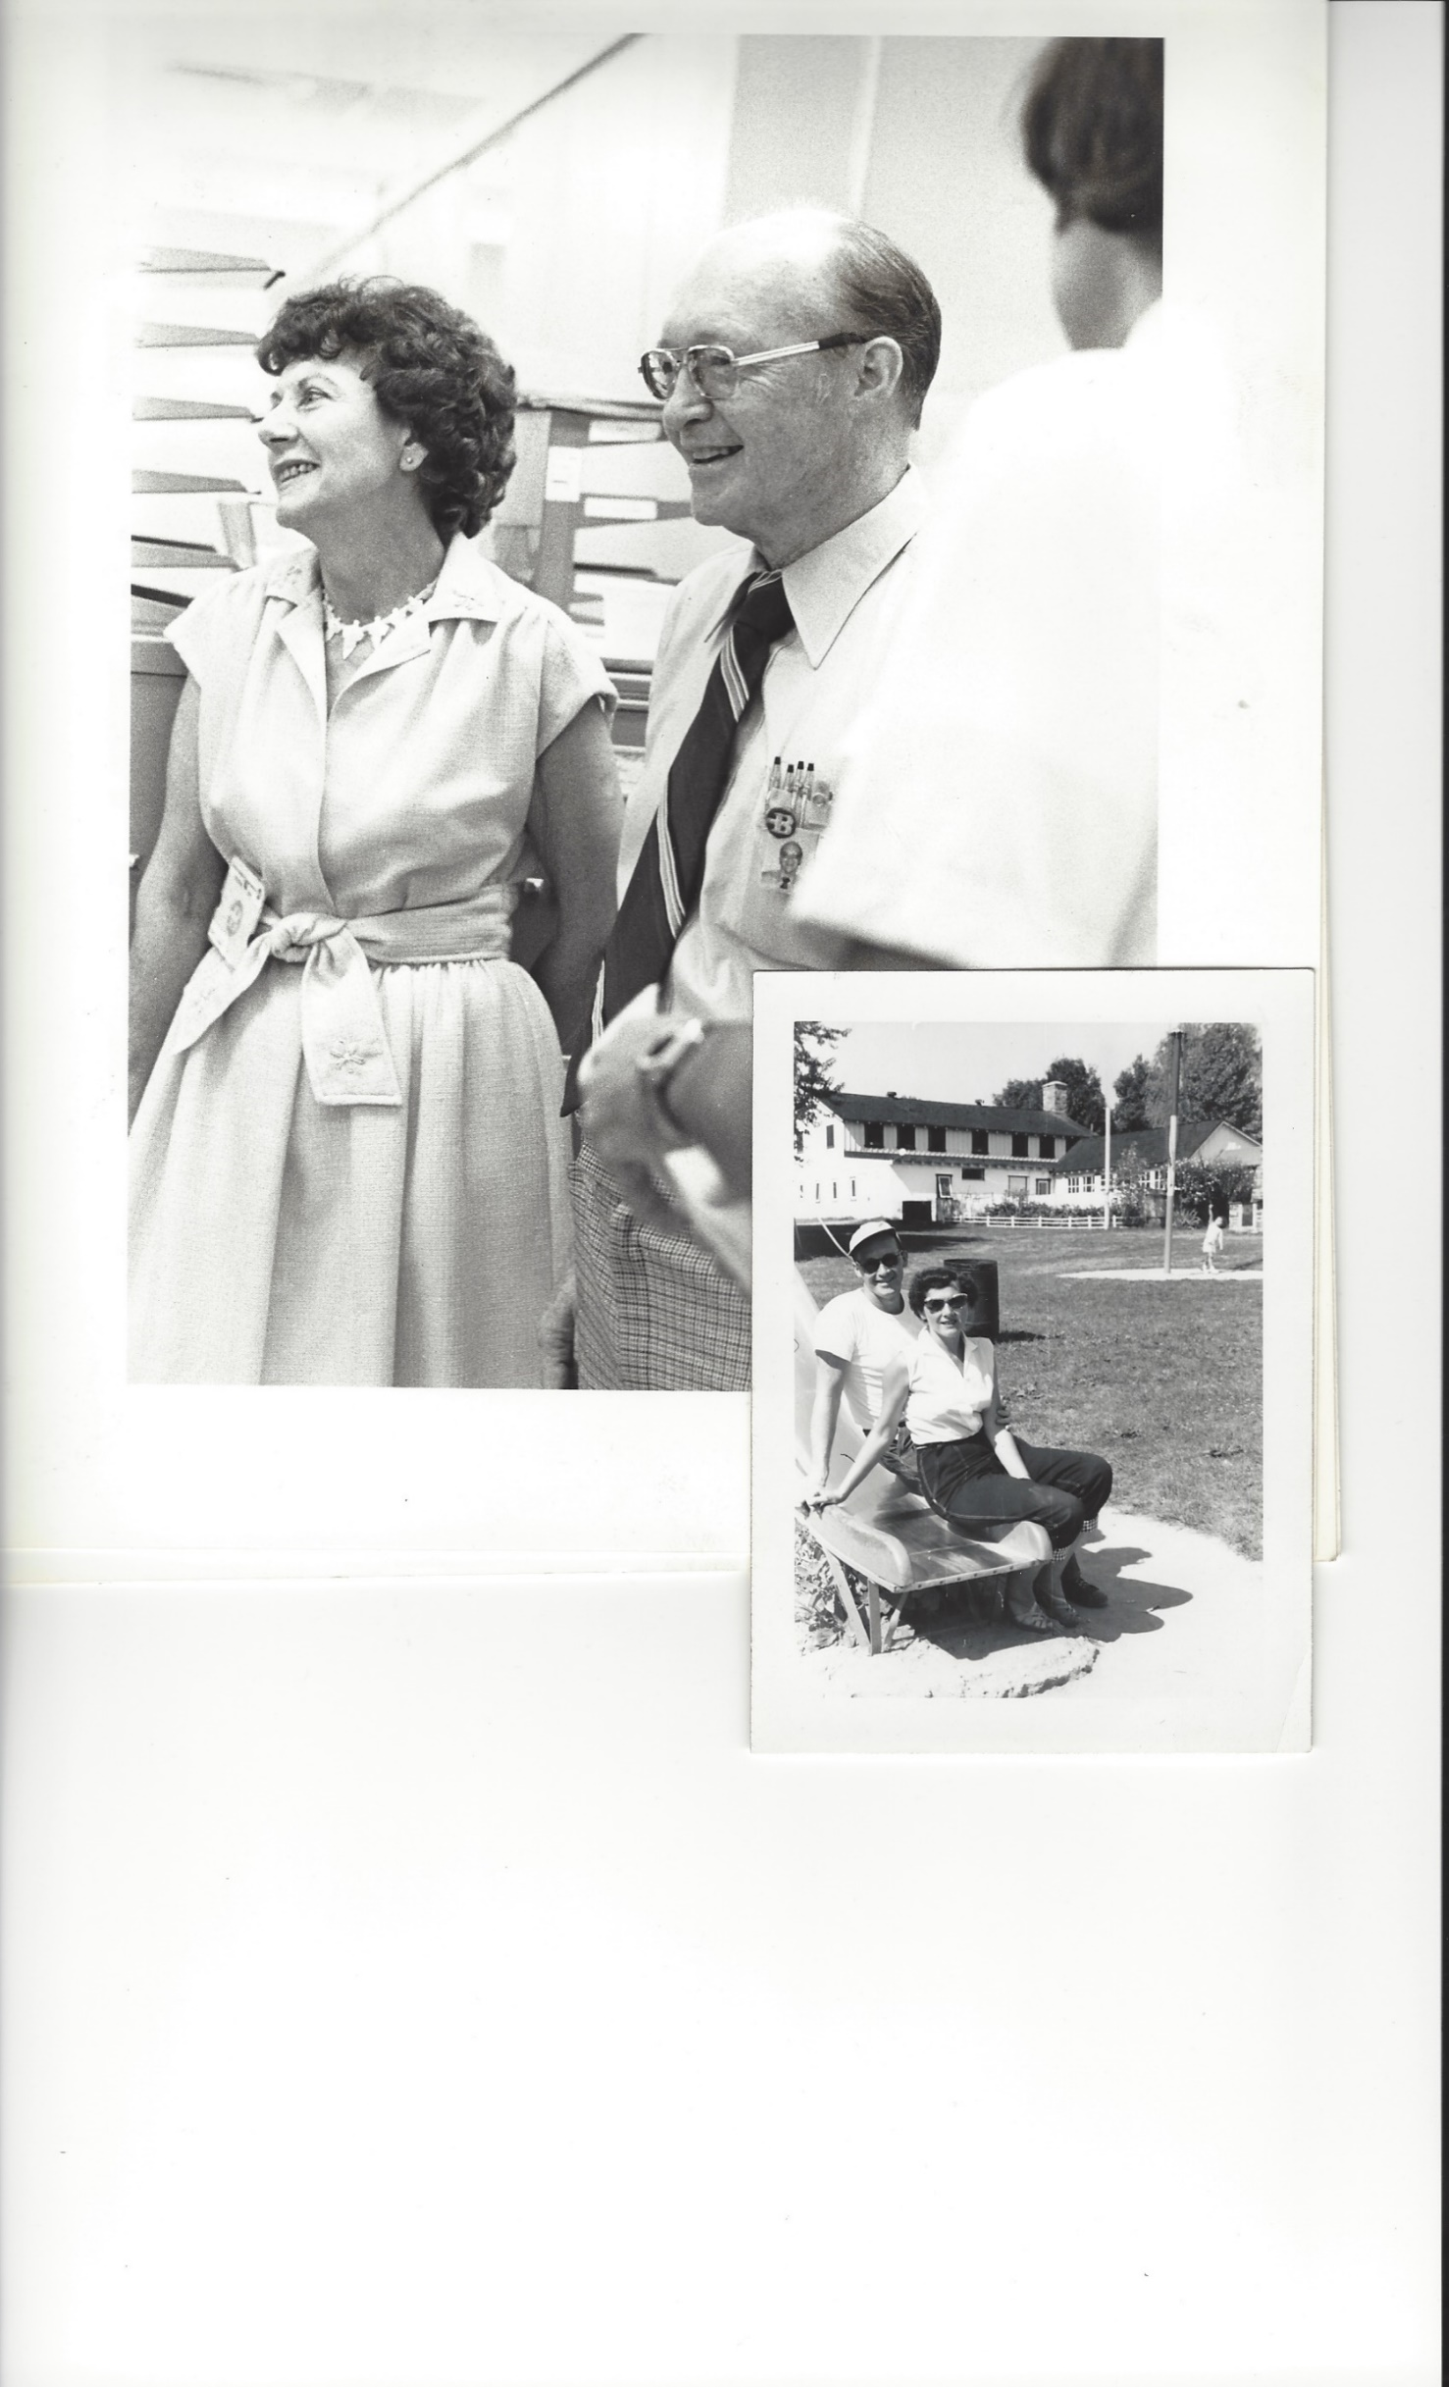
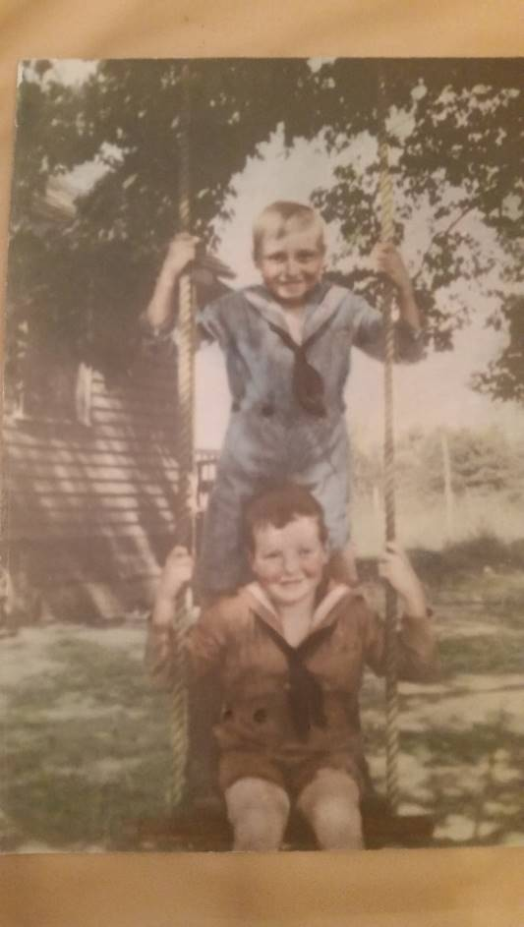

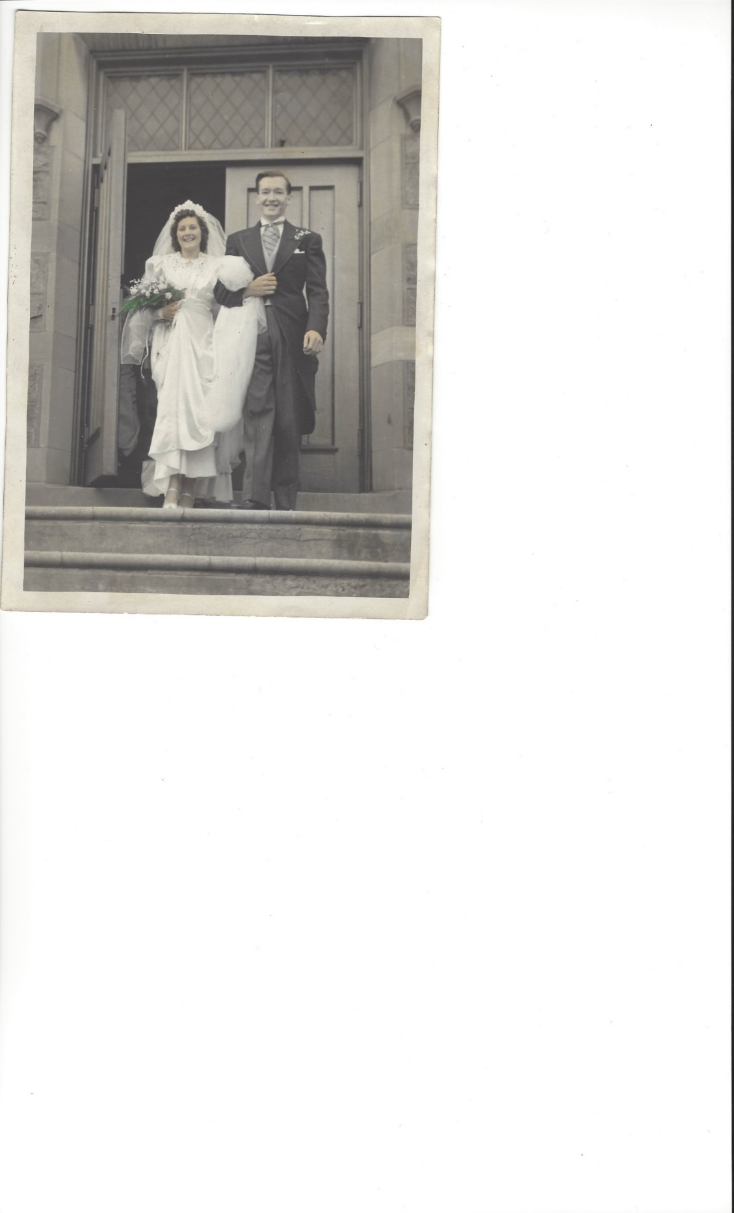
Notes:
This is my dad…. We took this picture this summer just a few weeks before his 101st birthday. We lost my mom 3 years ago so he came to Vashon Island to live with us and write the final chapter, as he says.
Reaching 101 is a major milestone, now he would say getting up every morning is a major milestone. - he loves that pete seeger song how do I know my youth is all spent my get up and go has got up and went but in spite of it all….
CLICK
it was interesting to hear him reflect and think about the meaning of over a century of experience, a century of building a life one day at a time. CLICK
His reflections created space for me to think about building the life of a library, of a campus… what day to day and century to century value do we bring that will over time contribute to building a meaningful story to tell about the value of a library.
Or as dad has brought value to my life and others, what lives will we influence by designing experiences for and with others that add up to something meaningful.
I’ve been working on building what I can best call a learning system that we can reflect on, learn from, and collaboratively create for students in a manner that builds the same richness of experience for the 4 yrs – probably not 101- that students are with us on our campus.

Slide 3
…an interconnected world, embedded in a fabric of relationships that requires us to pay attention to the dynamics of systems, not isolated individuals, buildings, or events. The natural world is adept at change, unfathomably complex, and filled with systems that support increasing diversity.
-Margaret Wheatley
Notes:
The root of this came from reading Margaret Wheatley who has written about systems thinking for many years.

Slide 4
Learning System
Dynamic network of intentionally designed elements co-constructed by educators that assures an optimal learning and research experience for students, faculty, and researchers.
-d.g.
Notes:
Who are we connecting with, what are the intentionally designed outcomes

Slide 5
Notes:
You have to promise not to laugh at my graphics… we collaborate well. If the larger circle is the institution, there are many fabulous partnerships and collaborations that at the very least serve the connected entities.

Slide 6
Notes:
What I think I mean by a learning system is more like this…. Where those collaborations are intentionally designed, strategically placed; and in enough alignment that there is forward, synchronous momentum.
As I was thinking about how to describe this system – I thought ok, I’m in Ohio – right there is a fabulous illustration.

Slide 7

Notes:
If this was really illustrative of what I invision it would rotate in 3d and create spider web links ….Don’t mean everyone has to think and act the same – I am not talking about group think. I actually value risk taking because in the risks are often the innovation we need to progress. Some of these horses have wild manes, others are jumpers, others have braided tails…… but there is a common purpose that we are all synchronizing energy around. We have thoughtfully designed this horse to be sure we have a holistic system.
So what is the library’s role in this learning system… Certainly Can’t speak for all provosts, but since moving to this role I have a much better idea of what I want from a library. Today I have 5 considerations for us to think about.

Slide 8
1. Aligning with and Strengthening the
Learning System
Notes:
First step there is Aligning with and Strengthening the
Learning System. Even if you don’t have one…..
A trick, eh?
You can take steps that will form the foundation

Slide 9
Seek to understand the big picture
Look for interconnected issues that impact more than one element in the system
Use your knowledge of the system structure to identify possible leverage actions
Examine multiple perspectives of an issue
Notes:
Systems thinkers would have us: READ
Consider what will make the elements of the system stronger – not just your own node. I love that libraries are creative and innovative places, but what I’m looking for is that innovation to not just be about the library – but for the library to reach out and determine how to strengthen and align with others.
Megan spoke about value and institutional context – one way to do that is to be sure your work is part of what your college or university is trying to achieve.

Slide 10
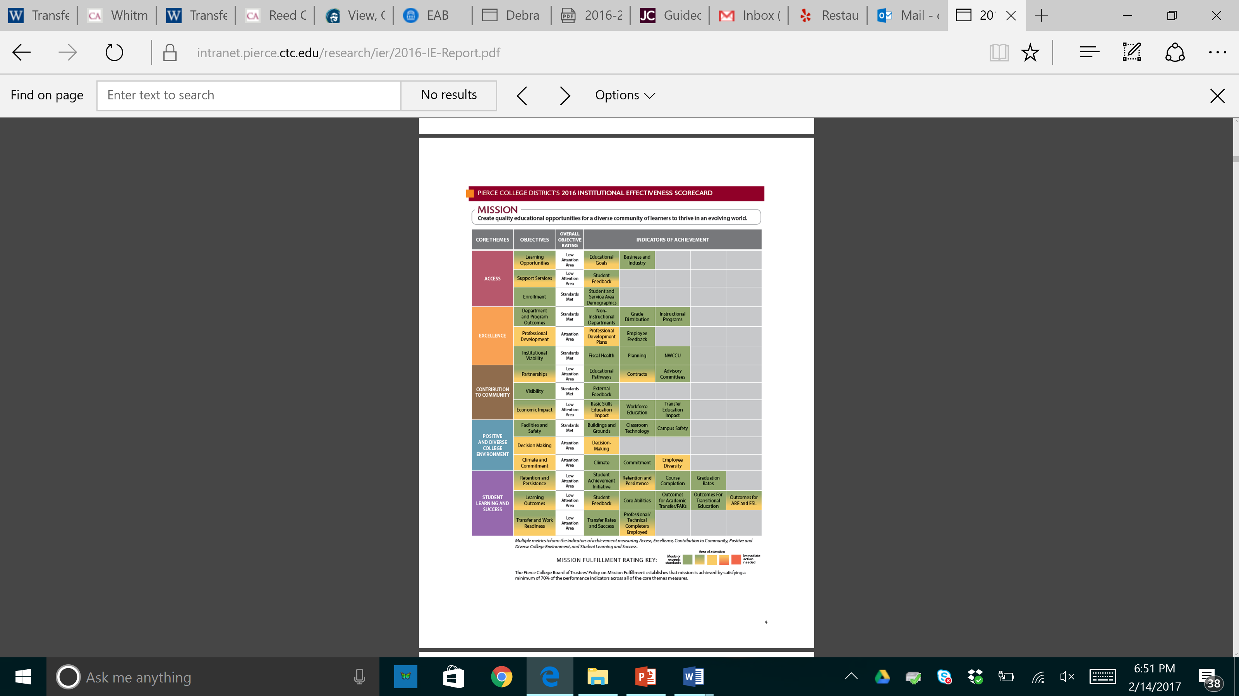
Notes:
Let me give you an example of strengthening and aligning with the learning system. I am going to use a lot of Pierce examples today – but please know I am not suggesting us a model. I love what our library is tackling, but every campus, every library is different. I’ll rely on you to help me make bridges to larger institutions, smaller more focused institutions…
This is our IE scorecard. Almost every institution has something like that that they use to report to the board or demonstrate mission fulfillment to accreditors – it may not look like this but it exists in some form.

Slide 11
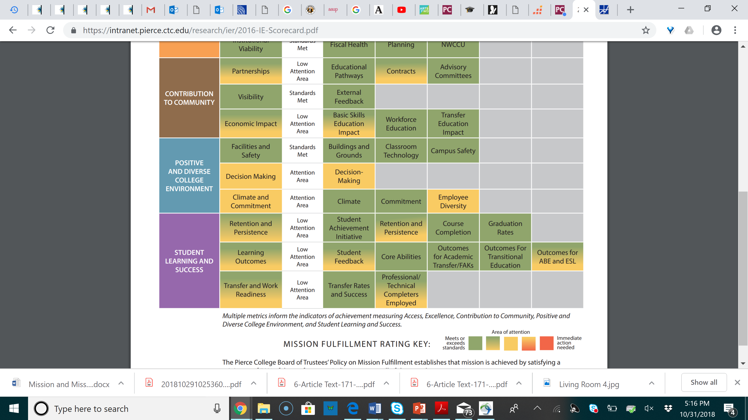
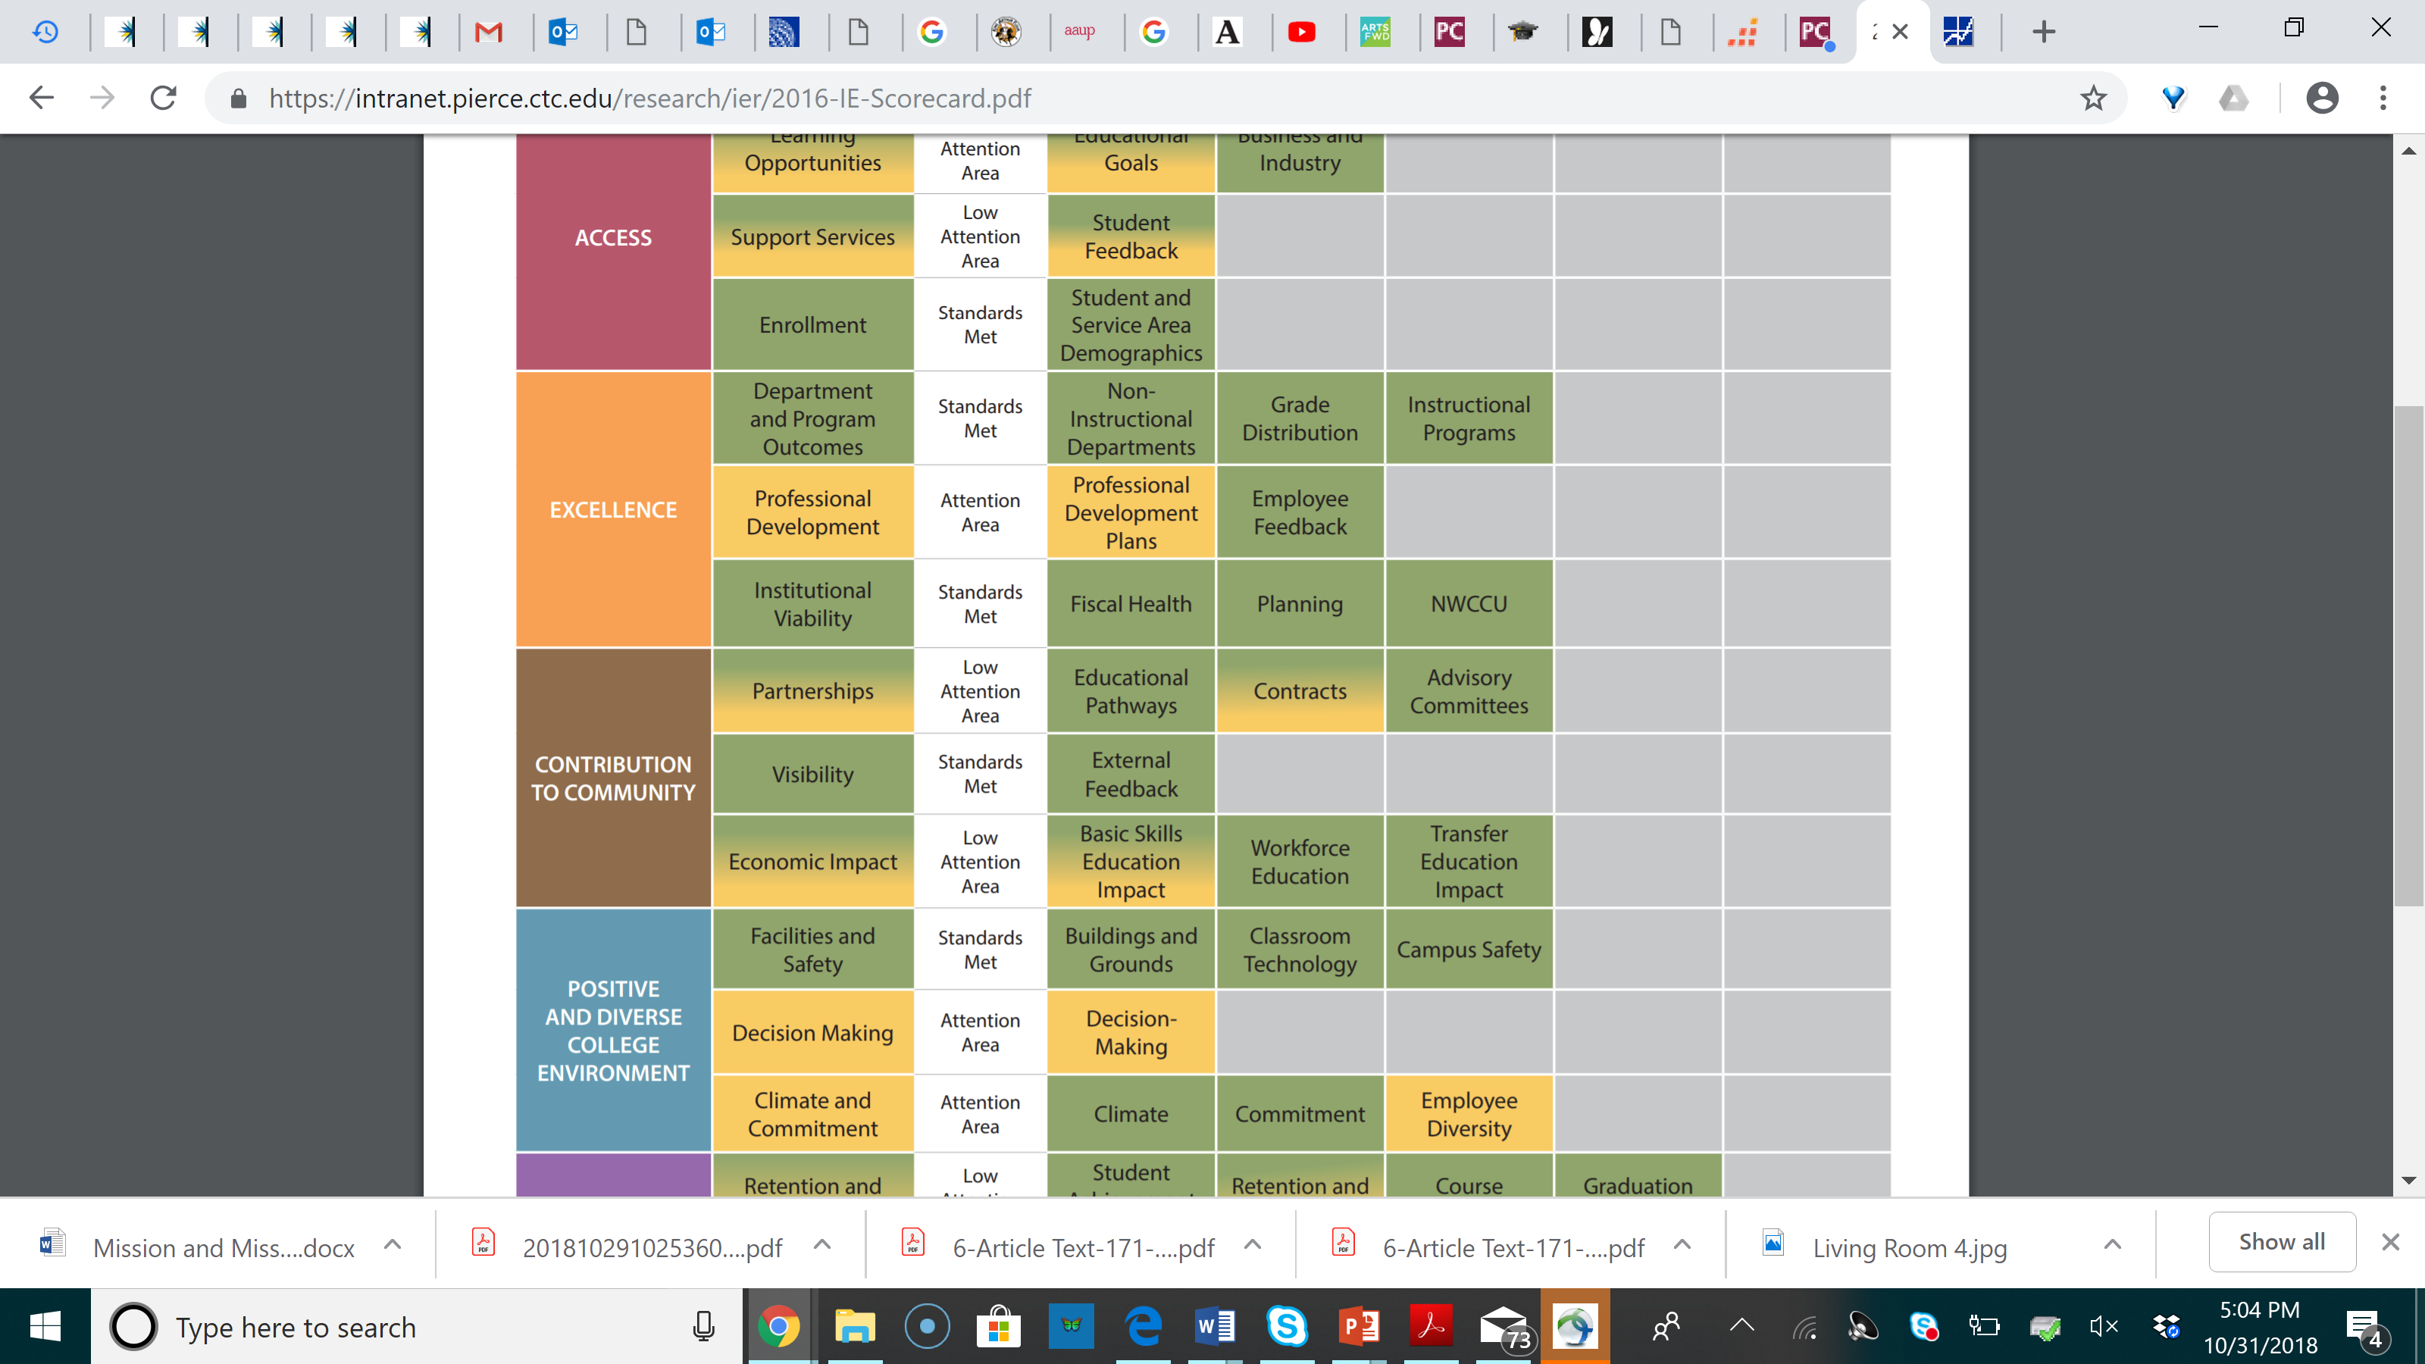
Notes:
What our library did was look to see what elements of the scorecard they could influence and started designing assessment projects that would do that.
Under Stu learning and success they thought they could influence…. Student Achievement Initiative is our states performance based funding model – I know Ohio public institutions are funded this way as well.
One of the data points was completion of dev ed English and transition to college English. So they designed instruction for dev ed classes that when assessed had strong statistical significance – if students participated, they transitioned. Think about the impact of saying you brought X amt of dollars to the college through the perf funding model. Their influence was clear

Slide 12

#2 Respond to Research that Aligns with
Institutional Priorities
Notes:
#2 is Respond to research that aligns with Institutional priorities.
This could be in two ways.

Slide 13
Determine the learning/retention/persistence/ success gaps and identify corresponding research
Design/Refine new library interventions in light of the research
Assess and Revise Intervention
Notes:
First is to …..

Slide 14
Student Engagement and Learning
Chickering /Gamson
Tinto
Kuh
Student-faculty Interaction
Student Cooperation
Student Investment in their Own Learning
Connection/Belonging/Agency
Growth Mindset
Notes:
For example – researchers like Chickering Gamson, Tinto, and Kuh have given us great perspective on… READ
We can use that research as a basis for improvement in our libraries

Slide 15
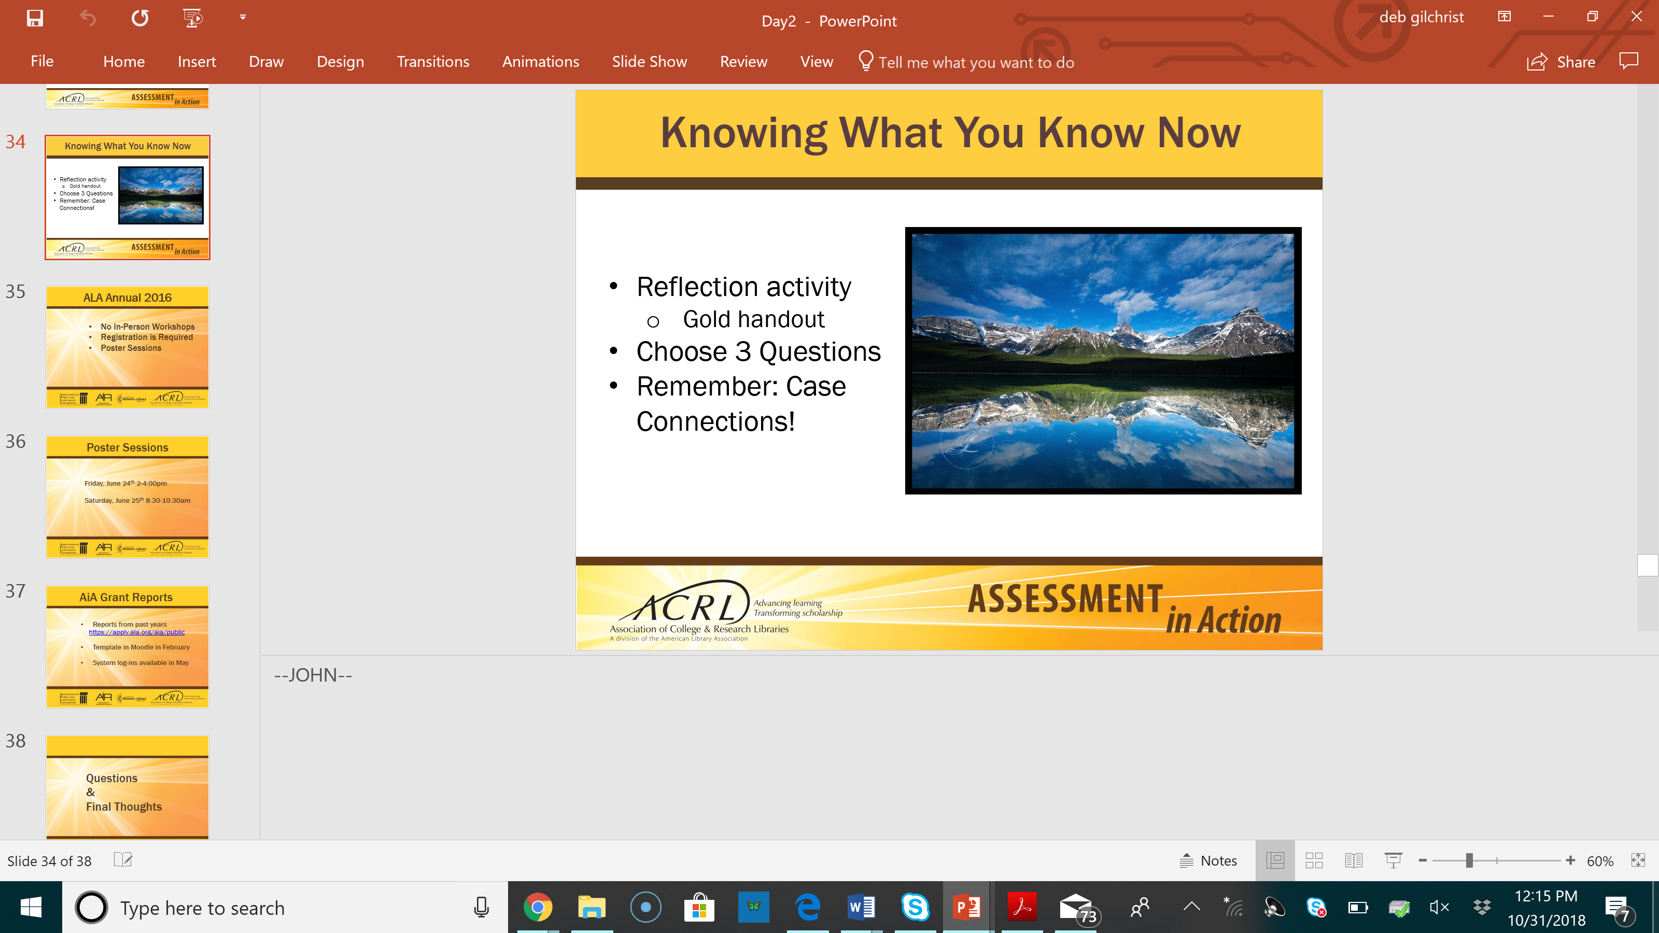
Compelling Evidence
Students benefit from library instruction in their initial coursework.
Library use increases student success.
Collaborative academic programs and services involving the library enhance student learning.
Information literacy instruction strengthens general education outcomes.
Library research consultation services/reference boost student learning.
Notes:
We can look to programs such as ACRL Assessment in Action.
It was designed to build capacity for librarians to conduct relevant assessment and action research not necessarily to determine research findings. But through the 3 year project compelling evidence about library impact in 5 areas emerged:
Students benefit from library instruction in their initial coursework.
Library use increases student success.
Collaborative academic programs and services involving the library enhance student learning.
Information literacy instruction strengthens general education outcomes.
Library research consultation services boost student learning
Can start here to select value projects that connect to institutional and learning system needs

Slide 16
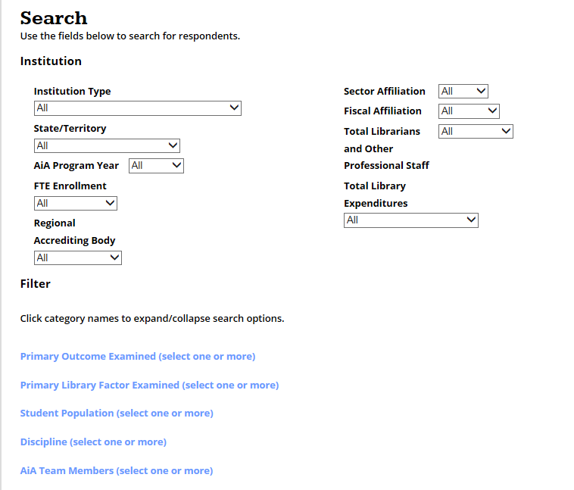
AiA Database
http://apply.ala.org/aia/public
Notes:
Database of all the project is on the acrl website….. Searchable and includes specifics of each campus project online (with images of final poster presentations)

Slide 17
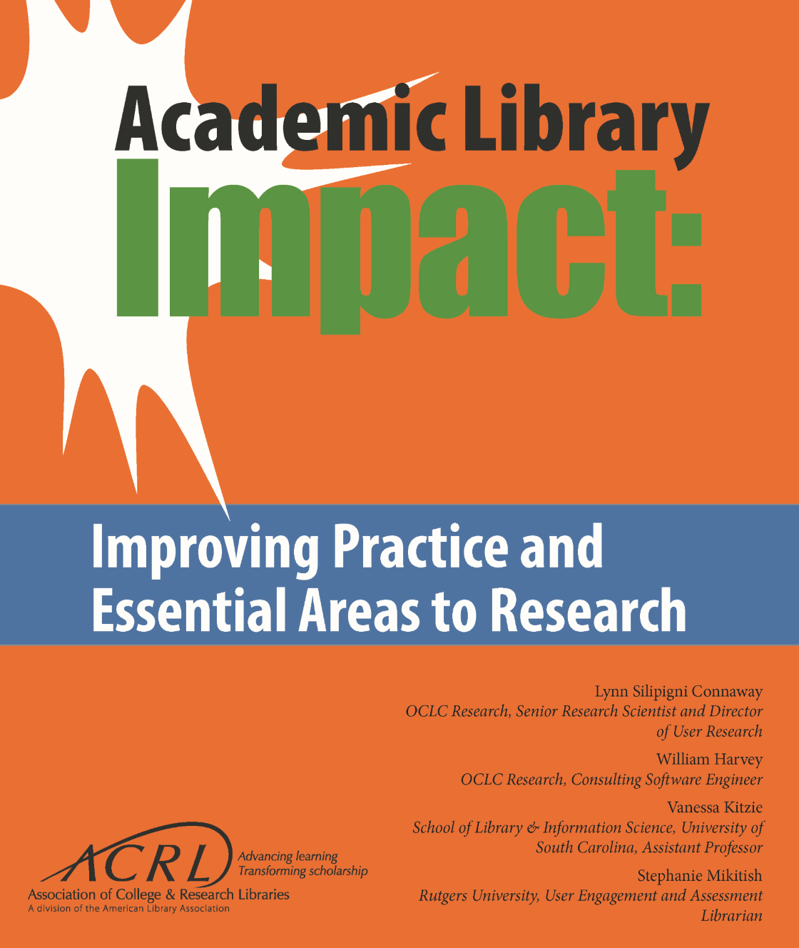
ACRL Publications
Notes:
ACRL publications such as Academic Library Impact: Iproving practice ad essential areas to research. Another great place to get ideas.

Slide 18
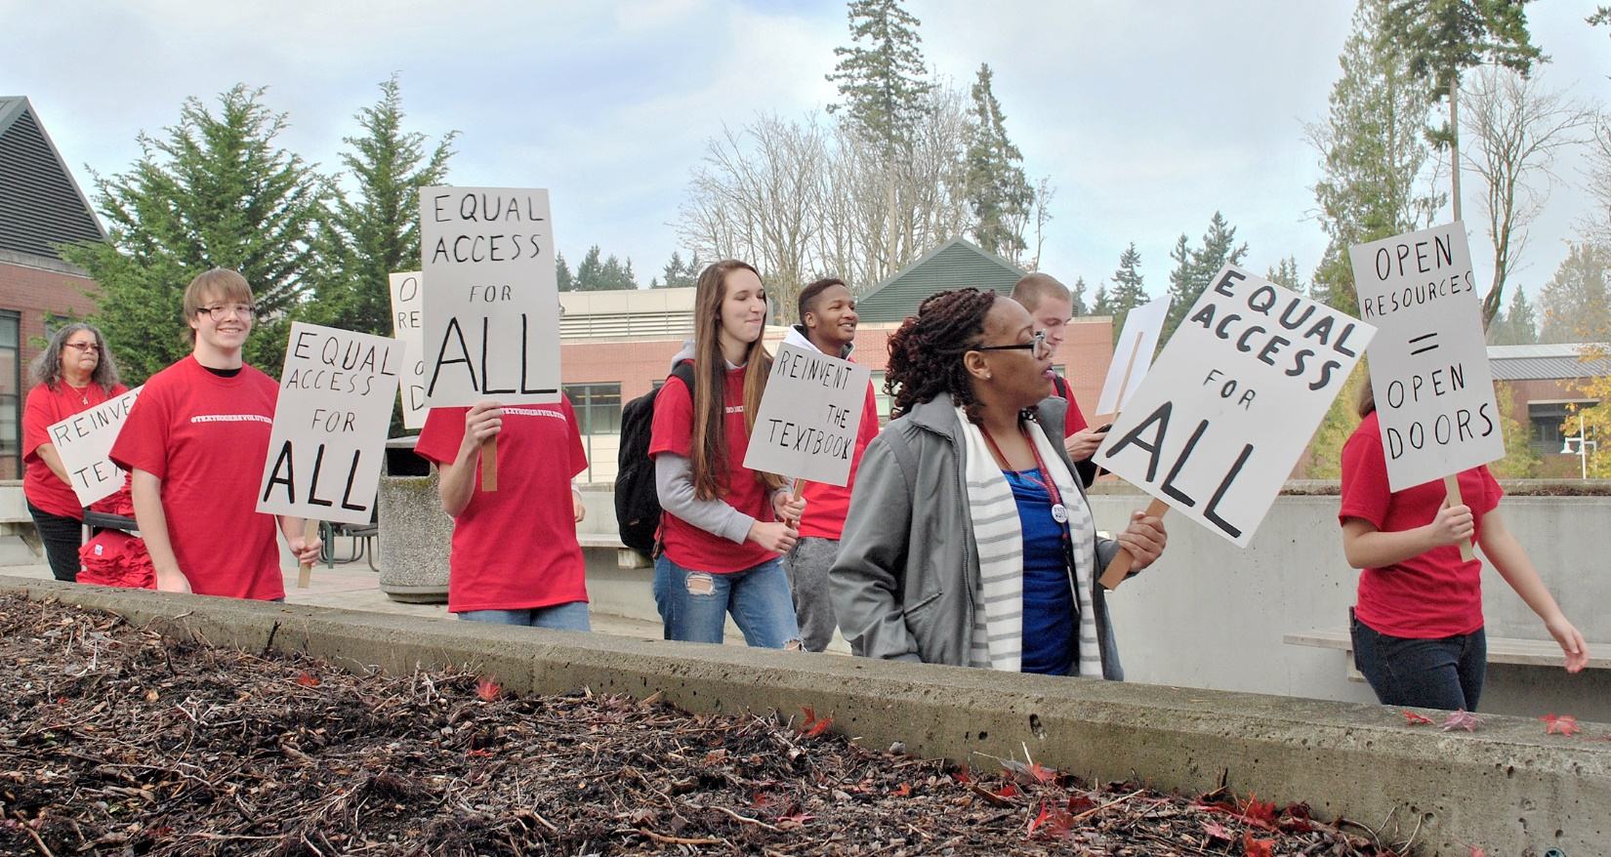

Open Education
“Student Rally” by Students of the Puyallup Post is used with permission.
Notes:
I know oer is a high priority on many campuses so wanted to say a little about it. Like most, our first entre into Open came because we wanted to save our students money. The average at Pierce is $2200 for books to complete the AA degree, and since community colleges have been about opening doors and increasing access, it was our job to look at what barriers might be in the way.
So the library proposed to the college that we set a goal of developing a full degree pathway using only open resources as a way to tackle access and equity concerns. It was accepted - We hired a fabulous librarian to lead our project which we called POP –Pierce Open Pathway.
While we started with money, we realized in our planning that the true power of this project would not be in the cost savings to students, but in pedagogical reform we could bring to the classroom experience. We took an instructional design approach that incorporated all 3 elements: Open resources, open course-redesign, and integrating IL.
Libraries have the opportunity to move the conversation beyond resources – I’m starting a campaign to drop the R and just say we are in the Open Education business. The power is in the open pedagogy. IF we just look at OER as textbook replacement, libraries are missing huge opportunities to deepen their role in the institution, and help change the educational experience for students.

Slide 19
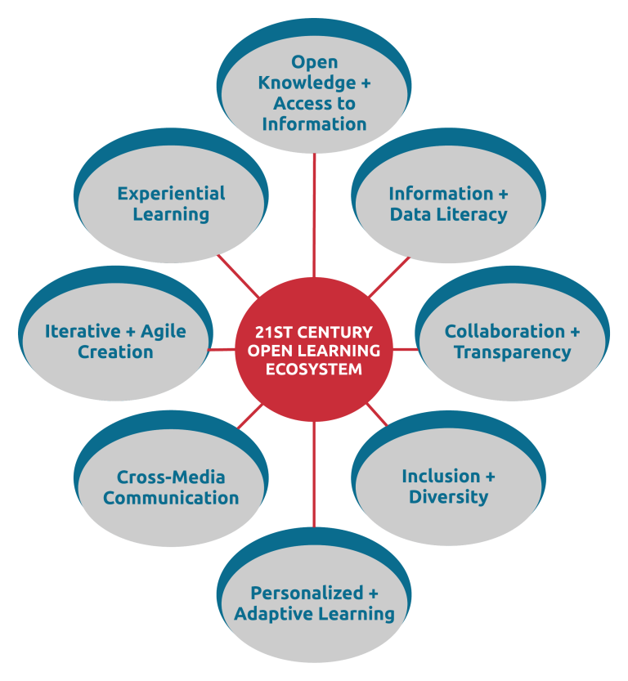
Informed Pedagogy
“Open Learning Ecosystems” by OSPI is CC-BY 4.0
Notes:
This image from the Learning Center at Duke University shows all the ways open education impacts learning. READ -- linking to open resources helps students in a number of ways, but take this next step and integrate Open Pedagogy. We are the right people to be leaders in this endeavor.

Slide 20
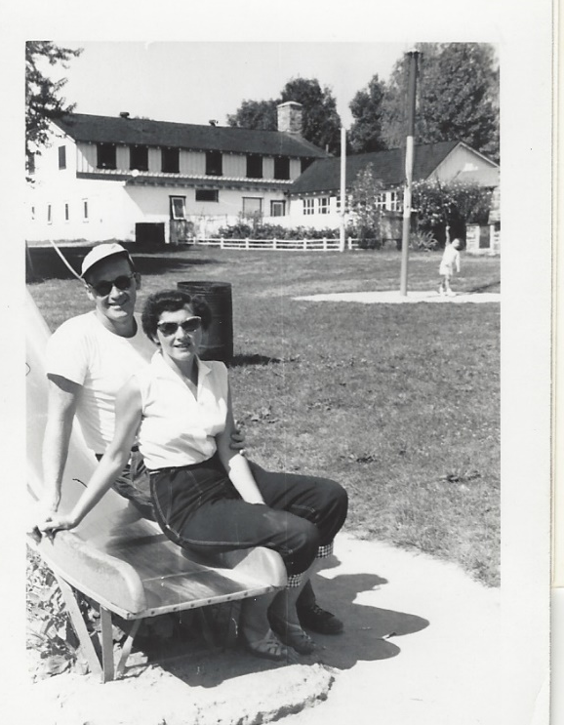
3. Be Bold with Data
and
Influence the Data Culture

Slide 21
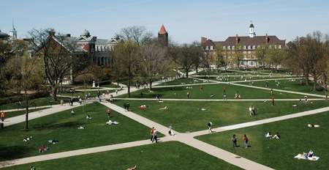
Cross-System
Notes:
Many colleges and universities are contracting with companies developing data analytics platforms that connect our disparate systems, data, and initiatives to gain insight into what works and what doesn’t and for whom.
I think about it like the paths across the quad – they serve to interconnect and many of those paths were put into place because of students initiated patterns, these large databases will do the same
They are looking at every bit of data an institution has to offer and seeing what correlations they can make, and more importantly about what predictions they can make about what students should do to be successful.
They take all of these diverse data points, that can be very inconsistent, and use very sophisticated modeling to determine relevance, relationship, and power
They are looking at trends and change over time, demographics, student activities, activities around key events, social networks….everything. Where is the library data – is it in the dataset for Starfish or Civitas or EAB – major companies that play in this sandbox. Is the value you bring to the table evident at this level?

Slide 22
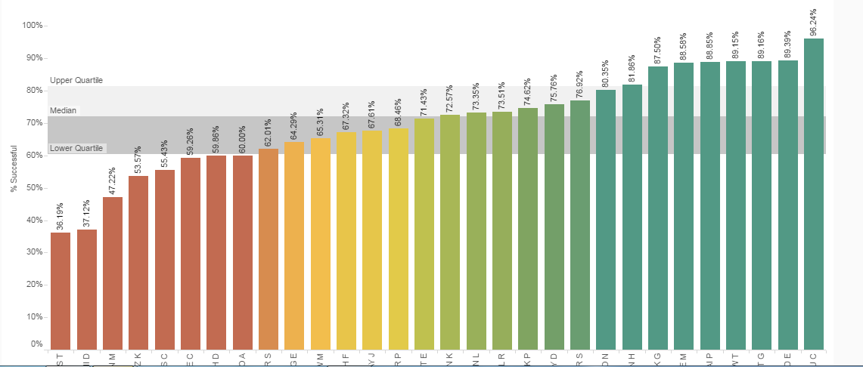
English Completion Rates
Notes:
There are many ways to gather data and evidence. Let me tell you one way we are doing that at Pierce
Students in a focus group told us that the best predictor of success in English 101 was who you took the class from. This is a chart of student success rates with our full time English faculty completion rates averaged over several quarters. They range from 36 to 96. So students were right.
I gave English faculty this chart and asked them to do the analysis – they saw it as a social justice concern and worked on finding solutions.
As a result,
We, as we say, democratized our data, and opened up all of it to every faculty member. That includes course success rates, subsequent course success rates, and many other options. We built tableau dashboards that allow faculty to disaggregate data in any number of ways. The power is in their hands -
There was an article about this in the Chronicle, and one blogger said he was surprised at this outcome as it was the kind of thing that would make faculty go berserk, leaving options for an institution to “use the data against them.” It – so far and we are 4 years in - because we worked hard at changing culture, and creating what I call a data positive culture. It means that as provost, faculty have to know that I understand:
The person with 36% completion is not the worst fac member and the one with 96 is not the best. They have to know that I mean it.
Leadership for cultural change, for data use, for analysis of data matters. We have to let more of this happen so librarians, all faculty and staff, have the freedom and information to deeply analyze learning and solve problems.
our library is also using the data dashboards. They are working with English on the norming of papers, they are looking at the student success of classes that had library instruction and didn’t. They are looking at the subsequent course completion of students who took our 3 credit IL course –did students who took it do better in courses in subsequent quarters that had heavy research emphasis.
What is the impact of OE on a students completion of key courses where those concepts are particularly relevant. And they are disaggregating all kinds of data to determine who is not succeeding so that they can design programs to lift up those students – not just talking about the positive correlations that already exist.
For example – we found out that our students of color were not using the library or tutoring at the same rates as white students. They are looking at what they can do – right now examining the social, institutional, and cognitive barriers facing students of color.
Be brave. Use data wisely and strategically. Hold focus groups ask students what they need.
If you are an administrator, help your staff feel safe with data by asking inquiry questions so they know blame and guilt are not a part of collective problem solving
If you are a brand new instruction librarian and feeling no power – incorporate an assessment into your class and ask someone else to help you interpret – not that you can’t do it alone, but you can take the lead to open up data conversations.
If you are a head of reference, bring dept level data to each meeting that allows you to talk about students in multiple ways. This is about them.

Slide 23
#6 Act on Equity, Diversity, Inclusion, Racism, Anti…
Notes:
I changed this section on the plane ride here… its been a hard week with the loss of two black shoppers in a Kroger store just because they were black and the 11 Jewish worshippers in Pittsburgh.
Not meaning act on these in the political sense. We can all hold different views and vote our conscience.
I am saying that we invite students onto our campuses who are all different colors, creeds, styles, backgrounds…. We need to serve them all, take responsibility for all of them, regardless of individual characteristics. They are OUR students.

Slide 24
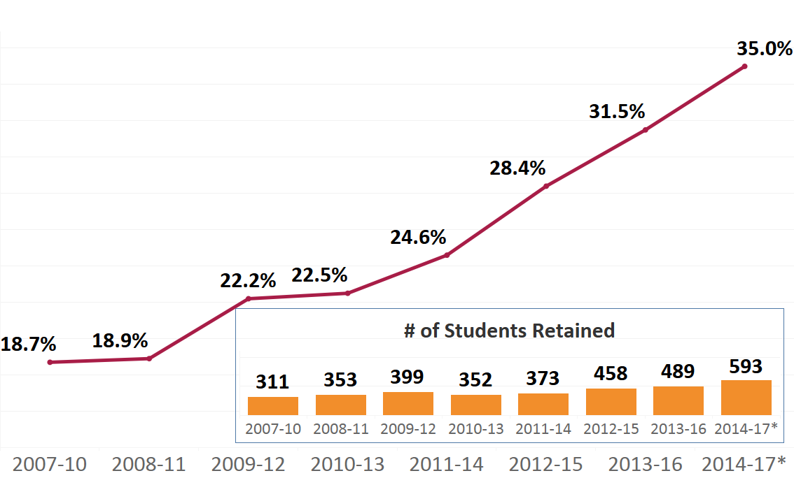
3 Year Graduation Rate
# Students Graduating
Notes:
This was our 3 year grad rate -- who wouldn’t be happy that we have doubled it.

Slide 25
White Students Compared to Students of Color 3 Year Graduation Rate
17.1%
Students of Color
Notes:
Here is the same data with white students compared to SOC. Not as great.. We have so much important work to do. Libraries can play a critical role both in settling and in shaking up.
Lets shake things up first:
Please think about how you as an individual and a library will confront racism, anti-Semitism, and other antis. We all avocate for equity, but if we are not talking about race we aren’t getting to the heart of the issue.
Our SOC tell us they need to see fac and staff that look like them, and we can all work to diversify our hiring but its not enough.
The systems and structures at the base of that reality have to be undone. The imbalance happened for a reason – barriers need to be broken.
Do a policy audit – look at everything you do and plan and ask what are unintended barriers.
If you have IL classes, go beyond talking about bias and perspective and bring in power and privilege -- why are some materials here and not others. When you search databases whose voice are not there and why
Disaggregate all your data, and in the disaggregation are the inequities.
When you plan displays of special collections or archives leave a blank space for the missing voices and describe why they are missing.
On the settling side: Hold a FAFSA party with experts to help students; we expanded hours to open before our quarter started because our students told us they did not have internet access at home. Or help students apply for graduate school.
There is solid research about the role of belonging – that if our SOC feel like they are welcomed and belong they will thrive. Libraries are a great place for that to happen. We can make connections that others can’t and influence their experience.
-- You may not make a difference for every students, but you will change the lives for the ones you do.
Think about the power you have to make a difference and use it. Become an accomplice, not just an ally.

Slide 26
Think Systemically
Contribute To A Learning System
Build On The Strong Body Of Evidence
Be Bold With Data
Act on Equity, Diversity, Inclusion, Racism, and Anti…

Slide 27
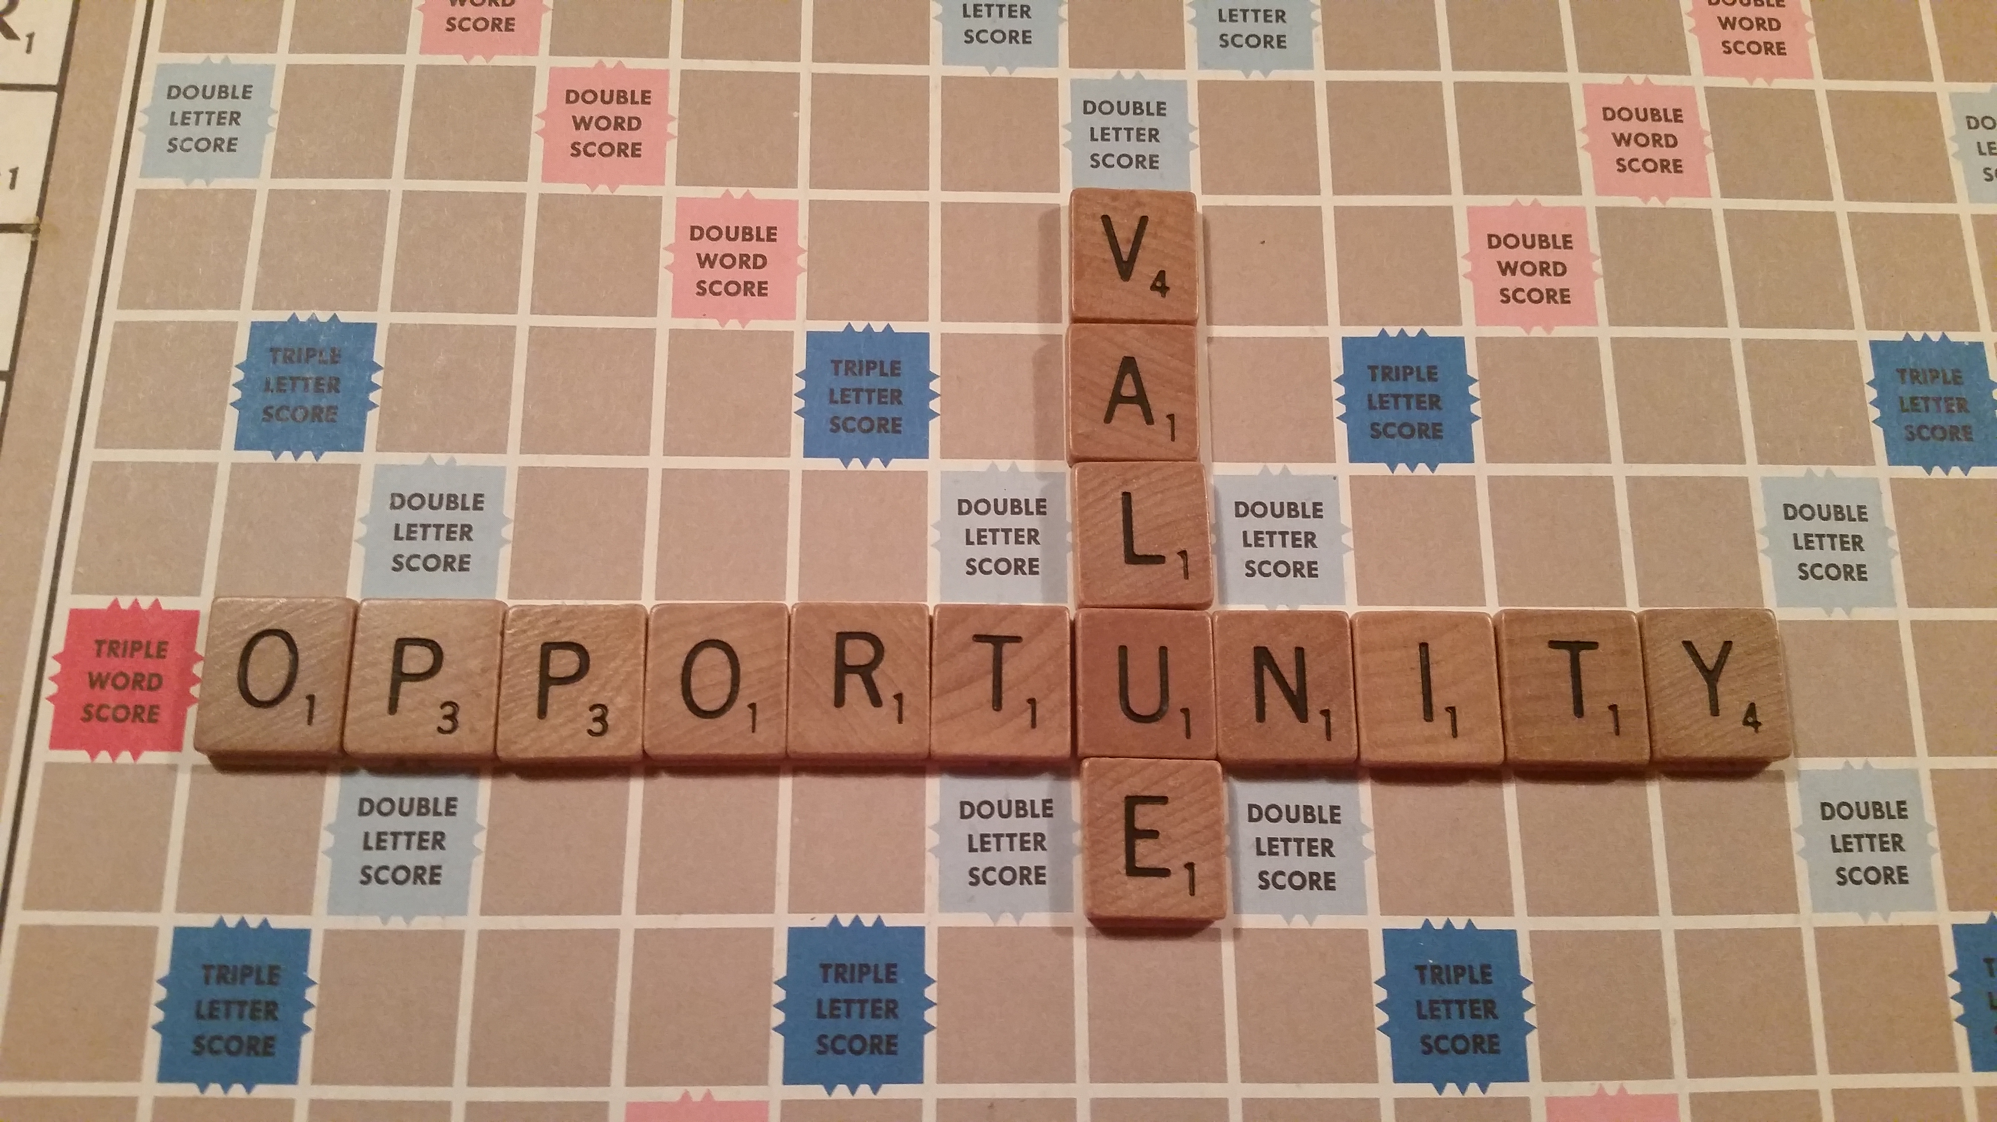
Notes:
Where are the opportunities and where is the value? Finding them will help to solidly contribute to that learning system and firmly and deeply center you in your institution. Be proud about what you have created – great collections, space, services, but also
Be proud of who you have impacted through your demo of value.

Slide 28
Connecting to Mission Fulfillment…

Slide 29
Building Evidence
Student retention improves with library instructional services.
Library instruction adds value to a student’s long-term academic experience.
The library promotes academic rapport and student engagement.
Use of library space relates positively to student learning and success.
Notes:
KAREN
And we have building evidence in 5 other areas:
Student retention improves with library instructional services.
Library instruction adds value to a student’s long-term academic experience.
The library promotes academic rapport and student engagement.
Use of library space relates positively to student learning and success.
Read more in reports…

Slide 30
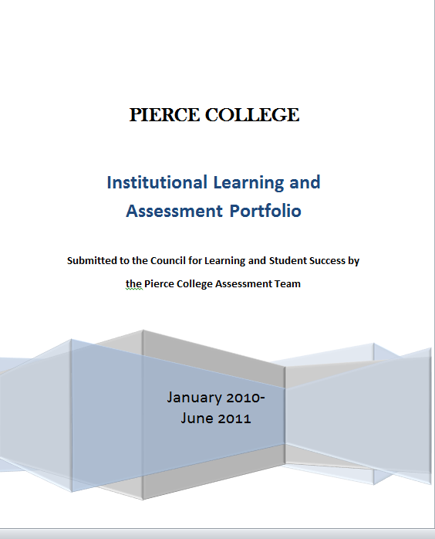
Notes:
Make your value visible

Slide 31


Learn more about the ACRL program “Assessment in Action: Academic Libraries and
Student Success” at http://www.acrl.ala.org/value/ and at http://www.ala.org/acrl/AiA.
Notes:
Program involved over 200 campus teams . . .
We now have field-generated knowledge about what it takes to get action, authentic.
Although each campus situation was unique, some commonalities emerged (both in findings about library impact on student success and collaborative teams)

Slide 32
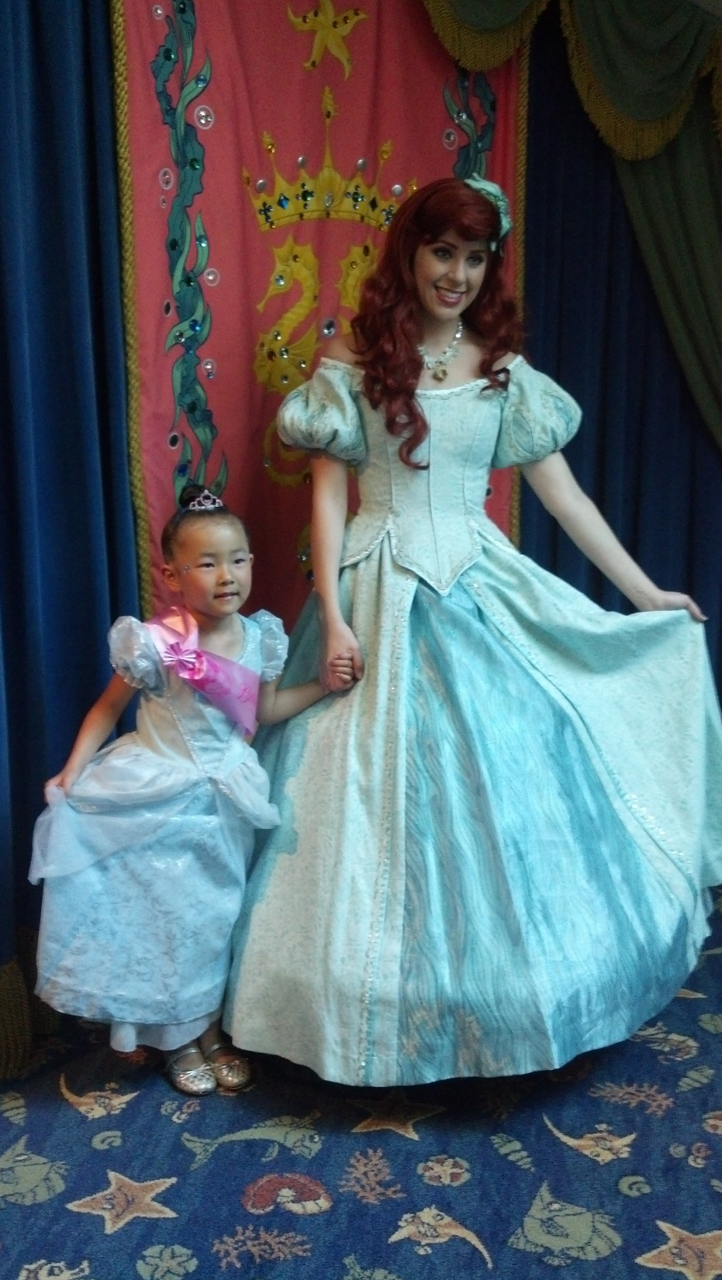
Notes:
Disney story… hold up magic band
Room key
Payment system
Fast pass
Links friends
Soda cups… A friend bought a refillable plastic cup she could use for her entire stay and when she paid, they didn’t ask her how long she was staying. She thought, why did I pay for 5 days when I could have paid for one and they would never know? Then she went to the soda machine, put her cup up next to it and the led readout said “hello lori… you have 5 days left on your card…”
Think about what they can predict about visitor behavior the Disney facilities.
I tell you this story because analytics, including predictive analytics will be part of our future in higher ed as well. I do not want to imply that we will be putting arm bands on our students and monitoring whether they really do go to tutoring or whether they order vegetables at the dining hall. Disney is a company with a business model, We are colleges and universities with an education model. But I do think there is power in looking at the role of predictive analytics and determining what that power is for us.
Right now, we have some Widespread but mostly very individualized student success initiatives occurring without an infrastructure to understand what works, when, and for which students throughout the organization. We are all approaching this from various perspectives.

Slide 33
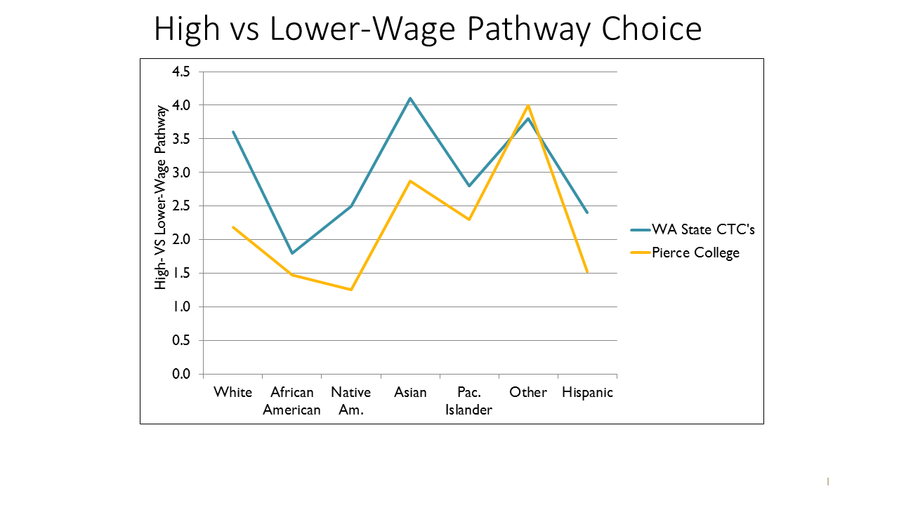
High vs Lower-wage Pathway Choice
Notes:
Deb
David Prince

Slide 34

6. Lead with Strategy and Evidence
Notes:
Take that data, and lead with strategy and evidence
You all are the leaders in this area - - those that are thinking creatively and deeply about this work. What will you do Monday morning, next week, next month to push the agenda, and move the library to the center in your way
Article in 1967--- who will lead the future of higher education: librarians will. Patrick hill. Still sure that’s the case. Repeated this year by xxxx in higher edu?
Start with a few philosophical elements of outcomes assessment and build from there??

Slide 35
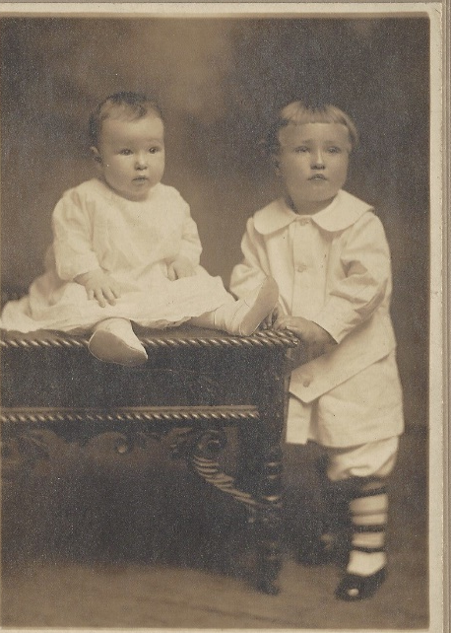
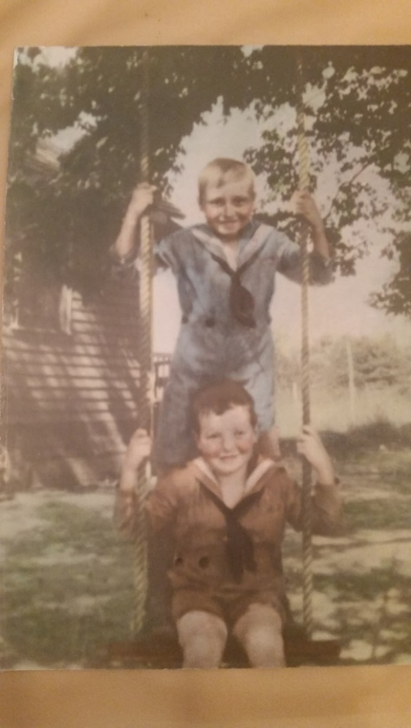
Notes:
You can’t begin to know how delighted I am to be here. I appreciate your interest and support of all things library assessment, and taking the time today for us all to listen and learn and share with a subject we all care about.
This my dad, in a photo taken last month – the occasion was his 100th birthday. He lives with us and it was a joy to celebrate with him. We lost my mom 3 years ago at age 96 so he came to Vashon Island to live with us and write the final chapter, as he says. Reaching 100 is a major milestone, and it was interesting to hear him reflect and think about the meaning of a century of experience, a century of building a life one day at a time. We counted how many breakfasts he had had over 100 years…
This event also created space for me to reflect on building a life… and in searching for the ever requisite metaphor for today…. About what story each of us wants to tell about our library---whats the story of our libraries as revealed no one day at a time, but one assessment at a time. What story of our library do you want to tell…. What will be the body of work that you want to reflect on as the life of your efforts
At pierce I renamed our assessment team the outcomes team, because outcomes and wheter we reach them is always more interesting. Assessments are the instrumrent or the test….the method to the outcome.
All the aspects of what makes a life rich an rewarding and filled with experiences that add up to something meaningful. He has been quite reflective, wondering why he got picked, wondering if his contributions added up to enough.
I was thinking about his reflections as a parallel of our own…of ours for today. Our reflections on what it might take to build a life……or since we RE TALKING ASSESSMENT TODAY,
build a learning system that we can reflect on, learn from, and create for students in a manner that builds the same richness of experience for the 4 yrs – we hope not 100- that students are with us on our campus.
I want to focus today on what it might take from a library to build that effective learning system – one that has value and makes contributions that matter and that we could love back on with pride and solid evidence of that contribution
In the life of a library, of a college or university, what do you want to demonstrate over the course of a lifetime of a college or university, or of a program, what is the
What does it look like to build a life? What do we want to have it look like when all is said and done?
And then, since we are talking academia and libraries, what is it we want from the life of a program, of a library,…. What will matter , what will have long term impact, what is the legacy that we leave to students, to other staff, to faculty, given that …
As you heard from the introduction, I have transitioned to a vp…I certainly don’t want to nor can I speak for every provost, but its certainly has become clearer to me about what I need from a library…. So I thought it as Advice to my former self as alibrary dean from a provost pt of view.
1. Lead with strategy and evidence
1.
What is
caring…
I love metaphor…. Squeeze metaphor until it runs dry….
systems thinking
Connect to the bigger picture – not about the library’s program, its about how well it connects to overall institutional gold
Aia
3. Take risks with the data you seek and show. 5. Use of data – expose it, be bold and honest with it…
You have to do some hard stuff to get a good result
4. Continuous improvement
6. Some things are too important: equity has got to be the driver. Social justice is paramount
7. Its not about the value of the library – its about the value of the impact you have on students
8. 1.0- assess/learn from it/change, 2.0 connect to others outside of the library and partner with assessments; 3.0: look at impact at the next step
9. Be the innovators of your campus- don’t have to do things same old way. Stop being supports. Patrick Hill
Small assessments add up over time- be strategic. What are we learning, how are we hanging because of it.
Ideo: fail often tosucceed sooner. Don’t have to be perfect
We cant sit on the sidelines and be a support to others – we need to be integrated
Go after meaningful strong data-- assess what we value and what will be valued, not value what we can assess
Build fervently on what has been done: AiA , he research
Like oer….we implemented, but didn’t assess the impact

Slide 36
Library: HUB?
Human LIbrary
Notes:
Library as HUB – already have a rapport with students; service point with long hours eves weekends
Human Library – careers
Organizing perm display by career communities
OER
Scorecard

Slide 37
Tableau chart of careers by students of color
Notes:
There are many ways to gather data and evidence. Let me tell you about what we are doing at Pierce
We were concerned about success rates in English 101, and did an number of things to try and understand what was happening. Students in a focus group told us that the best predictor of success was who you took the class from. This is a chart of student success rates with our full time English faculty for one quarter. They range from XX to XX. So they were right. So we as we say, democratized our data, and opened up all of it to every faculty member. So everyone can see everyone elses data. OR: our math faculty asked if they could see their own data 3 years ago. We said yes, and they came back with the most astounding plan to change the way they were teaching pre college math and the first college level algebra course required for most students. We gave them the data and asked them to do the analysis. That led to us doing what I call “democratizing the data” where every faculty member has access to everyone else’s data. That includes course success rates, subsequent course success rates, and many other options. We built tableau dashboards that allow faculty to disaggregate data in any number of ways.
There was an article about this in the Chronicle two weeks ago, and one blogger said he was surprised at this outcome as it was the kind of thing that would make faculty go berserk, leaving options for an institution to “use the data against them”. We have to let more of this happen – faculty have to be given the freedom and information to deeply analyze learning and solve problems. To brush the surface with this… we worked hard at changing culture, and creating what I call a data positive culture. It means that as provost, I have to constantly reinforce things like:
This chart means nothing in terms of faculty performance. They have to know that I believe that. Leadership for cultural change, for data use, for analysis of data matters. Significantly matters.
Math and English both realized that they were interpreting outcomes differently, some were awarding points for attendance, they had not normed assignments. Math did this whole analysis of subsequent course completion and analyzed every outcome, mapped them back to earlier courses, and looked at the way faculty whose students achieved the best were teaching. They also elected to make some common assignments and tests. Because we have been working collaboratively across the college in this way, our 3 year graduation rate has increased 85%, our fall to fall retention is up 61%. We have 1/3 fewer dev math sections because students are not failing. Many depts. Have done the same thing. I have made bold statements around acad free before, so I will take a risk and do that again. Educators have to work together on behalf of students and sometimes that means giving up’ ‘my way’ for the better way. It means agreeing to common assessments when it’s the most effective way. We have often put academic freedom down as the first filter, and then considered other things after that. I’m advocating to not lose it as a value, but use it wisely and not as much with teaching and pedagogy, as much as content and research.
So how is our library using the data dashboards. They are working with English on the norming of papers, they are looking at the student success of classes that had library instruction and didn’t. They are looking at the subsequent course completion of students who took our 3 credit IL course –did students who took it do better in courses that had heavy research emphasis. What is the impact of OE – not just OER but OE on a students completion of key courses where those concepts are particularly relevant. And they are disaggregating all kinds of data to determine who is not succeeding so that they can design programs to lift up those students – not just talking about the positive correlations that already exist. For example – we found out that our students of color were not using the library or tutoring at the same rates as white students. They are looking at what they can do – right now examining the social, institutional, and cognitive barriers facing students of color so that whatever they design can be thoughtful and scaleable.
Ideo…
Be brave. Use data wisely and strategically. Do focus groups to triangulate evidence. Don’t confuse assessment with research. We want solid practices that influence practice.

Slide 38
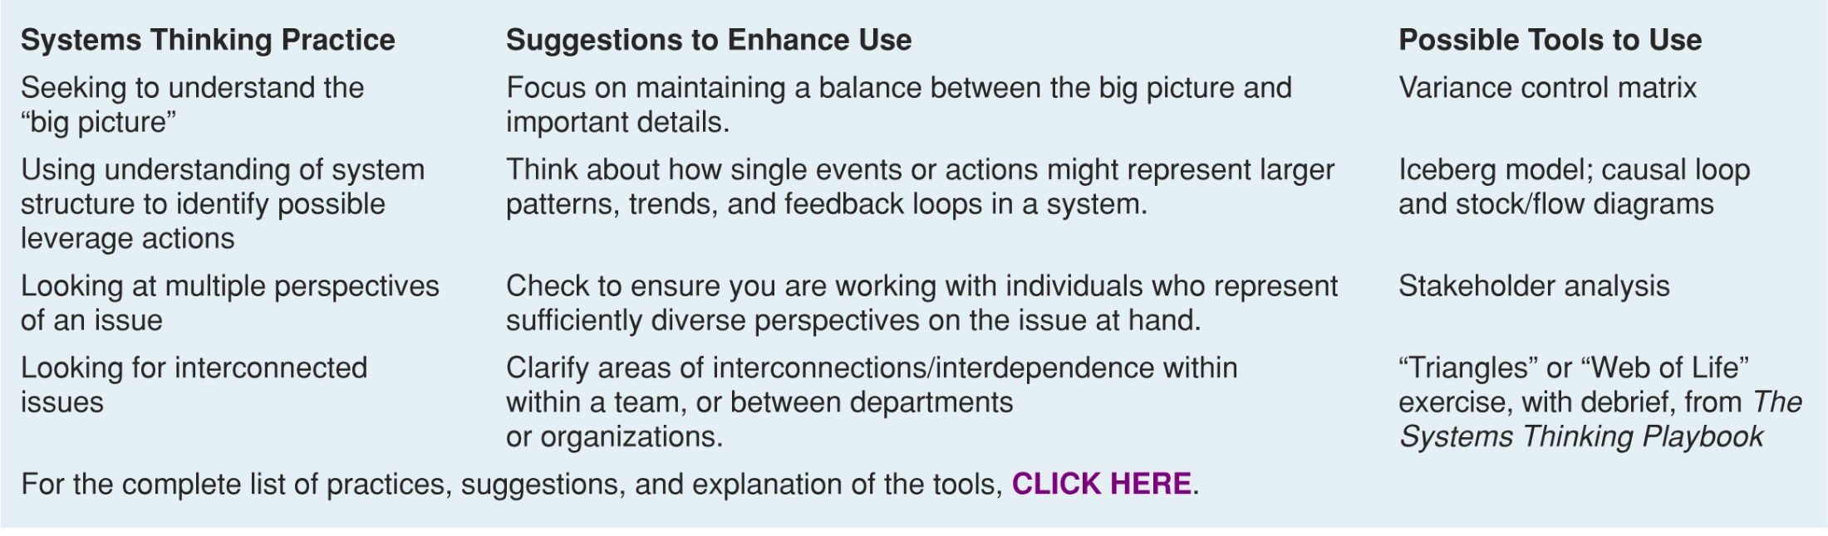
Notes:
A system has elements, interconnections, and a purpose – so to function effectively the “horse” has to exist, and if you choose to work within a system, you influence it by your actions, strengthen it with your collaborations, and reinforce its purpose with your value and impact.

Slide 39


Slide 41
Sbuild a learning ystems, data, stepping up and out…,
Build /contribute to a learning system.
Use data to influence how parts of that system interact, and to make the library a stronger part of that system

Slide 42
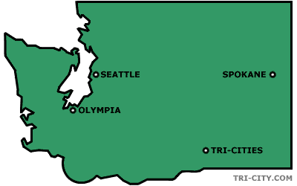
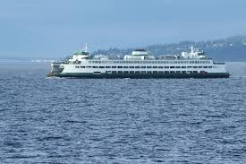
The average points per student… is higher for each year of the project. In some cases, the differences are substantial.
Participation in the PILR project resulted in considerably greater progress and achievement as measured by student achievement points.
Basic skills points per student for participants was 2.8 compared to 1.6 for non-participants. Similarly, the total points-per-student for project participants was 3.3 compared to 1.7 for non-participants.
PILR - Pre-College Information Literacy Research LMDC Washington

Slide 43
Student Engagement and Persistence
Active learning
Structures beyond the classroom designed to foster learning
Feeling connected; Relationships and interactions with caring staff and faculty
Collaboration among students
Respect for diverse learning needs and contexts
Educationally effective institutions channel student energy toward the right activities
Tinto
Chickering & Gamson
McLendon
Kuh
Notes:
For example, Research shows us some of the elements that lead to student engagement and persistence. We have the opportunity to look hard at each of these elements and other similar research to see where we connect and how we further student experience.
These are points in the research of Tinto, Chickering and Gamson, McLendon, and Kuh.
Active Learning -How will all librarians excel at teaching and incorporate active learning into all classes. How is the library itself structured to be an active learning space?
Structures beyond the classroom matter when they are designed to foster learning….. how does the library become more of an active learning space and be viewed by students as a key learning space?
Feeling connected matters to students. We have perfect environments for establishing those relationships with students in solid ways….how do we enhance those, and then design the assessments that demonstrate that contribution
There is room for us to link library strategies to research in these areas and other key campus issues and demonstrate how we are actively increasing student engagement and persistence

Slide 44

“I Came in Unsure of Everything: Community College Students Shifts in Confidence,” CCRC 2013
Student confidence is key to retention and success
Notes:
As an example of going one layer deeper, Our campus leaders look at everything that comes out of the Community College Research Center at NYR so I automatically know that connecting to it in some way will resonate.
This study, was titled “I came in unsure of everything…… Focuses on shifts in confidence that happen for our students.
Its shaped in part by past academic experiences and misconceptions of college upon entry, but continually shifts as a result of student interactions with campus personnel.
Student confidence is subject to change, based on one’s experiences in college.
The research encourages us to Create opportunities for students to experience “earned successes” – identifying their own strengths and needs and providing guided practice to accomplish challenging tasks
They particularly said that opportunities for guided practice of academic skills led to increased confidence and an intention to employ them
Asking for assistance was an area of concern for apprehensive students - - they didn’t know how to ask and thought they would engage inappropriately
Non-cognitive development
This way they learn to self manage the challenges they encounter and maintain or develop their academic confidence and expectations for success.
Think about how many students assume what the library is and what it does based on past experience.
Think about how they frequently have no idea of what faculty want and how that lack of confidence could be resolved by the library’s actions.
These kinds of studies provide opportunity for us. It may be a leap for some campus units….. But not for us - - if students know how and where to inquire, their confidence to deal with new material and engage new topics will increase. There is a definite role for us here
Evidence based decision making is expected by our administrators, so the fact that we are linking to a solid study, and at the same time trying to solve retention, not just further the library gives us a really strong foundation to stand on and acknowledgement we thinking big picture and contributing to the whole. Say that again - not just furthering the library or showing how the library is doing well, but at the same time using our library mission and programming to contribute to that whole.

Slide 45
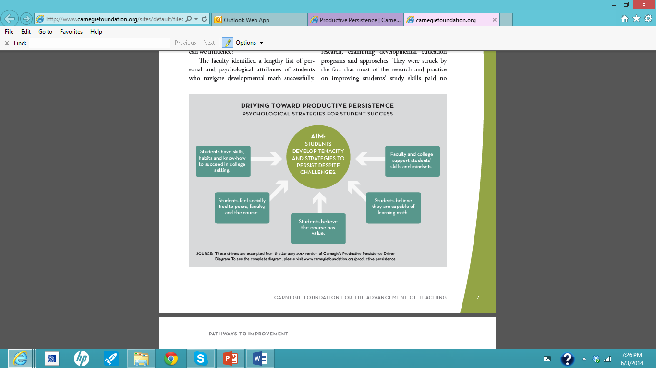
Notes:
Another research model I’ve just started to look at is productive persistence from Carnegie Mellon which they did related to math, but I think has a great deal of potential for libraries. This focuses on the psychological strategies for student success, such as having the skills and habits and know-how to succeed in a college setting, and feeling socially tied to peers, faculty, and the course they are in, and believing they are capable of learning. Developing the tenacity to persist despite challenges.
How do we increase our help for students struggling with the right questions, positively framing their persistence, understanding and applying the psychology…. What are all the opportunities for us to link to this research and similar research about the non-cognitive elements critical to college success?
The reason we started to look at this study was that our chancellor went to a conference and came back excited about it. She referred to it several times. There is a political and a strategic element to assessment work that we need to consider. This ties back to the institutional priorities elements I discussed at the beginning.

Slide 46
Notes:
Disney story… hold up magic band
Room key
Payment system
Fast pass
Links friends
Soda cups… A friend bought a refillable cup and when she paid, they didn’t ask her how long she was staying. She thought, why did I pay for 5 days when I could have paid for one and they would never know? Then she went to the soda machine, put her cup up next to it and the led readout said “hello lori… you have 5 days left on your card…”
Think about what they can predict about visitor behavior the Disney facilities.
I tell you this story because predictive analytics will be part of our future in higher ed as well. I do not want to imply that we will be putting arm bands on our students and monitoring whether they really do go to tutoring or whether they order vegetables at the dining hall. Disney is a company with a business model, We are colleges and universities with an education model. But I do think there is power in looking at the role of predictive analytics and determining what that power is for us.
Right now, we have some Widespread but mostly very individualized student success initiatives occurring without an infrastructure to understand what works, when, and for which students throughout the organization. We are all approaching this from various perspectives.

Slide 47
#3 Keep on Top of the Trends in Higher Ed
and Plan Strategically
Predictive Analytics
Performance Based Funding
Competency based learning
Early alert systems and dashboards
Intrusive interventions
“Wrap around” services
Notes:
And last, Library assessment professionals – and that’s all of us no matter what our job – need to keep abreast of where higher ed is going and very strategically plan ahead. We must be early adopters, and figure our niche early. We can’t afford to lag. And predictive analytics is one of those major trends
In addition, some of the trends I’m watching that I think are relevant here are:
Competency based education. Western Governors University is a big player in the west, and I believe Southern New Hampshire University is playing the same role in the east. They are what I categorize as a disruptive innovation, and will be a major game changer. For those that don’t know WGU - -it’s a competency based program where students must demonstrate every outcome and sub outcome in a course at a grade of B or better before moving on. They can move through the curriculum as fast as they want, so it is well suited to non-credentialed individuals working in a field. Its not credit for prior experience, but does recognize students come to us with skills and knowledge that can be immediately applied. The faculty role is disaggregated, so the assessments are designed by a group of faculty who don’t do the teaching.. WGU has no library – they use all online materials and students use no text books. That part is a little scary to me. Several of the Washington community colleges are replicating the WGU model for the associates degree and I wanted to be a part of that to be sure the library is engaged and more than a consulting role of finding good material. I want to embed critical thinking and eval of information into assessments.
Early alert systems and dashboards will be big. They will be interactive and the predictive analytics will be embedded and offering students options just as Amazon does now with the books we buy. The dashboard will help students make decisions and understand where they are and the implications of being there. What are the library indicators that need to be in that dashboard --- research paper analytics? We have and IC requirement at Pierce – how do we use a dashboard to inform students where they are on that learning grid and what they can do to strengthen? It started me thinking of the system the university of Minnesota designed several years ago that calendered the steps of the research paper and sent emails to students. What does that look like when it also is partnered with learning analytics?
Perhaps early warning and early intervention can be assignment based rather than mid quarter grades.
We will intervene more with students and not just let them sink or swim. Intrusive advising, tutoring, reference, ….. Will all be a part of a student’s life. What evidence do we need to be building right now to prepare to be a part of the design of those intervention systems?
The assessment of outcomes will become more holistic. This will not be an as much of an adjustment for us because of the way we want to partner with faculty. But for many faculty it will be huge. Whats keeping us from it now are frankly faculty contracts, and the fact that we still need credit hours and courses because of financial aid regulations.
Academic freedom will shift in this assessment world – faculty will have to demonstrate students are learning, and make adjustments. I’m not sure what other industry allows for such variation in product than ours - - but we will shift more because its good for students. Academic freedom was designed around the faculty member, and just as we have shifted from teaching to learning, I think we’ll see shifts here. My math faculty at pierce…. Our board of trustees grants tenure, and they wanted more focus on learning in the tenure packets. So last year I added a section to our tenure process that has faculty analyzing learning outcomes as a regular part of their annual tenure packet. That was a big step. Didn’t have to succeed - -but did need to demonstrate reflective practice
I am encouraging us to model that and take the lead in reformulating our traditions in ways that are student centered. Work in groups to analyze outcomes, talk about problems in the classroom – open it up to taking charge of the learning and improve based on what we see in student work.
I don’t’ consider the library to be a wrap around servie – but wrap around services are going to get more attention than ever before - - their time has come. Ecause other people think of us in that way, we have an opportunity to ride coat tails.
Ive been just letting my mind wander on this - - what if we had an entrance assessment on research strategies just as we do with English and math placement? Suggess rigfht tithere at advising what students can do to increase their chances of success?
What apps need to be developed so that we pushing expectations out to students and not just waiting for them to enter the library or the website?
How can the library intervene?
What can we pilot to assess interventions based on patterns of need,
Not just on what we think students need b
We do this
Through what you choose to assess and how you choose to assess it
The future – we have to use assessment/evidence to help create it
Be extremely strategic and lay a firm foundation within our institutions and nationally

Slide 48


1. Institutional context matters
2. Respond to research that aligns with institutional priorities
3. Proactively consider trends in higher education

Slide 49
Under the direction of the Head of User Experience, the Assessment Coordinator supports assessment initiatives in XXX University Libraries. S/he collects, analyzes, and documents data useful for evaluating library operations and understanding user needs; supports data management, analysis, and reporting needs across the Libraries; and coordinates and delivers training on evaluation, data, and reporting tools.

Slide 50
Assessment Coordinator : The Assessment Coordinator LEADS assessment initiatives in the University Libraries. They collaborate with all units to design innovative assessments that link the library’s resources, education, and programming to student learning and success at the course, discipline, and degree levels and to key university initiatives and institutional effectiveness efforts. The Coordinator is a key member of the library dean’s executive team, assisting all units in applying assessment results to develop creative library strategies focused on continuous improvement and engagement with students and faculty at all levels of the university. The coordinator stays abreast of key higher education research literature that connects with the university’s strategic plan and proposes links between that research and library assessment. The coordinator prompts the processes and discussions on continuous improvement, assisting the dean and department heads in creating a culture of evidence, inquiry and continuous improvement in the library. The coordinator partners with other campus units to design collaborative assessments and strategies that demonstrate library integration throughout the institution. The coordinator participates in institutional effectiveness efforts, transfers data/evidence to all relevant campus dashboards and databases, and is an active member of the campus assessment community, proposing links to library evidence wherever relevant.
Notes:
Know this is dense but couldn’t help myself
This work is so important, and needs leadership, not just skills in analysis. It is a critical role and deserves to be elevated in the library hierarchy.

Slide 51
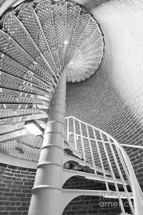
Notes:
Lucky enough to have a lighthouse in my town
Last weekend had the chance to climb to the top
As I thought about next steps, I thought about these stairs. They are not very far apart, allowing for small steps to be taken
there is a lovely relationship to them – they curve beautifully and yhet are not shaped symettically, allowing for shifts and changes and unevenness in the steps.
And best of all – there is a great beacon of light and view at the top.
These next steps are worth taking - -they will bring satisfaction, alignment, and firm up the library’s centrality to the acadecmic enterprise
I hope you will take the energy of the day, harness it and begin to take your first step, in whatever form that takes.

Slide 52
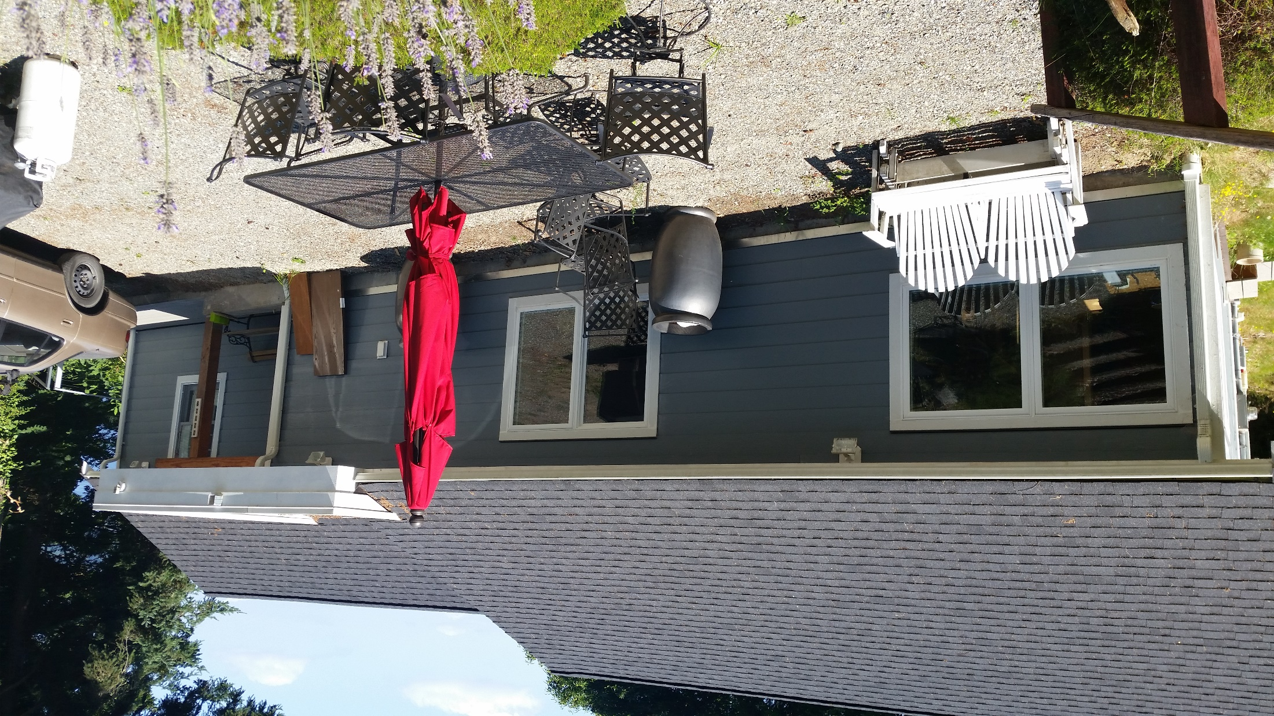

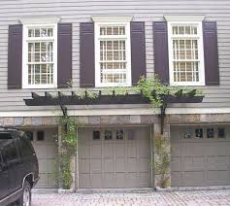


Slide 54
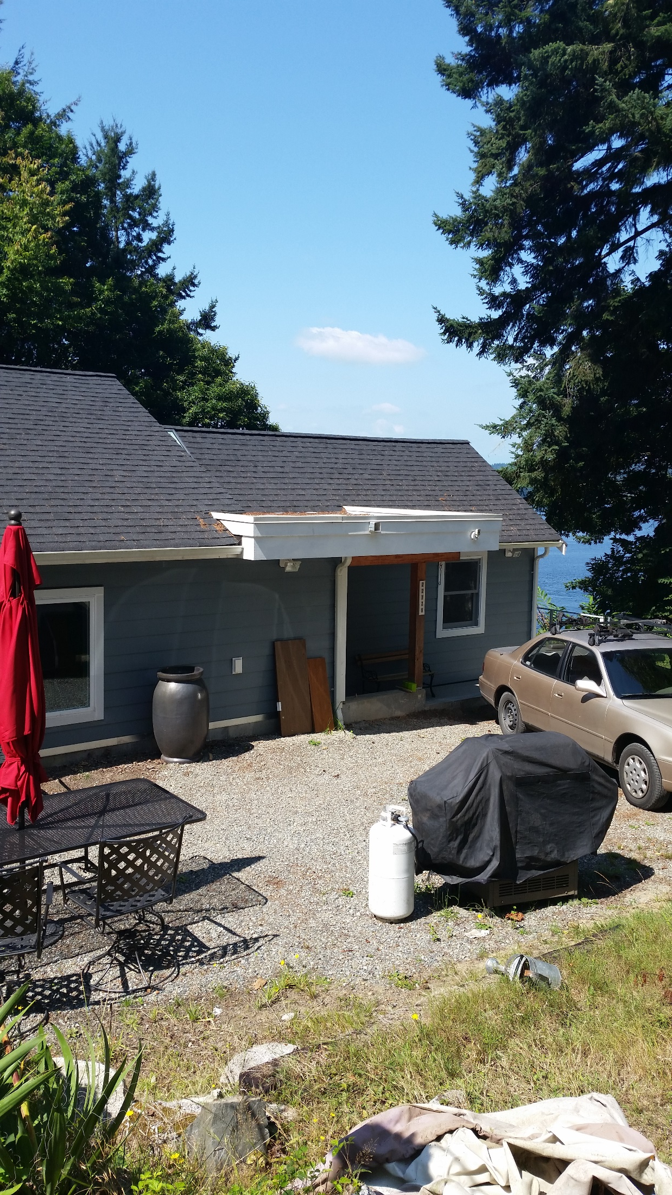


Slide 55
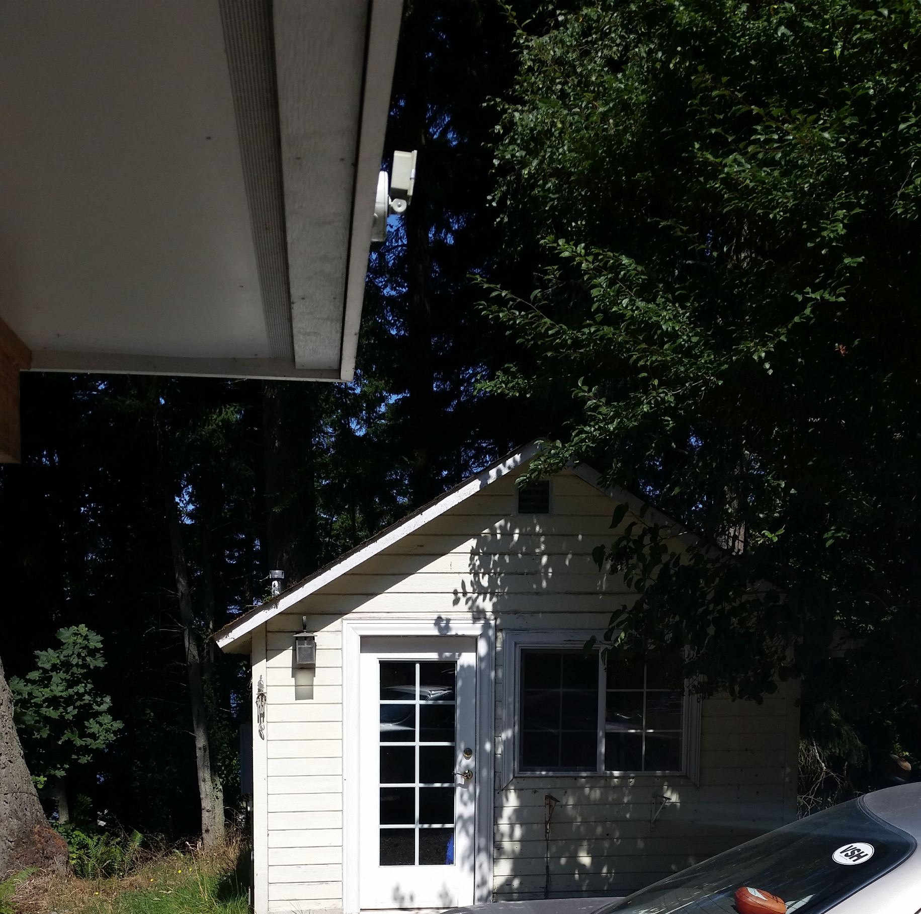


Slide 56
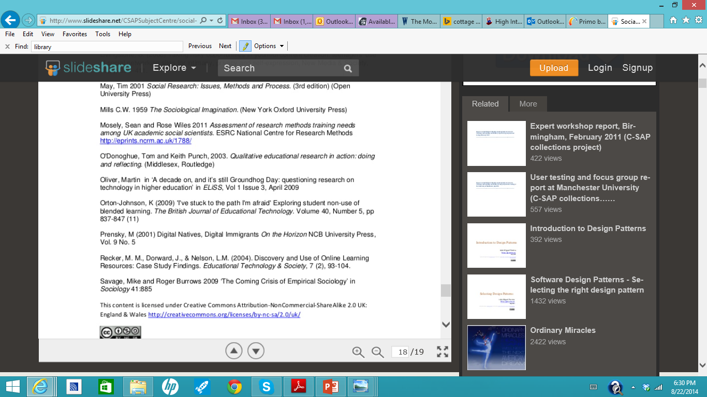

Slide 57
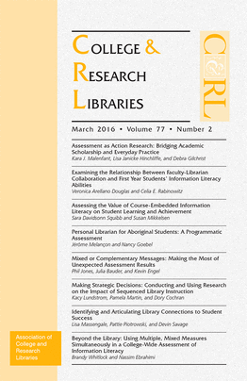
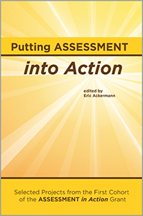
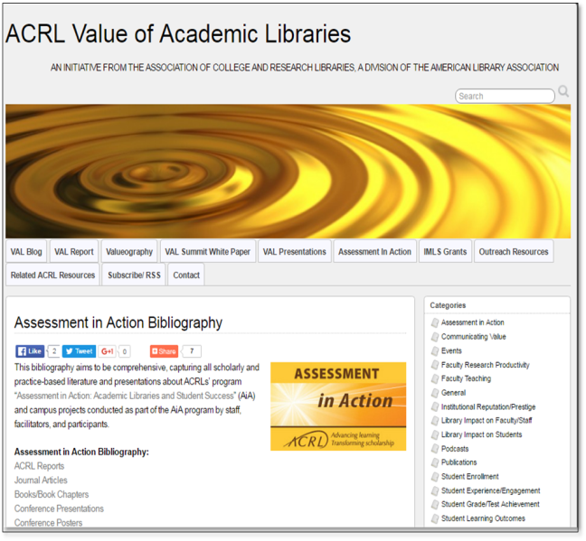
Other AiA Publications
http://www.acrl.ala.org/value
Notes:
Lots more about the particulars of the campus projects in other publications.

