Slide 1
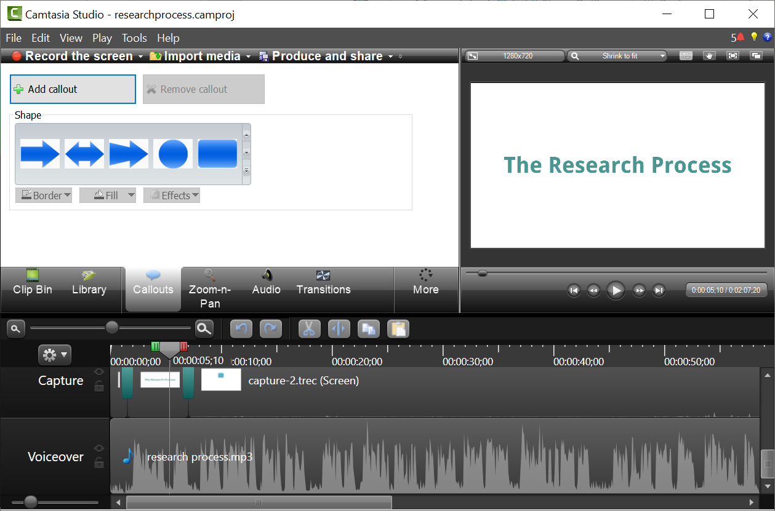
TECHSMITH CAMTASIA
Excels at:
Polished final products
Full-featured editor
Limitations:
Expensive (limited trial version)
Learning curve
https://www.techsmith.com/video-editor.html

Slide 2
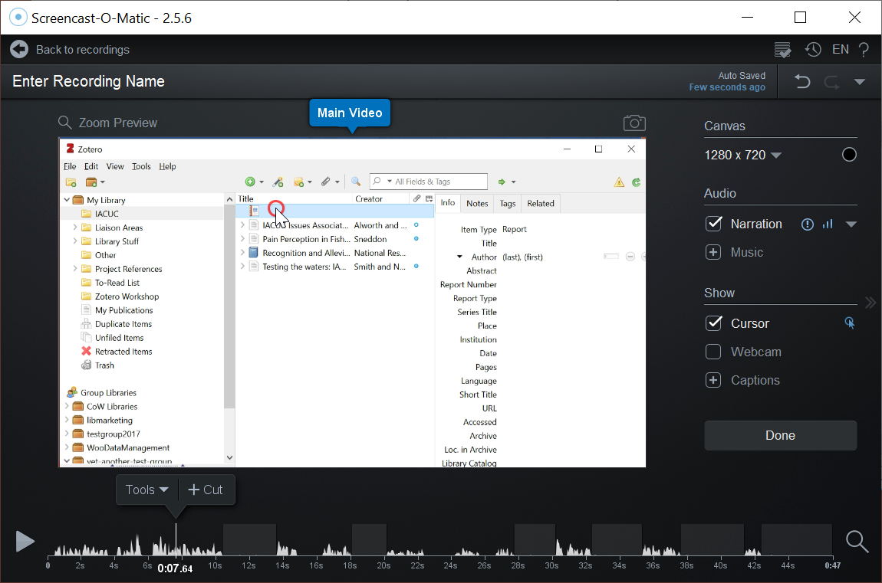
Screencast-o-matic
Excels at:
Fast & lightweight
Simple workflow
Inexpensive (free or paid)
Limitations:
Limited editing features
https://screencast-o-matic.com/

Slide 3
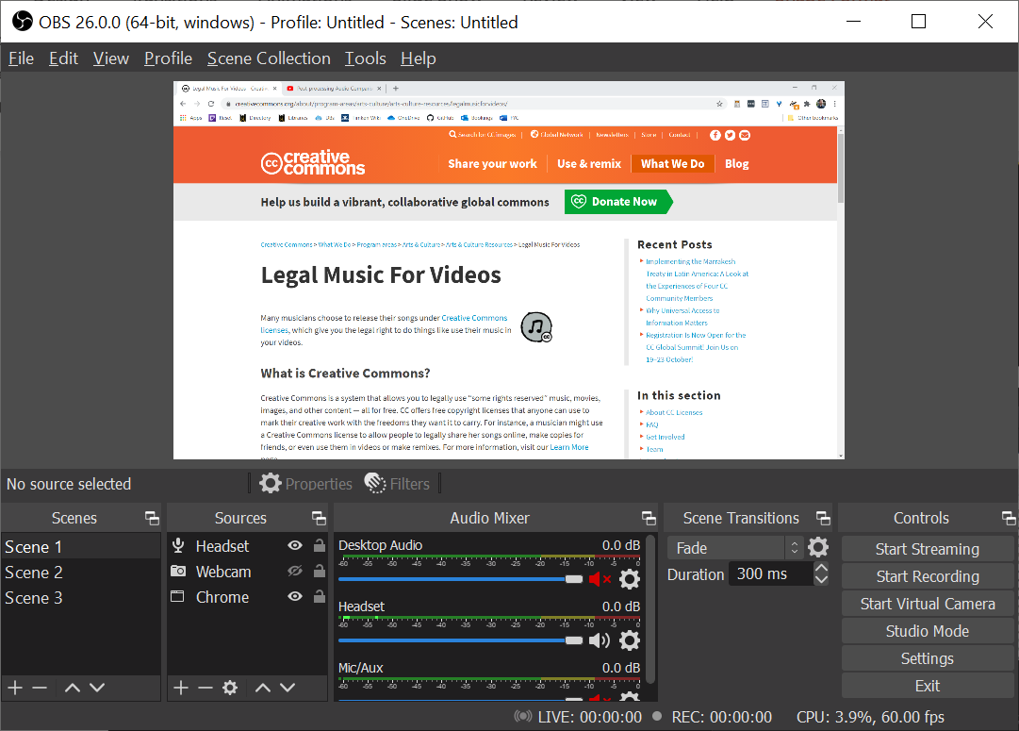
OBS Studio
Excels at:
Live broadcasts
Free & open-source
Limitations:
“Editing” happens in real-time
https://obsproject.com/

Slide 4
Audio Quality
The Elephant in the Room

Slide 5
Equipment
Recording
Post-production

Slide 6
Equipment
Use the best microphone you can find.

Slide 7
Equipment
Use the best microphone you can find.
Built-in laptop microphones:
avoid if possible

Slide 8
Equipment
Use the best microphone you can find.
Headsets or earbuds:
usually acceptable

Slide 9
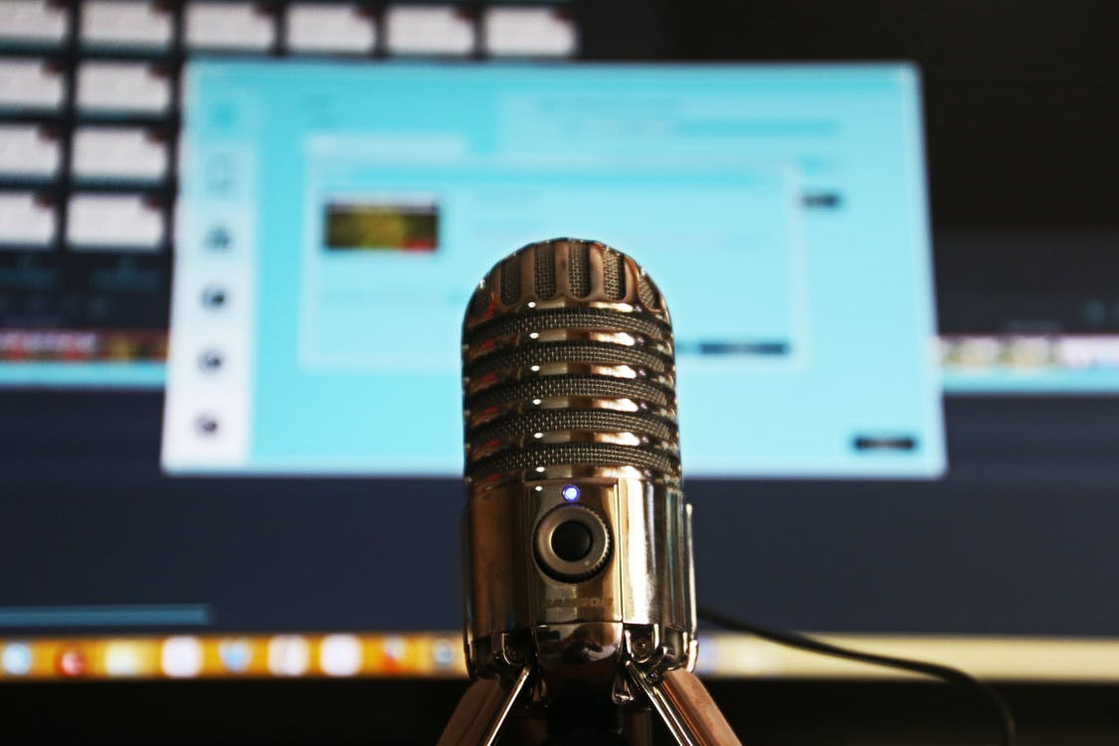
Equipment
Use the best microphone you can find.
Stand-alone microphone:
best option

Slide 10
Recording
Minimize distractions.
Record audio and video separately
Eliminate background noise
Speak slowly & enunciate
Mind your mic’s position

Slide 11
Post-production
Pro tools.

Slide 12
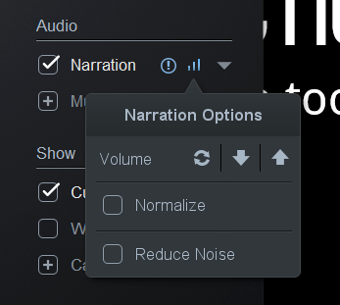
Post-production
Pro tools.
Adjust audio volume appropriately
Calibrate your ears

Slide 13
Post-production
Pro tools.
Volume Leveling:
normalization vs.
compression

Slide 14
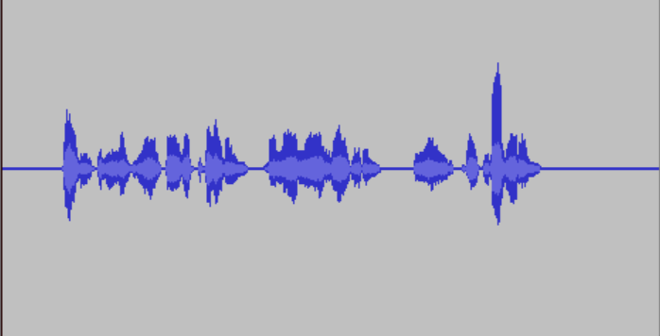
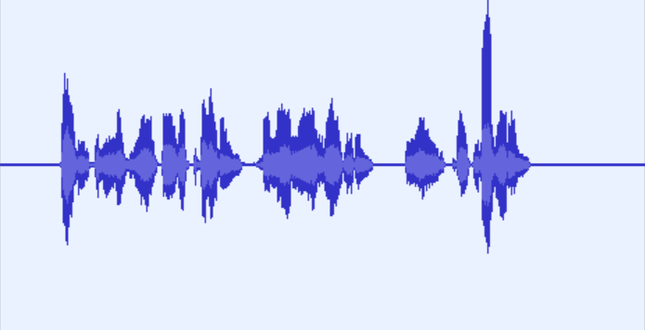
Post-production
Pro tools.
No effects applied:
Normalized:

Slide 15
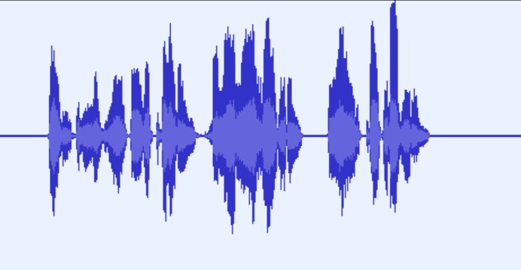
Post-production
Pro tools.
No effects applied:
Compressed:

Slide 16
Post-production
Pro tools.
Normalized:
Compressed:

Slide 17
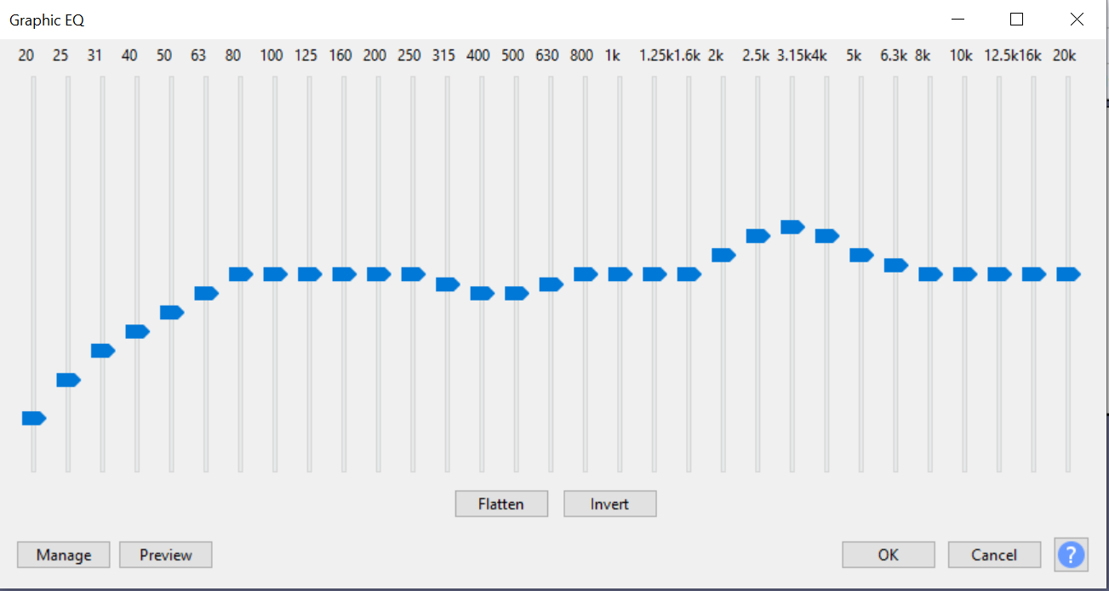
Post-production
Increasing Vocal Clarity: Equalization (EQ)
Pro tools.
Remove the lowest frequencies (<100hz)
Cut around 500hz to reduce “muddiness”
Boost 1-4khz range to increase clarity
Don’t overdo it

Slide 18
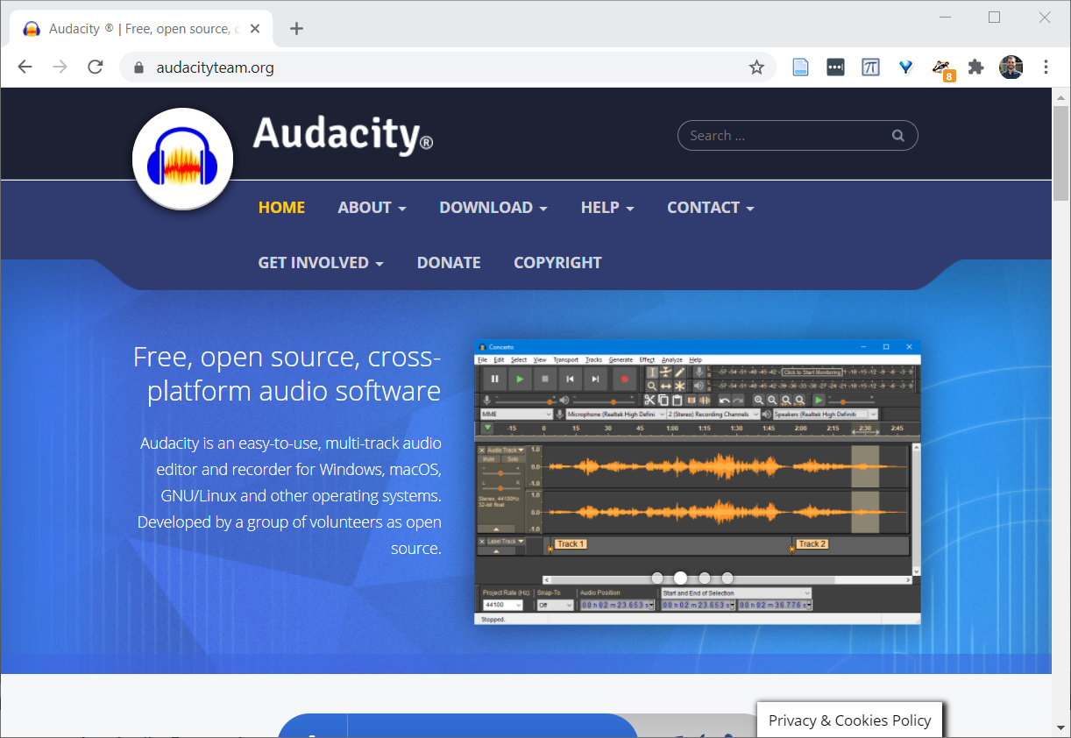
Post-production
Pro tools.
Tools:
Garageband (Mac)
Audacity (free; cross-platform)
https://www.audacityteam.org/

Slide 19
Post-production
Pro tools.
http://tiny.cc/stemig

Slide 20
Thank you
Questions? zsharrow@wooster.edu
Twitter: @scilibzach

