Slide 1
From Cataloger to Metadata-er
training library staff for today's projects

Slide 2

NGL
Next Generation Library Grant
  40+ digital collections
    archival, multimedia, scientific, fine arts …
  2 years
Digital Initiatives Coordinator and Interface Specialist
  Local staff support
Notes:
Background on the NGL project

Slide 3
Objectives
Creating digital objects
Metadata standards
  Dublin Core schema
  Vocabularies and standards
Processes for metadata creation
Knowledge and skill sustainability
Openness to changing roles and processes

Slide 4
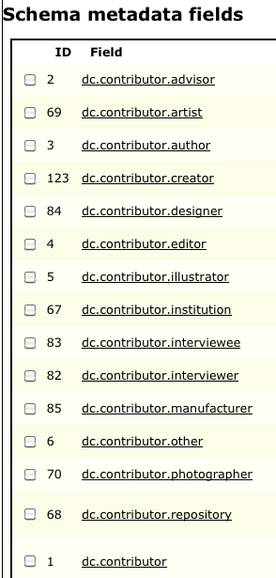
Metadata Standards
Group training sessions on Dublin Core and XML
Small group meetings on specific collection schema
Standards and vocabulary- catalogers taught us!

Slide 5
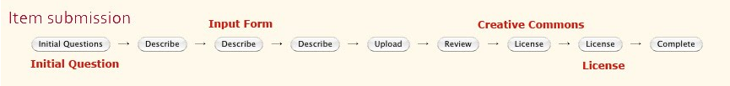
Metadata Creation
Who creates the metadata
  Students, library staff, faculty, librarians
How do we establish new workflows

Slide 6
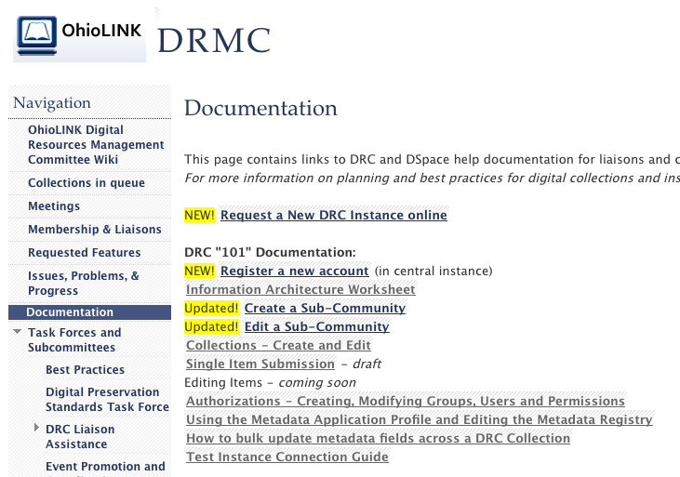
Sustainability
Documentation!
Practice
Communities
of support
Channels for troubleshooting and answering questions

Slide 7
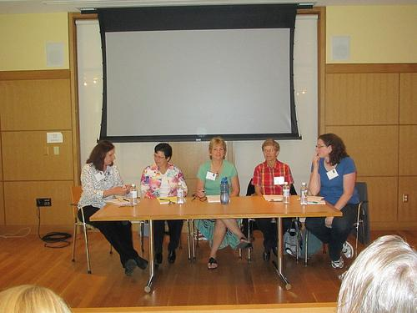
Changing Roles
Training and Workshops
  Skills
  Technology
  Big picture
Communication
  Peer presentations
  Encouraging
conversations

Slide 8

Changing Presenters...

Slide 9
CMDS(?)
Not only a ridiculously long title
Rethinking of duties based on new needs and responsibilities

Slide 10
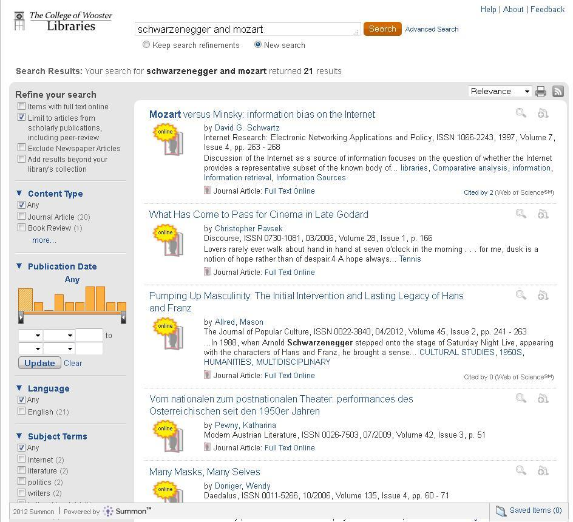
Why Discovery?

Slide 11
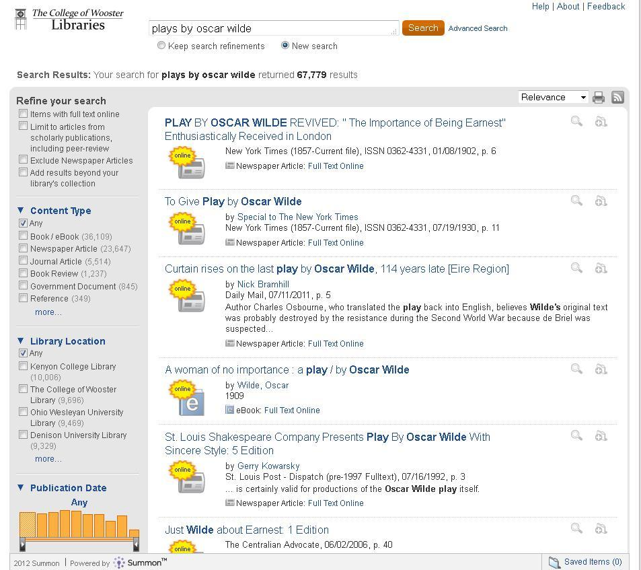
Discovery's broken promises

Slide 12
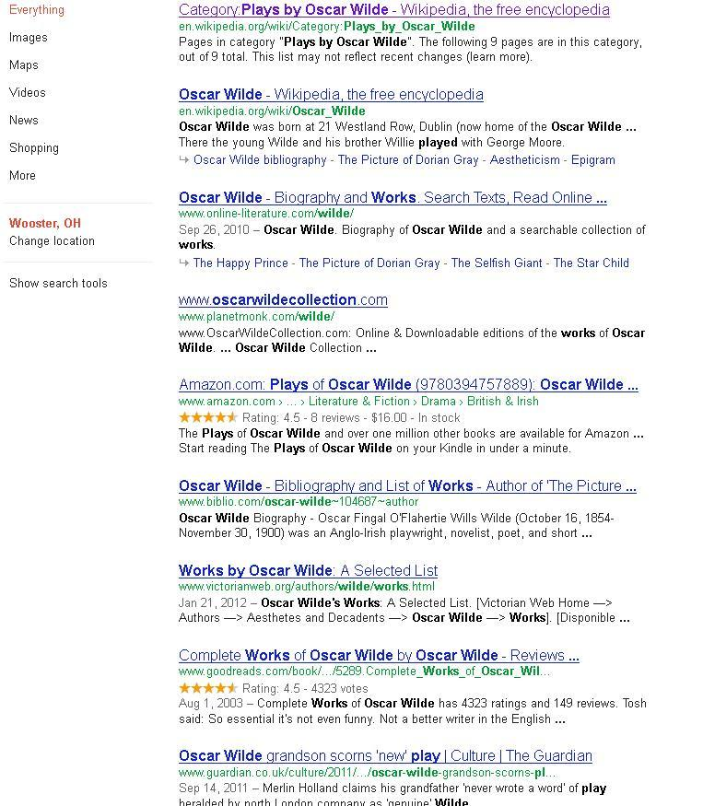
Discovery's broken promises

Slide 13
We're TS, we can fix it!
...but it involves time, energy, resources.
Guidelines:
A good TS person is a good PS person
Responsiveness matters (even if it's a firm shrug)
We need not act alone, ask for help

Slide 14
Practical steps
Understand demands of Discovery on staff time before jumping.
Be realistic about goals that Discovery can achieve for you.
If possible, shift time from tasks with decreasing demands (do your staff responsibilities follow your ordering trends?)
Cross-train in electronic resource management.

Slide 15
We need to change
To meet student needs/expectations
To meet faculty and administration needs/expectations
To better cage the beast knocking down our door

Slide 16
We need to change
...presenters

Slide 17
OSOA Timeline
Nov. 2009 – Faculty adopted Open Access Policy
May 2010 – Test phase begins, including retrospective sampling of faculty scholarship
      Records added individually and by batch load
Feb. 2011 – Article deposit website operational

Slide 18
Training
One-on-one sessions
Small group meetings
Direct hands-on record creation and editing
Self-guided training

Slide 19
What Worked?
Test period
Initial flexibility to experiment with metadata
Small group for direct support
      Prompt and reliable support
One-on-one sessions / direct hands-on training
      Well suited to nature of establishing a collection
Documentation edited to reflect best practices

Slide 20
What Was Needed?
More structured training
    Particularly with introduction to non-MARC metadata
Workflow designed from the outset
    Balancing cataloging duties with training and new metadata duties
More initial in-depth training vs. sporadic training
Emphasis on the collaborative nature of metadata creation

Slide 21
Considerations
Catalogers possess the skills to create metadata
    Reinforce similarities between metadata creation and cataloging
Lay groundwork with structured group training, followed by one-on-one sessions
Catalogers must be trained to collaborate with individuals outside of technical services
The trainee becomes the trainer

